Slide 1






Cancer in pregnancy
Frédéric Amant
Leuven Cancer Institute, Belgium
Netherlands Cancer Institute & Academic University Medical Center, the Netherlands

Slide 2
Take home message
Surgery, radiotherapy and chemotherapy are possible during pregnancy
Prematurity < antenatal exposure to chemo
Interdisciplinary approach in referral centers with high risk obstetrical unit

Slide 3
Cancer in pregnancy: agenda
Case study
Epidemiology, diagnosis and staging
Surgery
Radiotherapy
Chemotherapy
Long term pediatric outcomes
Multidisciplinary setting including obstetrical high care units

Slide 4
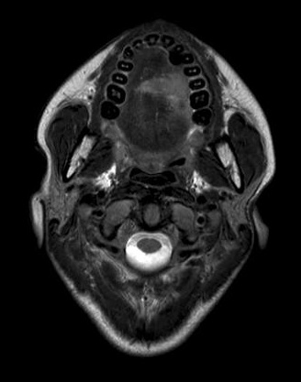
MRI pre-operative
Tongue tumor, over midline, diameter 3.2x2.9x2.4cm
Suspect nodes
Staging
Sonar liver, chest X-ray: negative
Stage cT4N2M0

Slide 5
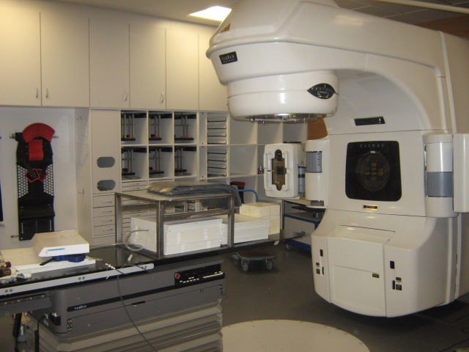
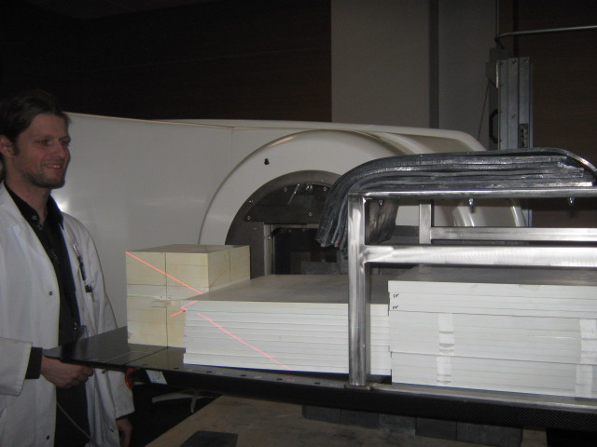
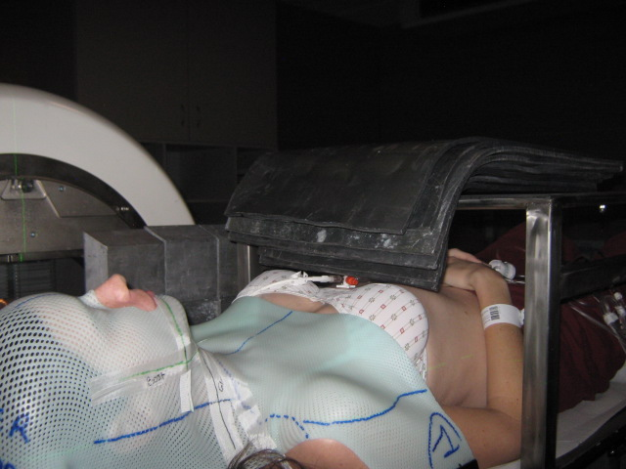
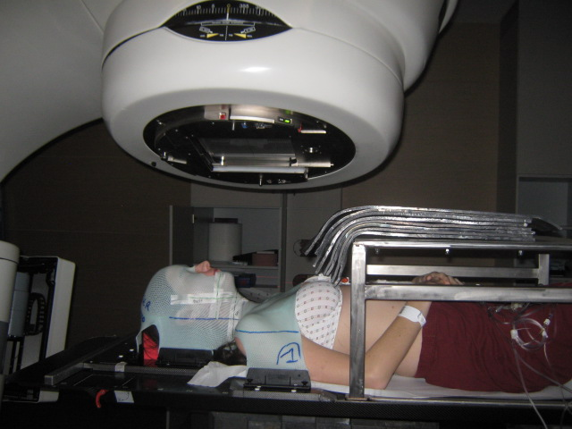
Notes:
Casus om verschil te duiden dat we kunnen maken in de kliniek.

Slide 6
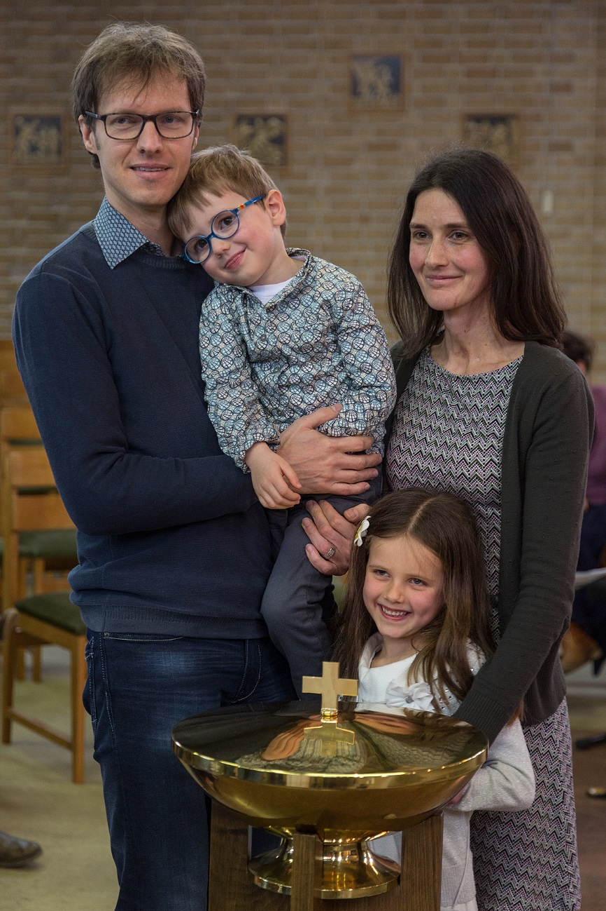

Slide 7
Cancer in pregnancy: agenda
Case study
Epidemiology, diagnosis and staging
Surgery
Radiotherapy
Chemotherapy
Long term pediatric outcomes
Multidisciplinary setting including obstetrical high care units

Slide 8
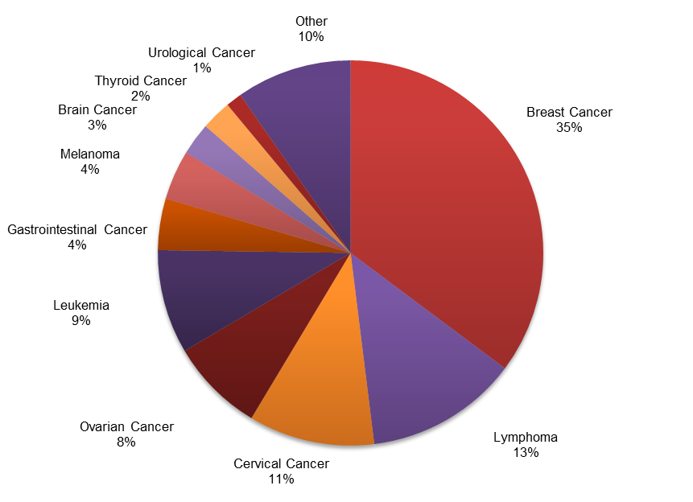
European registry www.cancerinpregnancy.org
Cancer is diagnosed during 1/1000-2000 pregnancies
→ annually 2500-5000 new cases in Europe
n = 1732

Slide 9
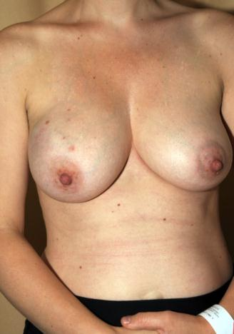
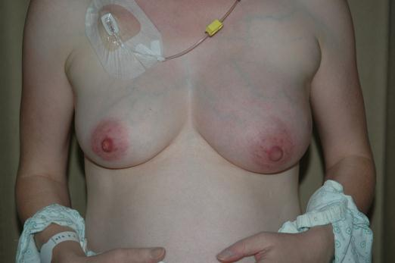
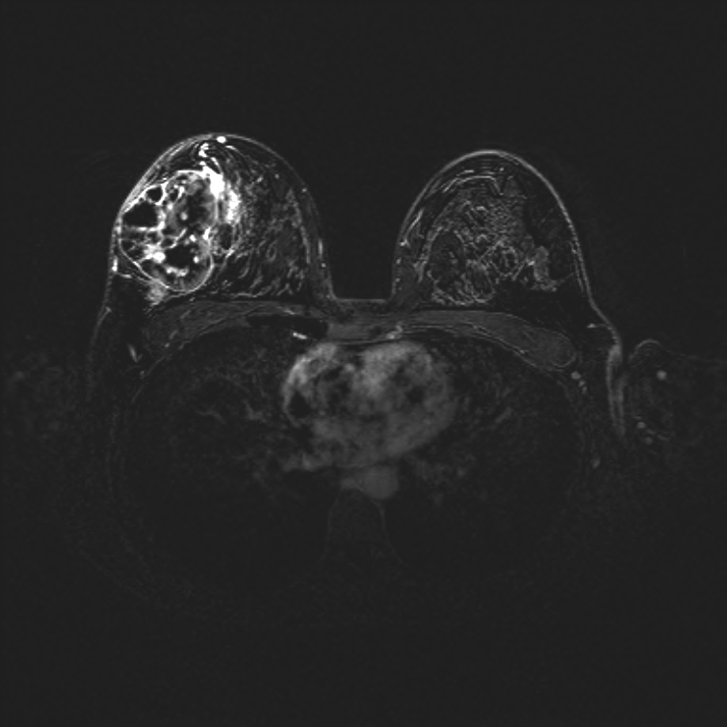
Diagnosis of BCP
History: risk assessment
  BRCA mutation (2-29% in young women) (Samphao et al, 2009)
  Consider genetic counseling given a young age
Clinical examination
  most often symptomatic, usually detected as a painless, palpable mass
  more difficult to interpret and diagnosis might be delayed
  every suspect mass = investigation in detail: core biopsy

Slide 10
Approximate fetal absorbed doses during imaging studies (Toppenberg, 1999)
The threshold dose for fetal damage is estimated to vary between 10-20 cGy
Procedure | Fetal dose (cGy) | Procedure | Fetal dose (cGy)
Chest x-ray (PA & lateral) | 0.00006 | Lumbosacral spine | 0.2 – 0.6
Abdominal x-ray | 0.15 – 0.26 | Mammography | 0.01 – 0.04
Pelvic x-ray | 0.2 – 0.35 | CT thorax | 0.01 – 1.3
Intravenous pyelography | 0.4 – 0.9 | CT abdomen | 0.8 – 3
Barium enema | 0.3 – 4 | CT pelvis | 2.5 – 8.9
Dorsal spine | < 0.001 | Tc bone scan | 0.15 – 0.20
Lumbar spine | 0.4 – 0.6
Sonography and magnetic resonance imaging are considered safe
and preferred, especially for the abdomen or pelvis
10

Slide 11
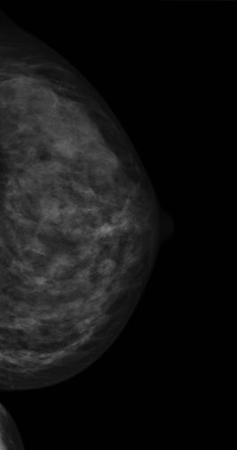
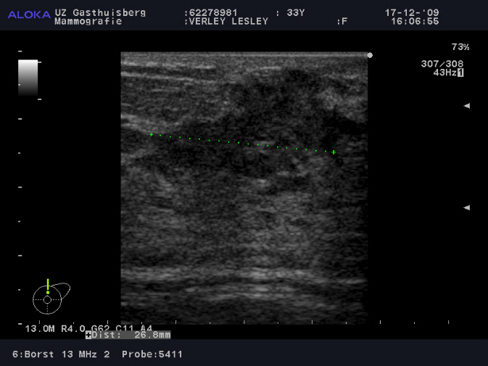
Sonography: lesion 23 x 29 x12 mm
Mammogram
Notes:
Op echo: onscherp begrensd, hypoechogeen letsel, sterk suggestief voor een maligniteit.
Op mammografie dens borstklierweefsel, het letsel kan mammografisch niet worden afgelijnd.

Slide 12
Safety of sentinel node during pregnancy
18.5 MBq ^{99m}Tc safe in breast cancer patients
  Fetal dose < 0.05 mGy (threshold is 100mGy)
  Low dosages
  Capture of ^{99m}Tc in lymph nodes
    Keleher et al. Breast J 2004
    Gentilini et al., Ann Oncol 2004
60-80 MBq safe in vulvar cancer
  80 % remains in injection site or lymph nodes
  Distance to fetus at least 10 cm
  Fetal exposure for 100MBq is around 0.1 mGy ie 1000 times lower than threshold of 100mGy
    Personal communication Ate Van der Zee
Patent blue is not recommended
  Anaphylactic reaction during pregnancy is hazardous

Slide 13
Sentinel lymph node biopsy for breast cancer treatment during pregnancy: maternal safety
Han et al., Br Ca Res Treat 2018
97 women (INCIP n=83; GBG n=14)
Median follow-up was 35 months (range 1 to 148), and median disease free survival was 32 months.
Eight patients experienced a loco-regional relapse:
  contralateral breast (n=1; 1.0%),
  ipsilateral breast (n=4; 4.1%),
  chest wall (n=1; 1.0%),
  axilla (n=2; 2.1%).
Of the 2 patients who had an axillary recurrence:
  one patient had also recurrent ipsilateral breast cancer,
  one patient had standard adjuvant treatment and ipsilateral axillary recurrence occurred 12 months after diagnosis.
SLN biopsy during pregnancy has a low axillary recurrence rate. This staging method can be considered during pregnancy instead of standard ALND for early stage, clinically node negative breast cancer.

Slide 14
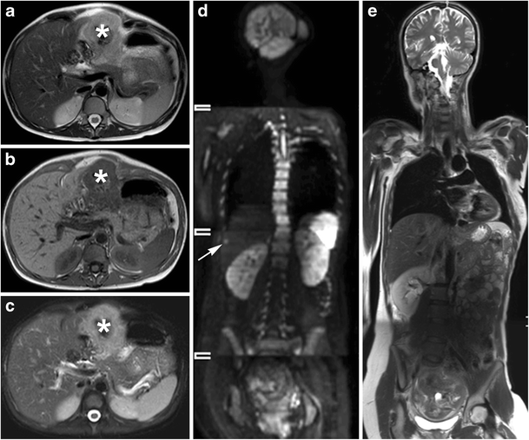
Whole-body diffusion-weighted MRI (WB-DWI/MRI)
Han et al., Eur Radiol 2018
Notes:
Patient with cancer of the transverse colon (A, B, C: *). Conventional MRI of the abdomen performed at time of diagnosis for which a T2-weighted sequence without (A) and with (C) fat suppression and (B) T1-weighted sequence were performed reveals no liver lesions. (D) WB-WI shows a b1000 hyperintense lesion corresponding to the lateral subcapsular area of segment 6/7 of the liver on (E) the WB T2-weighted image compatible with a liver metastasis and was confirmed during surgery,
Objectives
To evaluate the feasibility of whole-body diffusion-weighted MRI (WB-DWI/MRI) for detecting primary tumour, nodal and distant metastases in pregnant women with cancer.
Methods
Twenty pregnant patients underwent WB-DWI/MRI in additional to conventional imaging. Reproducibility of WB-DWI/MRI between two readers was evaluated using Cohen’s κ statistics and accuracy was compared to conventional imaging for assessing primary tumour site, nodal and visceral metastases.
Results
Both WB-DWI/MRI readers showed good–very good agreement for lesion detection (primary lesions: κ=1; lymph nodes: κ=0.89; distant metastases: κ=0.61). Eight (40 %) patients were upstaged after WB-DWI/MRI. For nodal metastases, WB-DWI/MRI showed 100 % (95 % CI: 83.2–100) sensitivity for both readers with specificity of 99.4 % (96.9–100) and 100 % (80.5–100) for readers 1 and 2, respectively. For distant metastases, WB-DWI/MRI showed 66.7 % (9.4–99.2) and 100 % (29.2–100) sensitivity and specificity of 94.1 % (71.3–99.9) and 100 % (80.5–100) for readers 1 and 2, respectively. Conventional imaging showed sensitivity of 50 % (27.2-72.8) and 33.3 % (0.8–90.6); specificity of 100 % (98–100) and 100 % (80.5–100), for nodal and distant metastases respectively.
Conclusions
WB-DWI/MRI is feasible for single-step non-invasive staging of cancer during pregnancy with additional value for conventional imaging procedures.

Slide 15
Cancer in pregnancy: agenda
Case study
Epidemiology, diagnosis and staging
Surgery
Radiotherapy
Chemotherapy
Long term pediatric outcomes
Multidisciplinary setting including obstetrical high care units

Slide 16
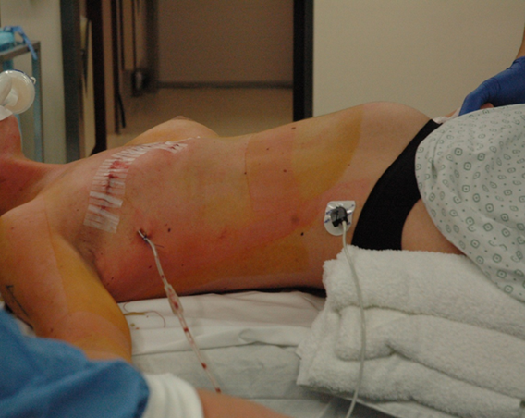
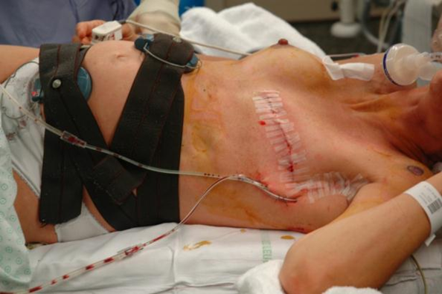
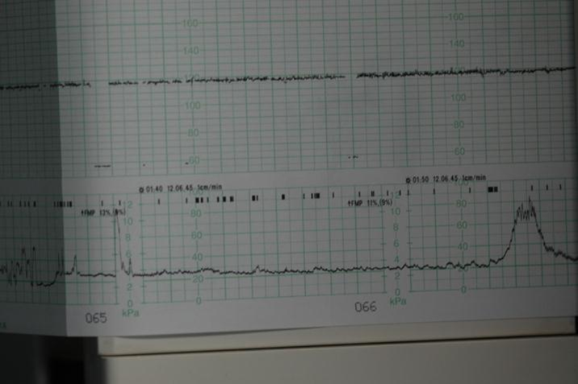
Adequate oxygenation and left lateral tilt position
Fetal heart monitoring
No fetal monitoring when fetus is non viable
Tocometry

Slide 17
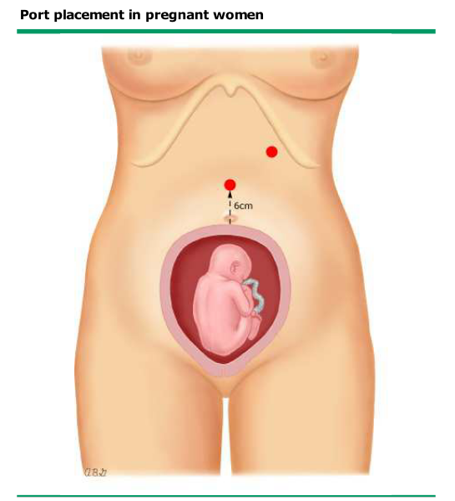
Suggested entry technique:
Use of a Veress needle inserted into the left—upper quadrant.
Gastric decompression with an orogastric tube prior to needle insertion minimizes the risk of gastric perforation
The needle should be angled approximately 15 degrees caudad to minimize the risk of splenic injury
Placement of a supraumbilical port 6 cm above the fundus with a Hasson technique is another entry method that reduces the risk of organ perforation.
Notes:
Supraumbilical primary trocar placement, at least 6 cm above the uterine fundus
With increasing gestational age
use of the subxiphoid
left upper quadrant
right upper quadrant insertion
Lateral displacement of the uterus during trocar insertion may also decrease the risk of uterine and fetal injury.
Hasson (open) technique

Slide 18
Cancer in pregnancy: agenda
Case study
Epidemiology, diagnosis and staging
Surgery
Radiotherapy
Chemotherapy
Long term pediatric outcomes
Multidisciplinary setting including obstetrical high care units

Slide 19
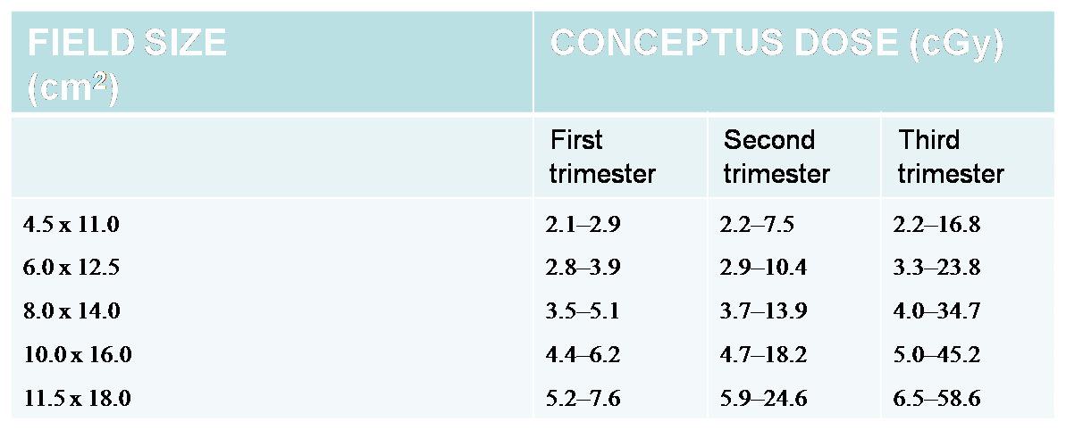
Radiotherapy of upper parts of the body during pregnancy
Safe during 1st and 2nd trimester of pregnancy, prohibited during the 3rd trimester (Mazonakis et al., 2003)
with ↑ gestational age: ↑ proximity of the foetus to the primary irradiation field,
↑ conceptus dose (threshold dose 10 – 20 cGy)

Slide 20
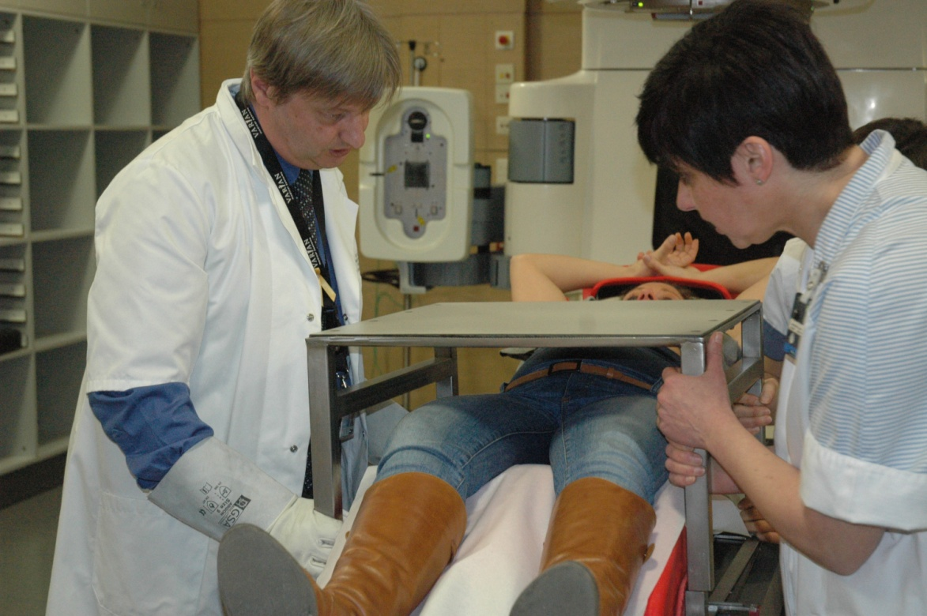
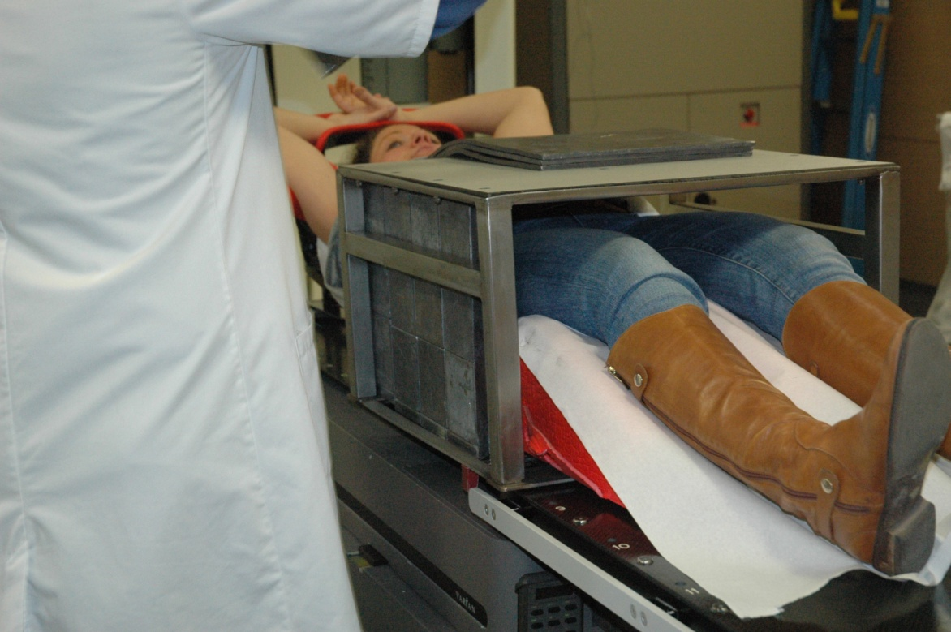
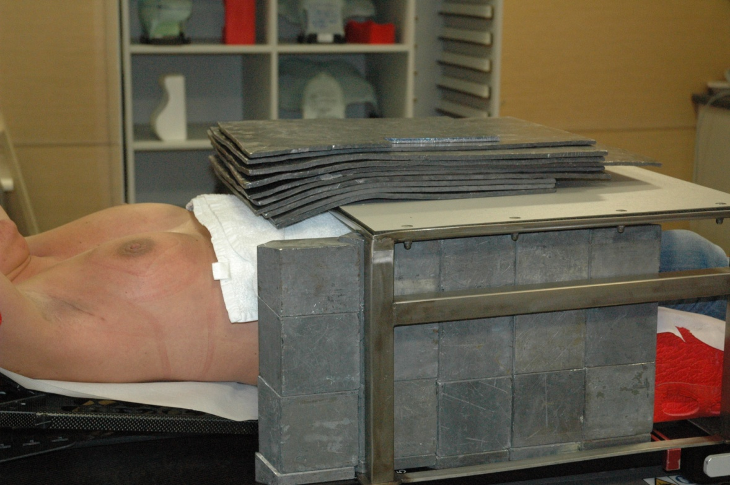
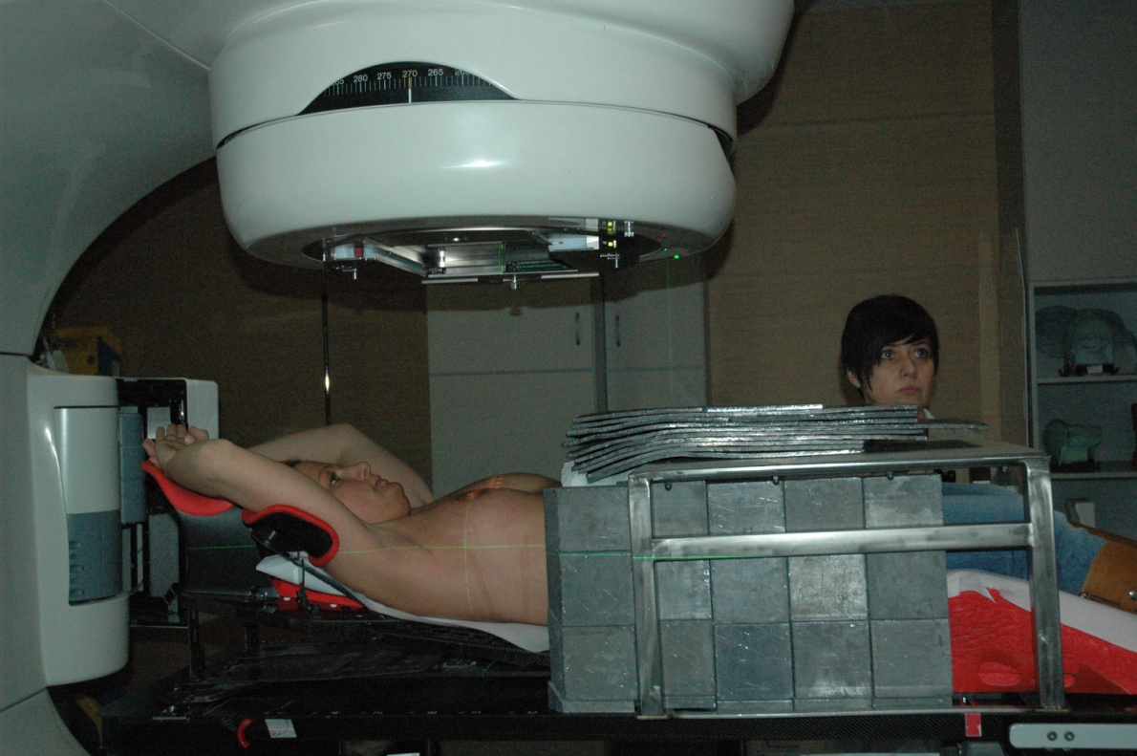

Slide 21
Cancer in pregnancy: agenda
Case study
Epidemiology, diagnosis and staging
Surgery
Radiotherapy
Chemotherapy
Long term pediatric outcomes
Multidisciplinary setting including obstetrical high care units

Slide 22
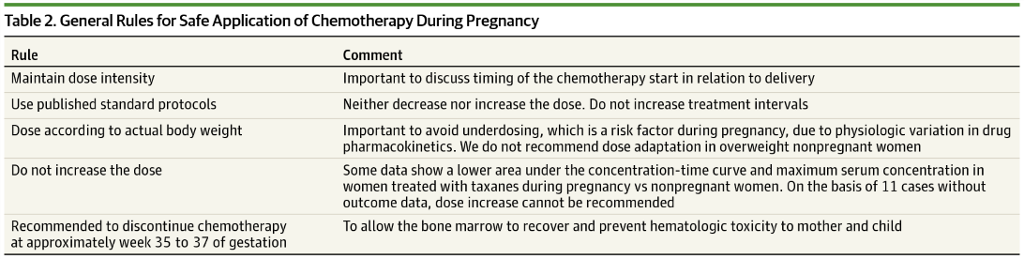
General Rules for Safe Application of Chemotherapy During Pregnancy
Loibl et al., JAMA Oncol 2015

Slide 23
Cancer in pregnancy: agenda
Case study
Epidemiology, diagnosis and staging
Surgery
Radiotherapy
Chemotherapy
Long term pediatric outcomes
Multidisciplinary setting including obstetrical high care units

Slide 24
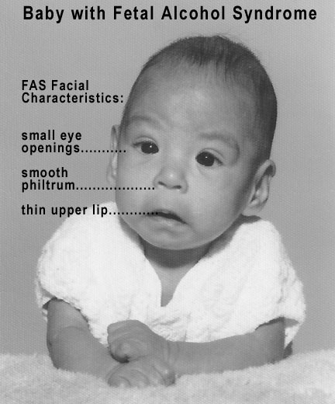
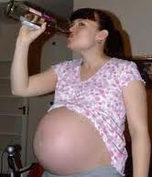
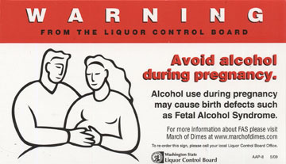
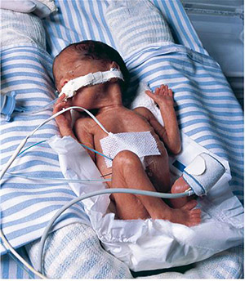
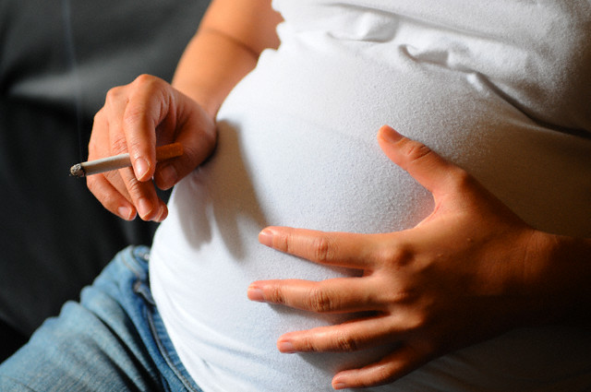
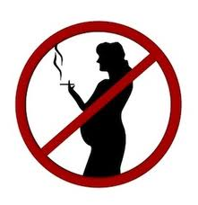

Slide 25
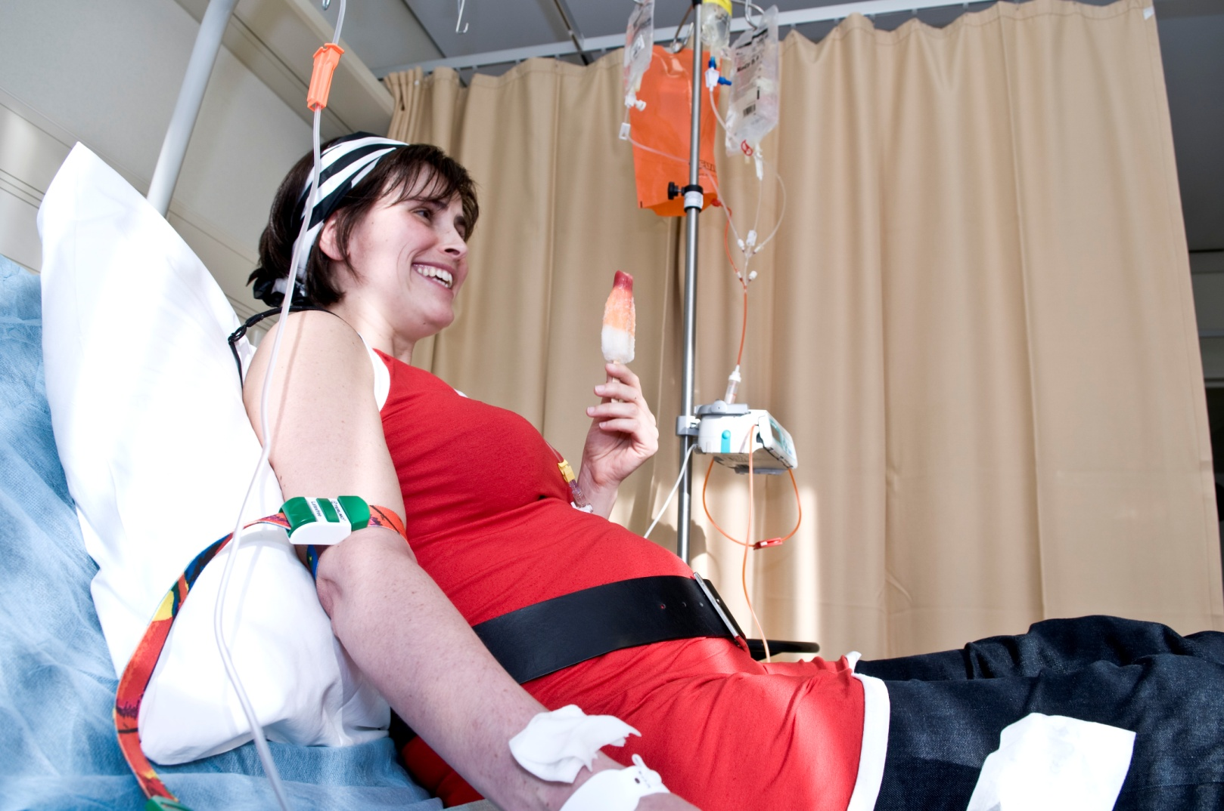

Slide 26
Pregnancy outcome
Van Calsteren et al, J Clin Oncol 2010
Congenital malformations (n = 13/175: 7.4%; 2.9% major and 4.6% minor)
Treatment during pregnancy | Malformation | n | (%)
None | Prader-Willi Congenital laryngomalacie Hemangioma | 3/58 | (5.2)
Surgery | Cardial hamartomas in tuberous sclerosis Multiple congenital anomalies (ao hypospadia, left pink missing, abnl position left foot) Hemangioma | 3/46 | (6.5)
Chemotherapy | Hip subluxation Pectus excavatum Hemangioma | 3/33 | (9.1)
Chemo + RT | Bilateral partial syndactily digiti II-III | 1/1 | (100)
Surgery +Chemo | Bilateral small protuberance on phalanx-5 Rectal atresia | 2/25 | (8.0)
Surgery + Chemo + RT | Doubled cartilage ring in both ears | 1/3 | (33.3)
RT, Surgery + RT, Other (hormonal, IFN, antibody) |  | 0/2, 0/2, 0/5 | (0.0)
Notes:
In 13 children a physical abnormality was diagnosed at birth. In red you can see the major malformations in blue the minor malformations. The overall incidence of major malformations of almost 3% reflects the background risk in the general population and when you look at the distribution over the different treatment groups, we can say cytotoxic treatment in the second and third trimester of pregnancy does not increase the risk of malformations.

Slide 27
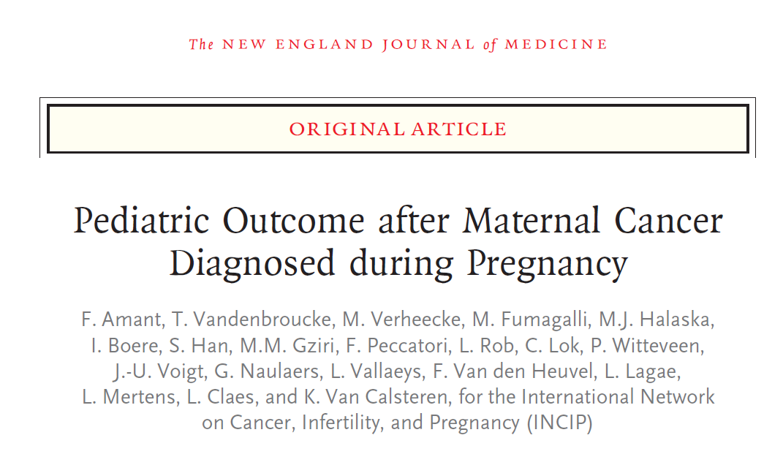

Slide 28
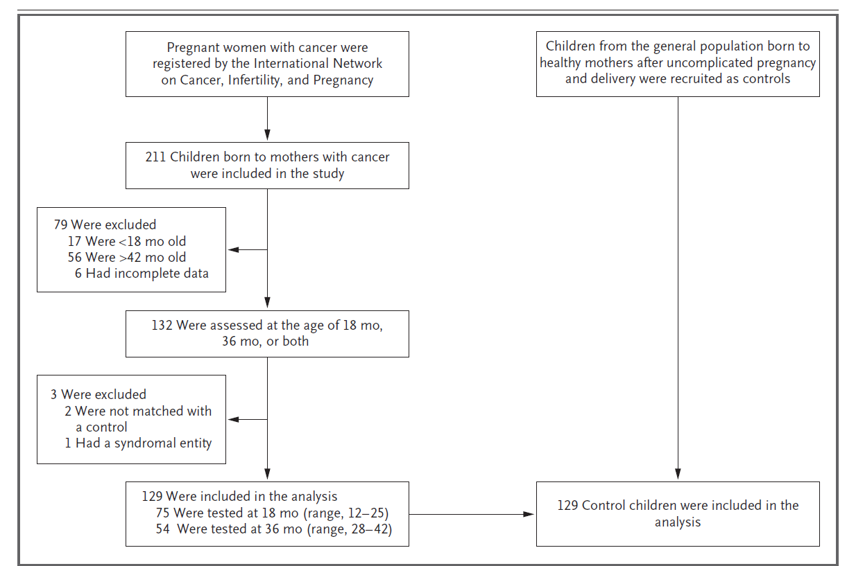

Slide 29
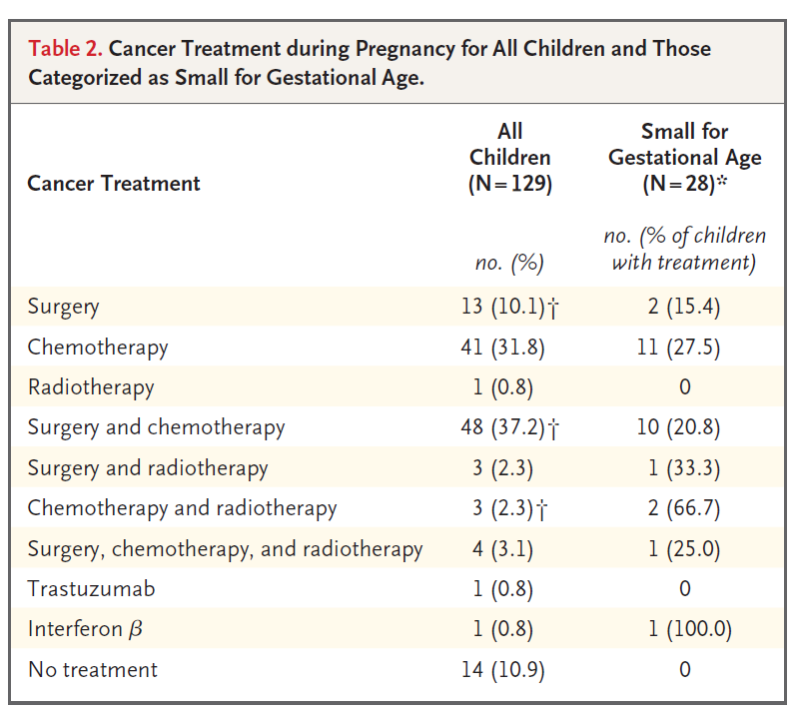
100 children exposed to chemo and/or radiotherapy
and stress, imaging studies, supportive drugs

Slide 30
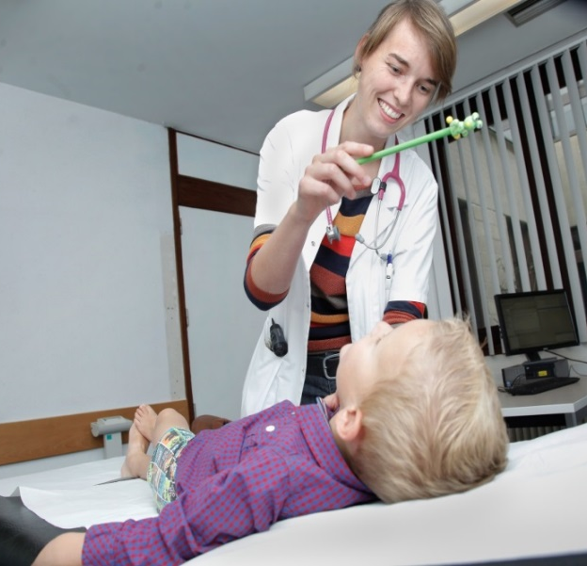

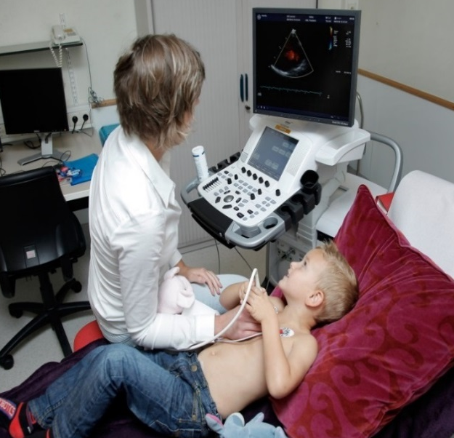
Methods
General Health | Cognitive outcome | Heart morphology and functions
General pediatric and clinical neurological examination | Bayley Scales of Infant Development – second / third edition | Echocardiography
General health questionnaire |  | Electrocardiography

Slide 31

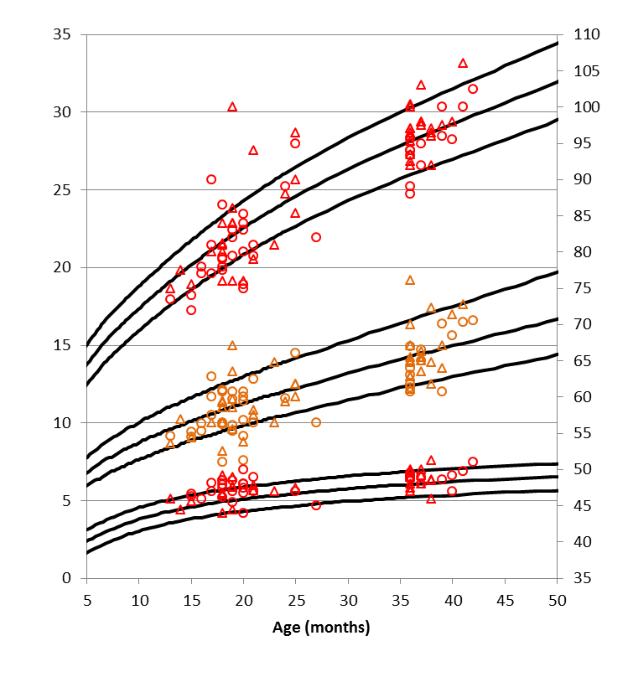
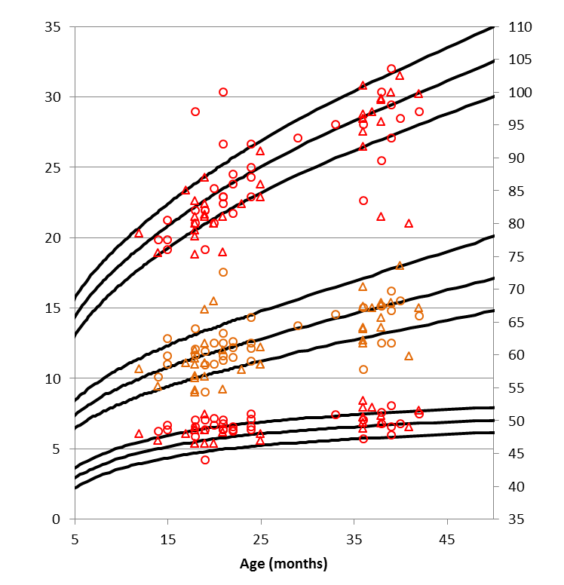
Postnatal growth
Males
Length (cm)
Females
Length (cm)
Weight (kg)
Weight (kg)
Head circumference (cm)
Head circumference (cm)
Study group Control group

Slide 32
General health
Incidence of medical problems
Need for surgery or medical care
➔ comparable between study and control group

Slide 33
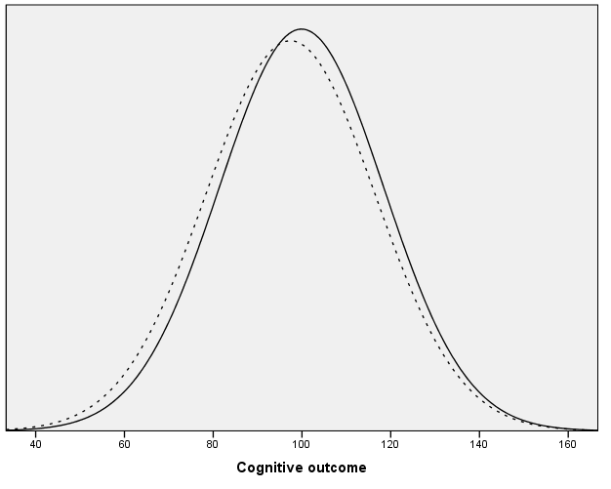
Cognitive outcome
Study group
------
Control group
Notes:
Cognitive outcome of the study (N=129) and control (N=129) group: the distribution of the results of the last performed Bayley Scales of Infant Development (second or third edition) for each child

Slide 34
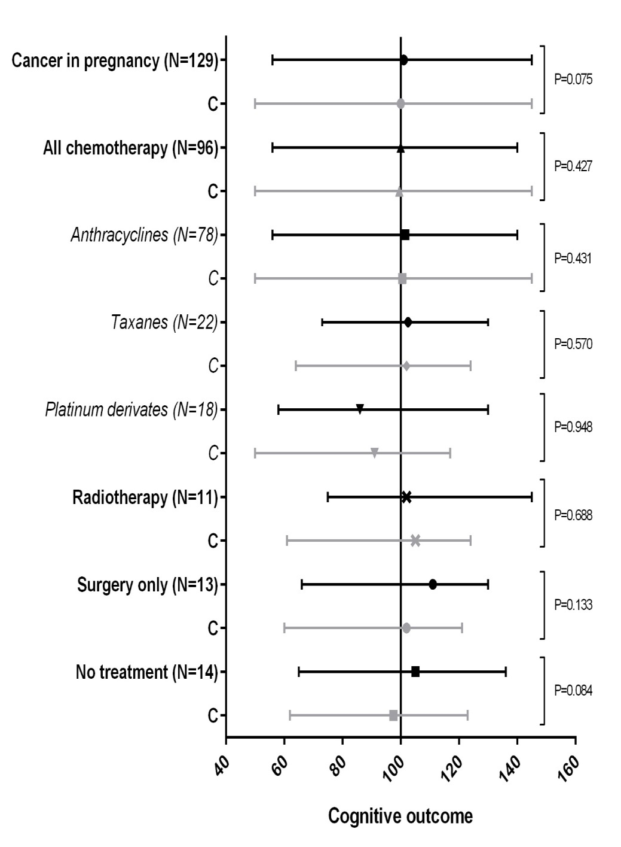
Cognitive outcome per treatment
Abbreviations: C, Control group
Notes:
Cognitive outcome (reported as Bayley II or III score) per treatment group comparing study and control (C) groups (median, range)
Each study group is 1:1 matched for gestational age and test age to the control group presented directly beneath the study group.
Some children have been prenatally exposed to a combination of treatment options (e.g. taxanes + platinum derivates) and therefore are part of more than one group.

Slide 35
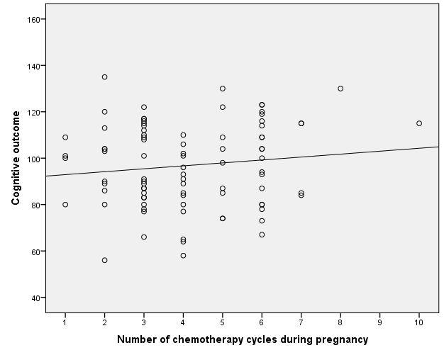
Cognitive outcome and chemo cycles
Notes:
Cognitive outcome (reported as Bayley II score) in relation to the number of chemotherapy cycles administered during pregnancy (N=87)

Slide 36
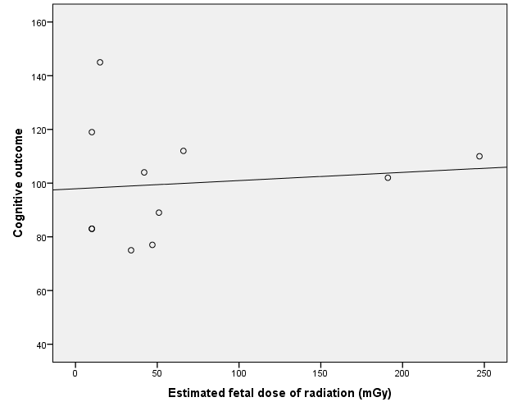
Cognitive outcome and radiation dose
Notes:
Cognitive outcome (reported as Bayley II score) in relation to the estimated fetal dose of radiation exposure during pregnancy (N=11)

Slide 37
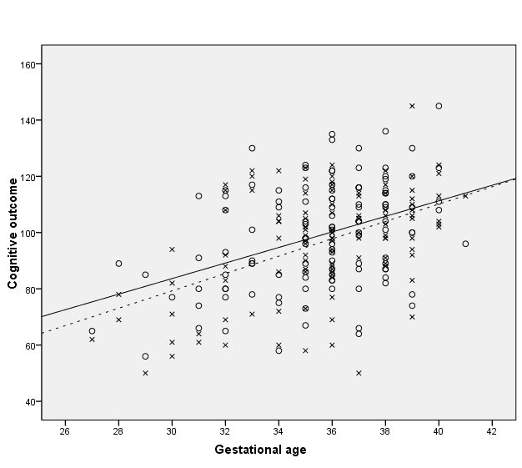
Cognitive outcome and prematurity
Study group
X
----
Control group
Notes:
Cognitive outcome (reported as Bayley II score) in relation to gestational age at birth for study (N=119) and control (N=119) group

Slide 38
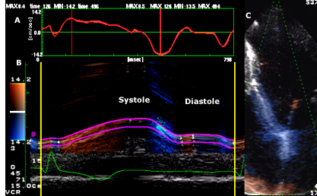
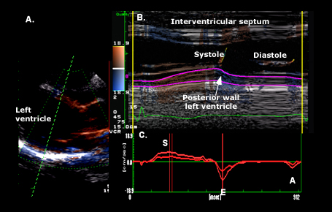
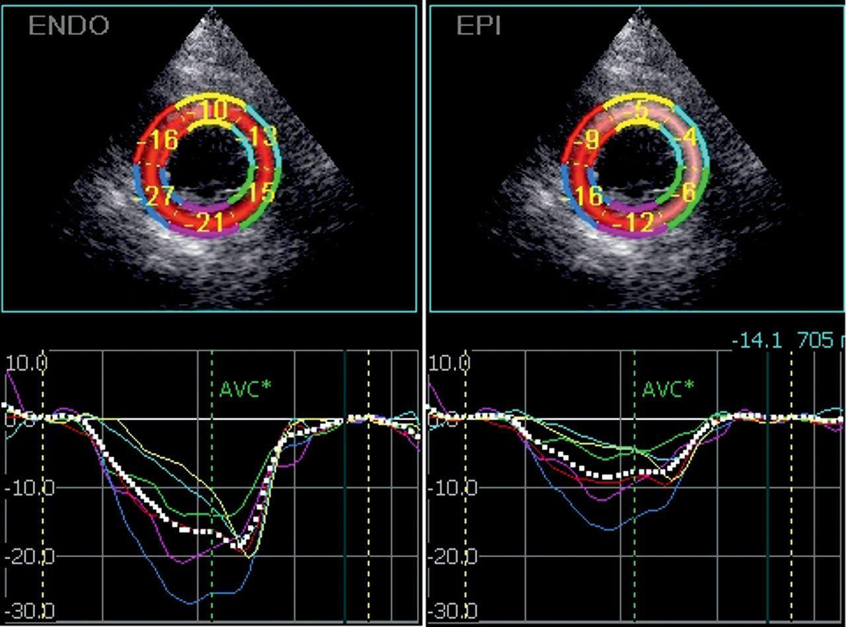
Tissue Doppler Imaging – Strain analysis
Cardiac functions
Notes:
TDI: myocardial motion measured at one point, absolute distance moved by that point over time – pulsed measures peak velocity 20-30% higher than the mean velocity by color doppler! Nowadays longitudinal direction (apical projections) mostly investigated. Cave 1 point does not fully capture true myocardial mechanics.
Strain: measure of tissue deformation, change in length normalized to the original length – the rate at which this change occurs is strain rate. Local contractile function. Peak systolic strain rate is volume independent, less pressure independent than strain. Contrast with TDI, strain rate measures the difference in velocity between 2 points. With this also myocardial velocity gradient (radial strain rate) can be measured (difference in velocity between the endocardium and the epicardium).

Slide 39
Echocardiography
 | N | Patients (N=26) Mean (range) | Controls (N=26) Mean (range) | P value
Age | 52 | 3.09 (2.31-3.62) | 3.19 (2.97-3.49) | 0.081
Body Surface Area (m²) | 52 | 0.63 (0.54-0.73) | 0.62 (0.50-0.76) | 0.693
Systolic blood pressure (mmHg) | 49 | 100 (83-124) | 97 (80-117) | 0.332
Diastolic blood pressure (mmHg) | 49 | 60 (50-71) | 56 (50-70) | 0.060
Heart Rate (beats per minute) | 51 | 99 (75-145) | 97 (76-123) | 0.584
LV shortening fraction (%) | 51 | 35 (30-39) | 35 (32-38) | 0.814
LV ejection fraction (%) | 51 | 65 (59-71) | 65 (61-69) | 0.812
LVEDD (cm) | 52 | 3.17 (2.79-3.64) | 3.15 (2.74-3.59) | 0.939
RVEDD (cm) | 52 | 1.39 (1.05-1.69) | 1.37 (1.13-1.66) | 0.912
LVPW thickness (cm) | 52 | 0.47 (0.38-0.60) | 0.44 (0.33-0.57) | 0.097
IVS thickness (cm) | 52 | 0.46 (0.39-0.57) | 0.45 (0.38-0.57) | 0.766
TDI basal segment LV lateral wall | 45
Peak systolic velocity (cm/s) |  | 6.5 (4.6-9.6) | 6.7 (5-9.1) | 0.481
Peak early diastolic velocity (cm/s) |  | 13.9 (10.3-1.74) | 14.7 (11.8-17.3) | 0.144
Mean global LV longitudinal strain (%) | 36* | 20.3 (15.6-25.3) | 21.4 (16.6-25.9) | 0.223
Mean global LV circumferential strain (%) | 19* | 21.7 (17.5-24.3) | 22.1 (16.9-24.4) | 0.747
Notes:
Echocardiographic measurements, pulsed tissue Doppler imaging (TDI) and speckle-tracking measurements in 3-year old children exposed to anthracyclines compared to matched controls
Abbreviations: LV, Left Ventricle; LVEDD, Left ventricular end-diastolic diameter; RVEDD, Right ventricular end-diastolic diameter; LVPW, Left ventricle posterior wall; IVS, Interventricular septum.
*Data were not included when tracking could not be performed due to bad image quality.

Slide 40
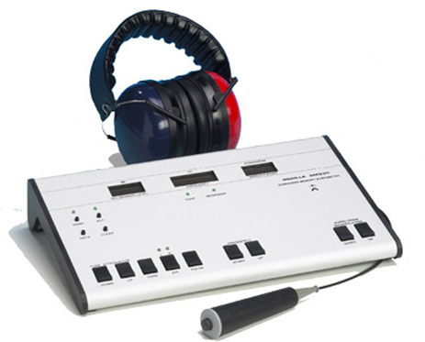
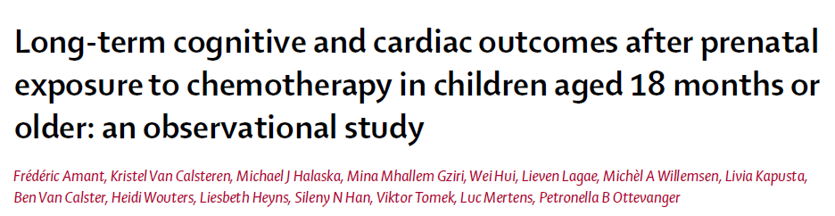
Audiometry
N = 21 between 5.0 and 17.4y (med: 6.5y)
  3 children with hearing loss
    Hearing loss in high tones (diagnosis at 6y – CT scan: damaged eardrum – up to 100 dB)
    ➔ exposed to cisplatin
    Mild hearing loss in low tones, right side (diagnosis at 6y – up to 50 dB)
    Mild hearing loss in low tones, right side (diagnosis at 6y – up to 50 dB)
    ➔ Premature born twin with major neurodevelopmental delay, exposed to idarubicin and arabinoside cytosin in pregnancy
Amant et al., 2012 (Lancet Oncology)
Notes:
One child had hearing loss for high tones at the age of 6 years (till 100 dB at 8000 Hz). She had been exposed to cisplatin at 28, 31 and 34 weeks of gestation. Cisplatin ototoxicity is known to manifest clinically as a hearing loss beginning in the high frequency region. However in this child, computed tomography showed a retracted tympanic membrane, a well-known consequence of chronic middle ear infections, which confounds the explanation of hearing loss.
Two children, of a preterm born twin pregnancy (see above) exposed to idarubicin and arabinoside cytosine, with a major neurodevelopmental delay as described above, revealed hearing loss for low tones at the right side (till 50 dB at 250 and 500 Hz).

Slide 41
Cisplatin-induced hearing loss
Geijteman E et al., Obstet Gynecol 2014
Single case report
Cervical cancer, diagnosed at 26w5d GA
5 cycles of 70mg/m² cisplatin during pregnancy
Cesarian section at 34w4d GA
Boy with severe bilateral perceptive hearing loss
  After birth: hearing loss of 30dB on the right and 60dB on the left
Geijteman et al., 2014 (Obstet Gynecol)

Slide 42

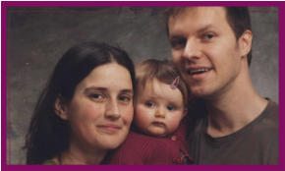
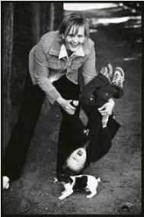
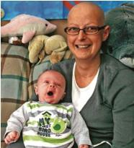















Slide 43

Transplacental transport mechanisms
Gedeon (2006)
Notes:
De proteïnen die een fundamentele rol spelen in de actieve efflux van xenobiotica zijn o.a. de transporters met de ATP-binding cassette (ABC-family). De energie die geproduceerd wordt door ATP hydrolyse gebruiken ze om molecules tegen de concentratiegradiënt in te transporteren. De belangrijkste efflux transporters zijn P-gp, MRP-2 en BCRP. Deze bevinden zich allemaal in de brush border membraan aan de maternele compartiment en ze zorgen ervoor dat de intracellulaire concentraties van de medicatie/xenobiotica laag gehouden wordt.
MRP-1 en MRP-3 komen tot expressie op het basolaterale membraan van het syncytiotrophoblast (=foetale zijde).
Extra:
P-gp : transport lipophilic drugs, that are neutral or cationic.
MRP’s: efflux of polar compounds
BCRP:

Slide 44
Cancer in pregnancy: agenda
Case study
Epidemiology, diagnosis and staging
Surgery
Radiotherapy
Chemotherapy
Long term pediatric outcomes
Multidisciplinary setting including obstetrical high care units

Slide 46
Changes in management (A) and obstetrical outcome (B) over 20 years
Management changes are shown for all 1170 patients, obstetrical outcome is shown for all singleton pregnancies.

Slide 47
Changes in 20 years
Every five calendar years:
  10% more patients treated during pregnancy (RR 1·10, 95% CI 1·05 to 1·15)
    31% more patients received chemotherapy during pregnancy (RR 1·31, 95% CI 1·20 to 1·43)
    Increase of 2·6 days in GA of the last chemotherapy cycle given during pregnancy (95% CI -1·1 to 6·3)
  4% more live births (RR 1·04, 95% CI 1·01 to 1·06)
  7% fewer preterm live births (RR 0·93, 95% CI 0·86 to 0·99)
  9% fewer iatrogenic preterm live births (RR 0·91, 95% CI 0·84 to 0·98)
  9% fewer NICU admissions (RR 0·91, 95% CI 0·83 to 0·99)
  16% more SGA (RR 1·16, 95% CI 0·99 to 1·35)
Notes:
log-binomial regression with time as a continuous predictor
Wil je de data over de niet conclusieve resultaten over GA bij laatste cyclus chemotherapie in de zwangerschpa laten zien? Ik heb hem er nu in staan maar dat CI is natuurlijk heel breed dus geen eenduidig antwoord.
SGA is ook net niet ‘significant’ maar wel een groot effect zichtbaar.
Ik denk dat we dit kunnen verklaren doordat in de gehele groep de NICU opname met prematuriteit geassocieerd is en dat natuurlijk ook daalt. Specifiek in de groep met chemotherapie is de kans alleen wel verhoogd. Ondanks dat we meer chemotherapie geven lijkt het effect van de daling van de prematuriteit dit effect op NICU opname te niet te doen in de algemene populatie. Door laten lopen van de studie zal uitwijzen of dit effect wellicht later wel weer bereikt wordt.
We moeten duidelijk maken dat de veranderingen over de jaren de gehele zwanger met kanker populatie betreft en de uitspraken van de chemo effecten op SGA en NICU alleen voor de vrouwen met chemo therapie zijn in vergelijking met de vrouwen zonder chemotherapie.
T.a.v. slide 16:
" inderdaad toch groot effect op SGA maar hoe komt het dat het niet significant is? en zelfs licht effect op RR? Hoe verklaren we dat? "
Zoals Ben al vaker heeft gezegd is die significantie wel belangrijk maar niet alles zeggend. Ik denk dat we zeker een stijging laten zien. Verklaring is wellicht het nog steeds de aantallen? En dat het effect zeker substantieel is en klinisch relevant maar statistisch misschien net niet groot genoeg om dit significant aan te tonen? Daarbij is net zoals aangegeven hierboven de RR berekend in de algemene populatie, dus de stijging per 5 kalender jaren in de gehele groep patiënten met kanker ind e zwangerschap. In de chemogroep is dit effect waarschijnlijk nog veel groter gezien de multivariaat.
Groeten!

Slide 48
Recommendation: obstetrical high care units
Less terminations
More cancer treatment (especially chemotherapy)
Less prematurity
Small for Gestational Age (SGA) babies and Neonatal Intensive Care Unit (NICU) admission
  Obstetrical high care units when antenatal chemotherapy
Notes:
Clinical recommendation; involve obstetrical high care units
Ik denk dat we dit kunnen verklaren doordat in de gehele groep de NICU opname met prematuriteit geassocieerd is en dat natuurlijk ook daalt. Specifiek in de groep met chemotherapie is de kans alleen wel verhoogd. Ondanks dat we meer chemotherapie geven lijkt het effect van de daling van de prematuriteit dit effect op NICU opname te niet te doen in de algemene populatie. Door laten lopen van de studie zal uitwijzen of dit effect wellicht later wel weer bereikt wordt.
We moeten duidelijk maken dat de veranderingen over de jaren de gehele zwanger met kanker populatie betreft en de uitspraken van de chemo effecten op SGA en NICU alleen voor de vrouwen met chemo therapie zijn in vergelijking met de vrouwen zonder chemotherapie.
T.a.v. slide 16:
" inderdaad toch groot effect op SGA maar hoe komt het dat het niet significant is? en zelfs licht effect op RR? Hoe verklaren we dat? "
Zoals Ben al vaker heeft gezegd is die significantie wel belangrijk maar niet alles zeggend. Ik denk dat we zeker een stijging laten zien. Verklaring is wellicht het nog steeds de aantallen? En dat het effect zeker substantieel is en klinisch relevant maar statistisch misschien net niet groot genoeg om dit significant aan te tonen? Daarbij is net zoals aangegeven hierboven de RR berekend in de algemene populatie, dus de stijging per 5 kalender jaren in de gehele groep patiënten met kanker ind e zwangerschap. In de chemogroep is dit effect waarschijnlijk nog veel groter gezien de multivariaat.
Groeten!

Slide 49


Clinical geneticist
Midwife
Primary care team
Physiotherapist/lymphoedema specialist
Breast surgeon
Breast nurse
Pediatrician
Medical ethicist
Pathologist
Radiologist
Psychologist
Medical oncologist
Radiotherapist
Perinatologist/obstetrician
Reconstructive/plastic surgeon
Social worker
Obstetric nurse
Notes:
Composition

Slide 50

Surgical staging in node positive disease after chemotherapy and after C/section

Slide 51
Psychological distress and coping:
Clinical recommendations
Vandenbroucke et al., 2016, Psycho-oncology
  Rational and balanced information about
    Disease, treatment and prognosis of the patient
    Evidence on outcome for the child
    Follow-up of the child after birth
  Consultation with a psychologist for
    Evaluation of distress, concerns and coping strategies ➔ Do not forget the partner!
    Emotional and relationship difficulties
    Stimulating attachment to the newborn
  Consultation with a social worker to
    Look for practical and emotional support in the patient’s network
    Organize additional help from national services (maternity care, cleaning help, babysit…)
  Peer support

Slide 52



Undifferentiated high grade sarcoma during pregnancy: a mutual ominous combination

Slide 53
Take home message
Surgery, radiotherapy and chemotherapy are possible during pregnancy
Prematurity < antenatal exposure to chemo
Interdisciplinary approach in referral centers with high risk obstetrical unit

Slide 54

Invitation to become INCIP member
Our international network counts 125 members in 37 countries.
International registry: www.cancerinpregnancy.org
frederic.amant@uzleuven.be
Europe |  |  |  |  | Other continents
Austria: 5 | Belgium: 8 | Czech Republic: 2 | Denmark: 3 | Finland: 1 | Australia: 1 | Canada: 2 | Chile: 1
France: 3 | Germany: 10 | Greece: 7 | Hungary: 1 | Ireland: 1 | Israel: 4 | Kazakhstan: 1 | Mexico: 1
Italy: 10 | Lithuania: 2 | Norway: 3 | Poland: 6 | Portugal: 3 | Qatar: 1 | Russia: 4 | China: 1
Romania: 1 | Serbia: 2 | Slovenia: 1 | Spain: 5 | Sweden: 2 | Tunisia: 1 | Turkey: 2 | United States: 4
Switzerland: 2 | The Netherlands: 16 | United Kingdom: 7 |  |  | Uruguay: 1 | South Africa: 1

Slide 55

Fertility preservation surgery for gynaecologic cancers
Frédéric Amant
Gynaecologic Oncology
Leuven Cancer Institute, Belgium
Netherlands Cancer Institute & Amsterdam University Medical Centers, the Netherlands

Slide 56
Take home message
Fertility preservation is frequently possible in early stage disease
Deviation of standard treatment
Motivated patient

Slide 57
Agenda
Ovarian transposition
Cervical cancer
Ovarian cancer

Slide 58
Informed consent and selection patients
Counselling
  Preservation fertility is no guarantee for succesful pregnancy
  No randomised studies
Patient characteristics
  Strong desire to retain fertility
  Age?
  Proven fertility? Infertility?

Slide 59

Transposition of the ovaries as high and lateral as possible
Ghadjar et al., Radiat Oncol 2015

Slide 60

‘Simple’ trachelectomy or conisation

Slide 61
Pregnancy and obstetrical outcome after vaginal radical trachelectomy
Hauerberg L. et al, Gynecologic Oncology 138 (2015) 304–310
 | n (%)
VRT Desire to conceive Referred to fertility treatment Pregnant women | 120 72 (60.0%) 40 (55.6%) 55 (76.4%)
Pregnancies Spontaneous After fertility treatment | 77 58 (75.3%) 19 (24.7%)
Abortions First trimester Second trimester Therapeutic abortions | 21 16 (76.2%) 2 (9.5%) 3 (14.3%)
Deliveries Premature 24–28 WOG 28–32 WOG 32–34 WOG 34–37 WOG At term N37 WOG | 53 3 (5.6%) 5 (9.4%) 4 (7.5%) 21 (39.6%) 20 (37.7%)
*WOG, weeks of gestation, ongoing pregnancies: 3.
Notes:
Objective. To present and evaluate an unselected national single center strategy with fertility preserving
trachelectomy in cervical cancer.
In 2003 nationwide single-center referral of women for trachelectomies was agreed upon between all Danish
departments performing cervical cancer surgery with the purpose of increasing volume, to increase surgical
safety and facilitate follow-up.
Methods. Prospective data were recorded in the Danish Gynecological Cancer Database of all Vaginal Radical
Trachelectomies (VRT) performed in Denmark between 2002 and 2013. Oncologic, fertility and obstetrical outcomes
of 120 unselected consecutive VRTs were assessed.
To obtain complete follow-up about fertility treatment, pregnancy and obstetric outcome the women filled out
an electronic questionnaire. Median follow-up: 55.7 months.
Results. 85.8% of the patients had stage IB1 disease, 68.3% squamous cell carcinomas, 30.0% adenocarcinomas
and 1.7% adenosquamous carcinomas.
Six recurrences (5.1%) and 2 deaths (1.7%) occurred. Four women with adenocarcinomas (10.5%) had recurrences,
compared to two women with squamous cell carcinomas (2.5%).
Seventy-two women (60.0%) desired to conceive and 55 women obtained a total of 77 pregnancies. Of the 72
women 40 were referred to fertility treatment.
First and second trimester miscarriage rates were 21.6% and 2.7%, respectively.
A total of 53 children were born of which 41 were delivered after gestational week 34.
Conclusion. This unselected national single center referral study confirms the oncological safety of Vaginal
Radical Trachelectomy.
The complete follow-up regarding reproductive data, reveals a surprisingly extensive need of fertility treatment
and due to the rate of prematurity, these pregnancies must be regarded as high-risk pregnancies.

Slide 62
Fertility results and pregnancy outcomes after conservative treatment of cervical cancer: a systematic review of the literature.
Bentivegna et al., Fertil Steril 2016
Fertility outcome according to FSS
 | Cone resection | Dargent procedure | Radical Trachelectomy laparotomy | Radical trachelectomy minim invasive | NACT | Total
Pregnancy rate | 22/39 (56) | 241/424 (57) | 135/310 (44) | 57/87 (65) | 60/78 (77) | 515/938 (55)
Live birth rate | 51/69 (74) | 308/460 (67) | 120/175 (68) | 50/64 (78) | 71/93 (76) | 600/861 (70)
Prematurity rate | 8/51 (15) | 113/285 (39) | 59/104 (57) | 25/50 (50) | 11/71 (15) | 216/561 (38)
Notes:
Objectives
To evaluate the fertility results, obstetric outcomes, and the management of infertility in patients submitted to fertility-sparing surgery (FSS) for invasive cervical cancer.
Design
Systematic review.
Setting
Not applicable.
Patient(s)
Patients submitted to FSS for invasive cervical cancer (stage IB).
Intervention(s)
Five different FSS procedures were studied.
Main Outcomes Measure(s)
Fertility, pregnancy outcomes, and management of infertility.
Result(s)
A total of 2,777 patients submitted to FSS and 944 ensuing pregnancies were included in this review. Five different surgical procedures were performed and studied. The overall fertility, live birth, and prematurity rates after these procedures were, respectively, 55%, 70%, and 38%. The pregnancy rate was higher in patients submitted to a vaginal or minimally invasive radical trachelectomy compared with a laparotomic radical trachelectomy. The live birth rate was similar, whatever the FSS procedure. The prematurity rate was significantly lower in patients who had undergone a simple trachelectomy/cone resection and neoadjuvant chemotherapy followed by FSS compared with other conservative surgeries. A majority of second trimester fetal losses and premature deliveries were related to premature rupture of membranes.
Conclusion(s)
The choice between the different FSS procedures depends first and foremost on the oncologic characteristics of the tumor. Nevertheless, when several options seem to offer the same oncologic results (for example, stage IB1 disease >2 cm), fertility results should then be taken into consideration to select the best choice acceptable to the patient/couple.

Slide 63
Results of radical trachelectomy for cervical cancer according to treatment modality
Pareja et al., Gynecol Oncol 2015
Treatment | Fertility preservation rate, % | Pregnancy rate (overall), % | Recurrence rate, % | Death rate, %
ART (all sizes) | 85.1ª | 16.2ª | 3.8ª | 0.4ª
VRT (all sizes) | 91.1^{b} | 24ª | 4.2^{a,b} | 2.9^{a,b}
NACT | 89.6 | 30.6 | 7.6 | 1.7
ART, tumor ≥ 2 cm | 82.7 | NC | 6 | 1
VRT, tumor ≥ 2 cm | NC | NC | 17.1 | 4
Fertility rates are highest in those patients treated with neoadjuvant chemotherapy
followed by conservative surgery and thus this approach should be offered as the
ideal approach to patients with tumors > 2 cm.
Notes:
NACT many patients underwent simple trachelectomy/conisation

Slide 64




Notes:
Mucineus cystadenoom in beeldvorm.

Slide 65




18-year-old serous borderline
19-year-old serous borderline
Notes:
Sereus borderline carcinoom in beeldvorm.

Slide 66
Fertility preservation for serous borderline and stage I invasive ovarian cancer
  Patient information
  Comprehensive surgical staging:
      Vertical midline incision/laparoscopy/robot
      Cytology
      Complete abdominal inspection and palpation
      Unilateral salpingo-oophorectomy
      Omentectomy
      Random peritoneal biopsies
      Retroperitoneal lymph node resection (where indicated)

Slide 67

Reproductive status after cryopreservation of ovarian tissue
in 66 young female cancer patients
Hulsbosch et al., Gynecol Obstet Invest 2018
Selection of patients:
- oncologic prognosis
- child wish (psychological evaluation & counseling)
- age of patient
- type and number of cycles of chemotherapy

Slide 68
Take home message
Fertility preservation is frequently possible in early stage disease
Deviation of standard treatment
Motivated patient

Slide 70

Aigues Tortes national park
Pyrenees

