Slide 1
Cervical cancer
David Cibula

Slide 2
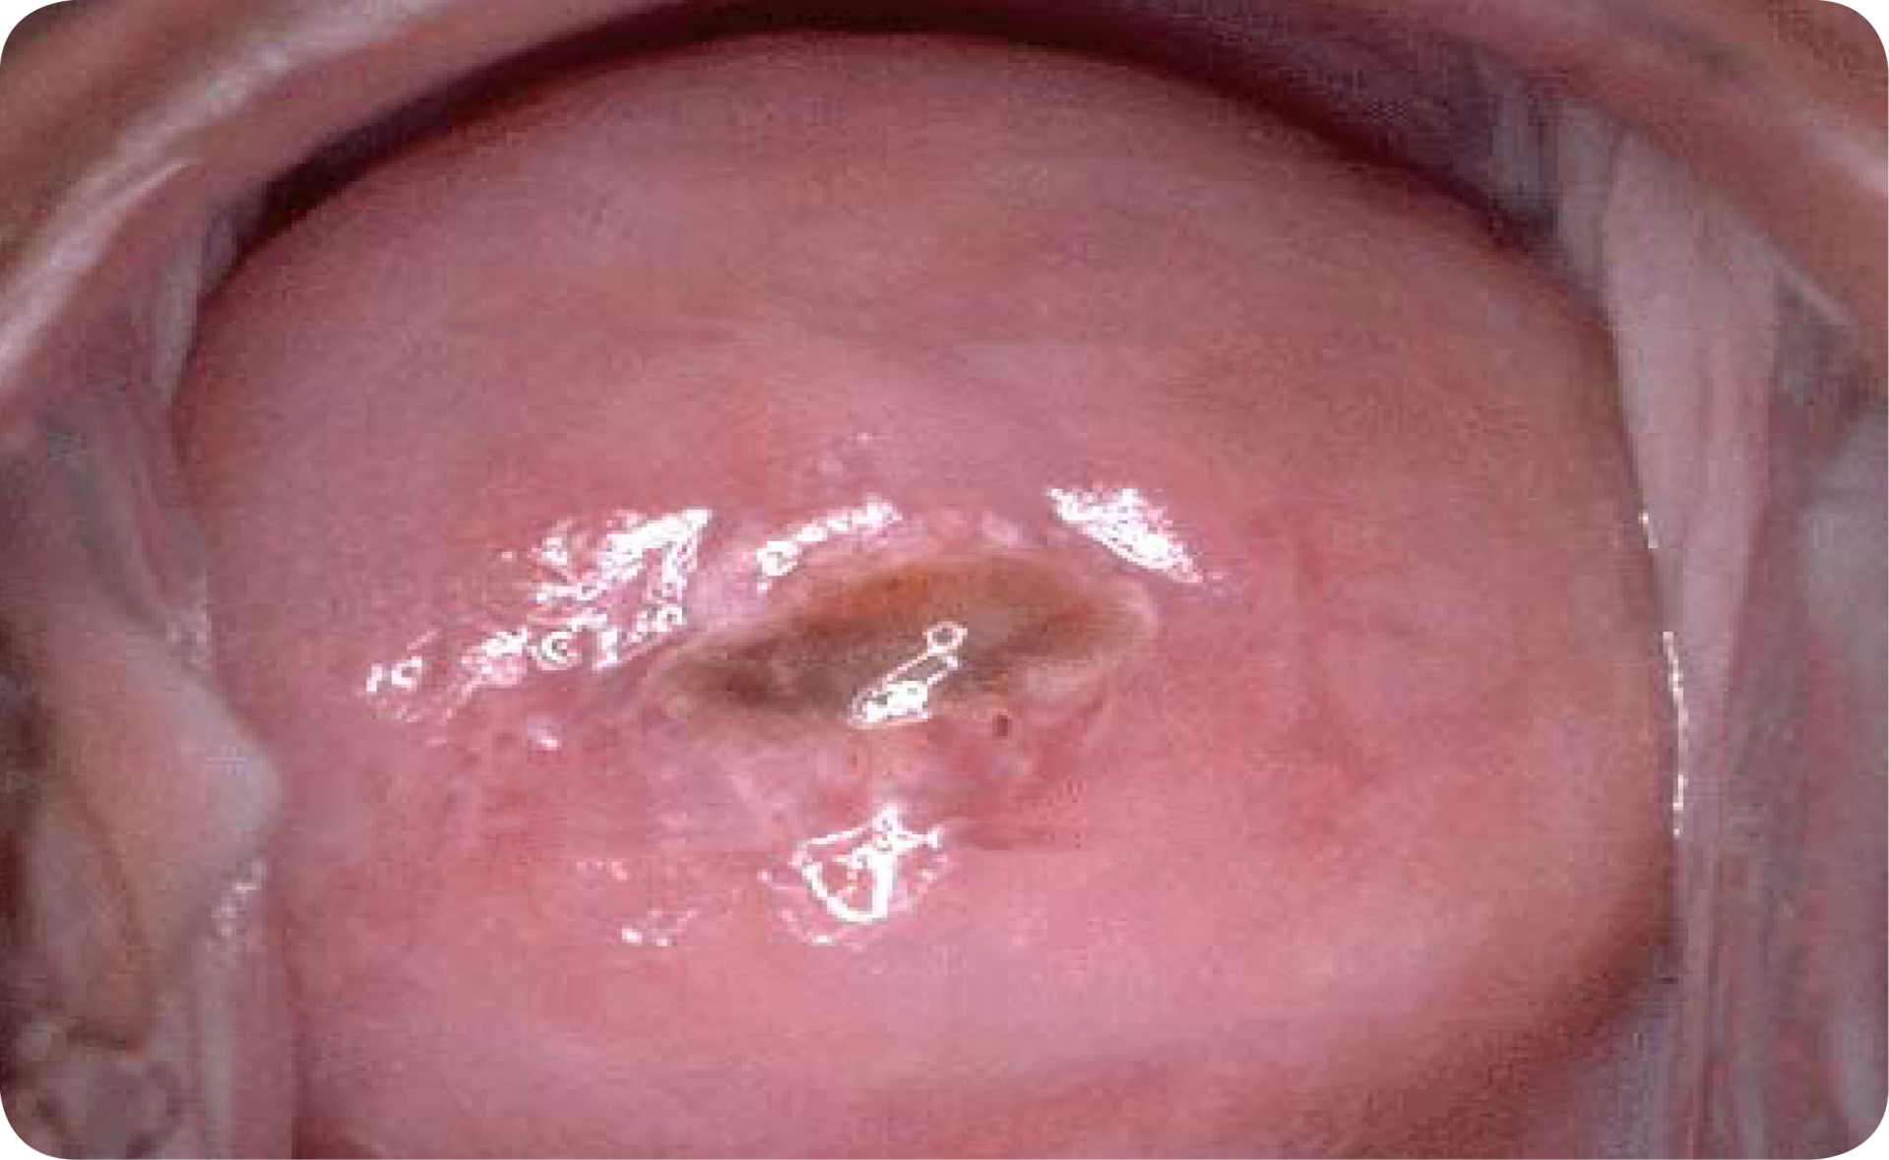
CZ/CER/0018/14

Slide 4
Incidence / mortality

Slide 5
Gynekologické nádory v ČR: časové trendy
Cervical cancer (C53)
Endometrial cancer (C54,C55)
Ovarian cancer (C56)
+12,6 %
-6,8 %
-7,3 %
Počet na 100 000 žen
Počet na 100 000 žen
Počet na 100 000 žen
-10,4 %
-22,0 %
-9,3 %
Rok
Rok
Rok
incidence
mortalita
+25,2 %
+32,3 %
+34,8 %
Počet žijících s nádorem
Počet žijících s nádorem
Počet žijících s nádorem
Rok
Rok
Rok
prevalence
%: trend 2001 - 2011

Slide 7
Age standardized rate – top 20 in Europe

Slide 8
Proportion of patients in age-categories according to disease stages [%]
Age
Notes:
První peak – stadium 1, trochu 2-3
Druhý peak – stadia 2-4

Slide 9
Screening

Slide 10
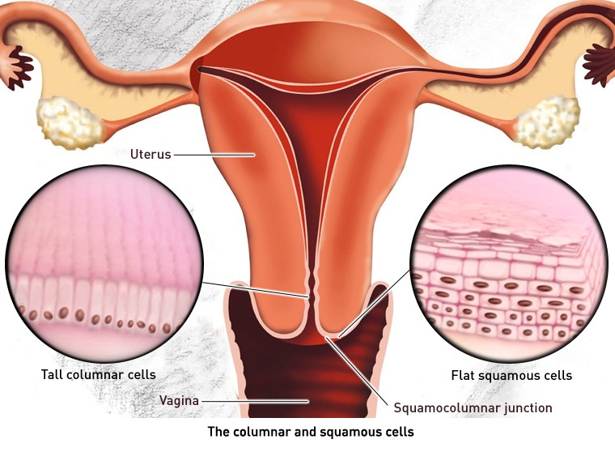
Adenocarcinoma
(ADC)
15%-20%
Squamous cell cancer (SCC)
80-85%

Slide 11
Screening coverage in the Czech republic according to age groups
Age at screening

Slide 12
Cytology and HPV DNA test
100
80
Mean difference
35,7%
60
Sensitivity for ≥CIN2 (%)
40
20
Cytology
HPV DNA test
0
Bigras (N=13,842)
Cardenas (N=1,850)
Coste (N=3,080)
Kulasingam (N=774)
Mayrand (N=9,977)
Petry (N=7,908)
Whitlock EP, et al. Ann Intern Med. 2011; 155:687−697, W214−5.
Notes:
Today, it is widely accepted that HPV DNA testing is more sensitive than cytology for the detection of cervical precancer. In a systematic evidence review of randomized studies conducted for the US Preventive Services Task Force, HPV DNA testing was found to consistently demonstrate a significantly greater sensitivity in the detection of CIN2 or greater in comparison with cytology.
Upon comparison of six studies from developed countries with organized cervical cancer screening programs, the average increase in CIN2 sensitivity for HPV DNA testing was 35.7% higher than the average sensitivity of cytology.

Slide 13
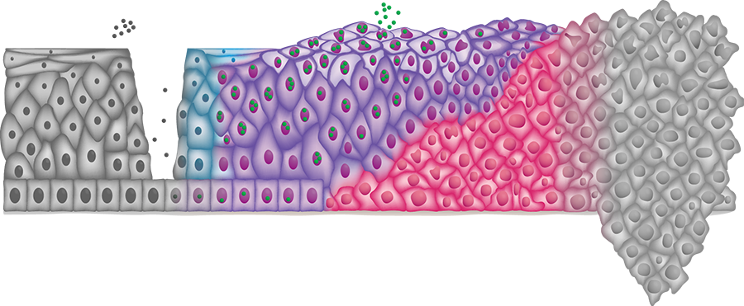
HPV
HPV infection
HPV DNA replication
HPV E6/E7 gene expresion
Cell cycle dysregulation
Cancer
HPV DNA Test*
-
+
HPV E6/E7 mRNA Test
-
-
+
p16/Ki-67 Test
-
-
-
+
Notes:
An HPV DNA test detects an HPV infection early when the HPV DNA starts replicating, all the way through cancer.
An HPV mRNA test detects an HPV infection only at a later stage when the viral E6/E7 genes are starting to be turned on.
The p16 & Ki-67 dual stain detects cells whose cell cycle has become deregulated & that have actually transformed into potential cancer cells.

Slide 14
Screening
vs
Vaccination

Slide 18
Clinical staging

Slide 19
Clinical staging
Mandatory clinical and radiological diagnostic work-up
Local work-up:
Pelvic examination and biopsy
Pelvic MRI OR endovaginal/transrectal expert ultrasound
Nodal / distant work-up (LACC or suspicious LN):
PET-CT or chest/abdomen CT

Slide 20
Risk factors

Slide 21
Sexual behaviour (number of partners, early debute)
HPV infection, precancer lesion
Smoking
No vaccination against HPV

Slide 22
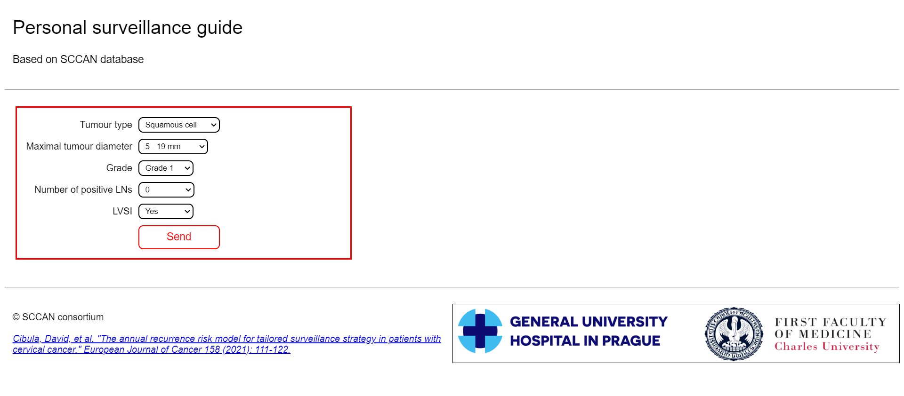

Slide 23
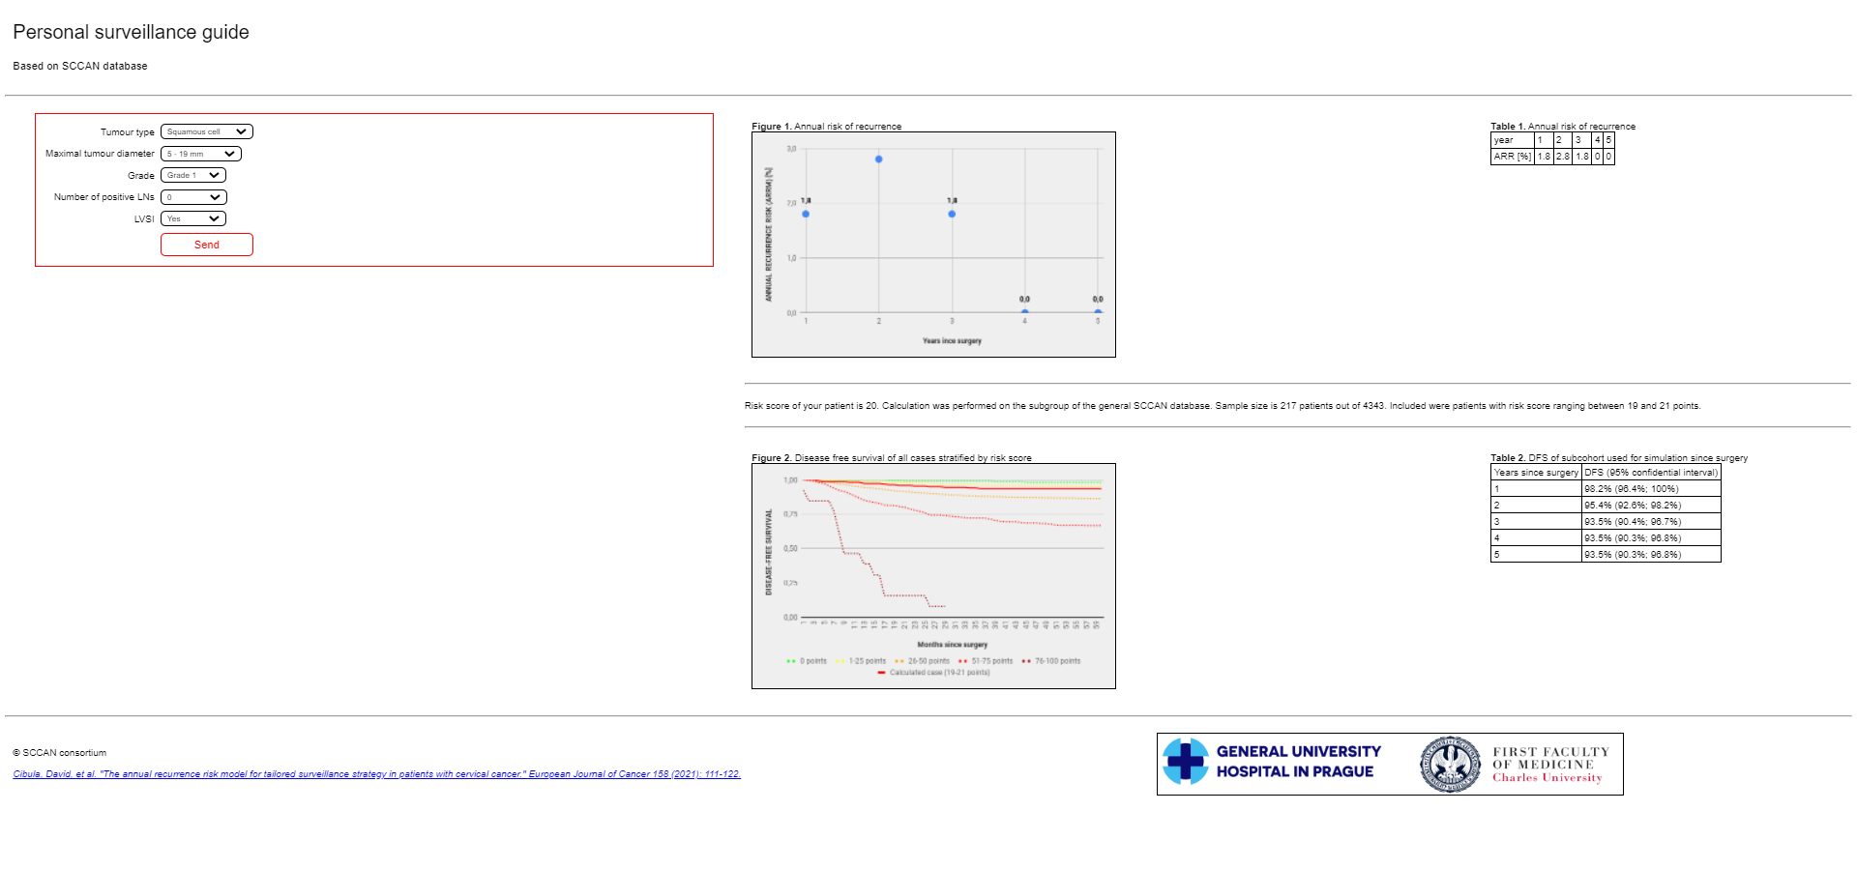

Slide 24
Prognostic parameters

Slide 25
Tumor related:
Tumor size
LVSI
Parametrial invasion
Extra-tumoral:
Lymph node involvement

Slide 26
Classification

Slide 27
1a1 < 3 mm
1a2 ≤ 5 mm

Slide 28
Treatment

Slide 29
T1a (<5mm)
Simple hysterectomy
Or
Conisation

Slide 30
T1b
SLN (LN)
Frozen section
LN neg LN pos
Pelvic lymphadenectomy
Radical hysterectomy
+/- BSO Primary chemoradiation

Slide 31
Fertility sparing management

Slide 32
Fertility sparing
Candidate selection
Squamous cell / usual type (HPV related) adenocarcinoma
Largest diameter ≤ 2 cm
LN staging (SLN / LN)
FS
LN neg. LN pos.
Identical principles

Slide 34
A = conization
B = simple trachelectomy (ST)
C = vaginal radical trachelectomy
D = abdominal radical trachelectomy
C

Slide 35
Advanced stages

Slide 36
Advanced stages
Locally advanced Metastatic
Primary
Concomitant
Combined
Chemoradiation
Palliative
Systemic
Treatment
(Carboplatin / Cisplatin / Paclitaxel)

Slide 37
Bevacizumab (04/2015 – EMA)
in combination with paclitaxel and cisplatin or paclitaxel and topotecan
… persistent, recurrent, or metastatic cervical cancer
Pembrolizumab (04/2022 – EMA)
in combination with chemotherapy +/- bevacizumab
… persistent, recurrent, or metastatic cervical cancer in tumours PD-L1 (CPS) ≥1
Tisotumab vedotin (10/2021 – FDA)
a tissue factor-directed antibody and microtubule inhibitor conjugate
… recurrent or metastatic cervical cancer with disease progression on or after chemotherapy

