Slide 1


Endometrial Cancer
Is Cinderella now a Princess ???
Nicoletta Colombo
Università Milano-Bicocca
Istituto Europeo Oncologia

Slide 2
Financial Disclosures
I have the following ongoing financial relationships with ACCME defined ineligible companies to report over the past 24 months:
  Employee: University of Milan-Bicocca and European Institute of Oncology IRCCS, Milan
  Consultant/Advisor: Roche; PharmaMar; AstraZeneca; Clovis Oncology; MSD; GlaxoSmithKline; Tesaro; Pfizer; BIOCAD; Immunogen; Mersana; Eisai; Oncxerna, Nuvation Bio
  Promotional Speaker: AstraZeneca, Tesaro, Novartis, Clovis, MSD, GlaxoSmithKline, Eisai
  Investigator/Researcher: AstraZeneca, PharmaMar, Roche
  Nonfinancial interests: Steering Committee Member for ESMO Clinical Guidelines, Chair Scientific Committee ACTO onlus
Notes:
QBGROUP spa
Titolo della relazione
2

Slide 3

Cinderella was born to wealthy, unnamed parents who treated their daughter with great love. After the death of her mother, her father remarried, believing that she "needed a mother's care". He died shortly thereafter, upon which she was forced to work as a scullery maid for her wicked stepmother, Lady Tremaine and two stepsisters, Anastasia and Drizella.
Despite the cruelty of her jealous stepfamily, Cinderella remained kind, spirited, and internally beautiful.

Slide 4
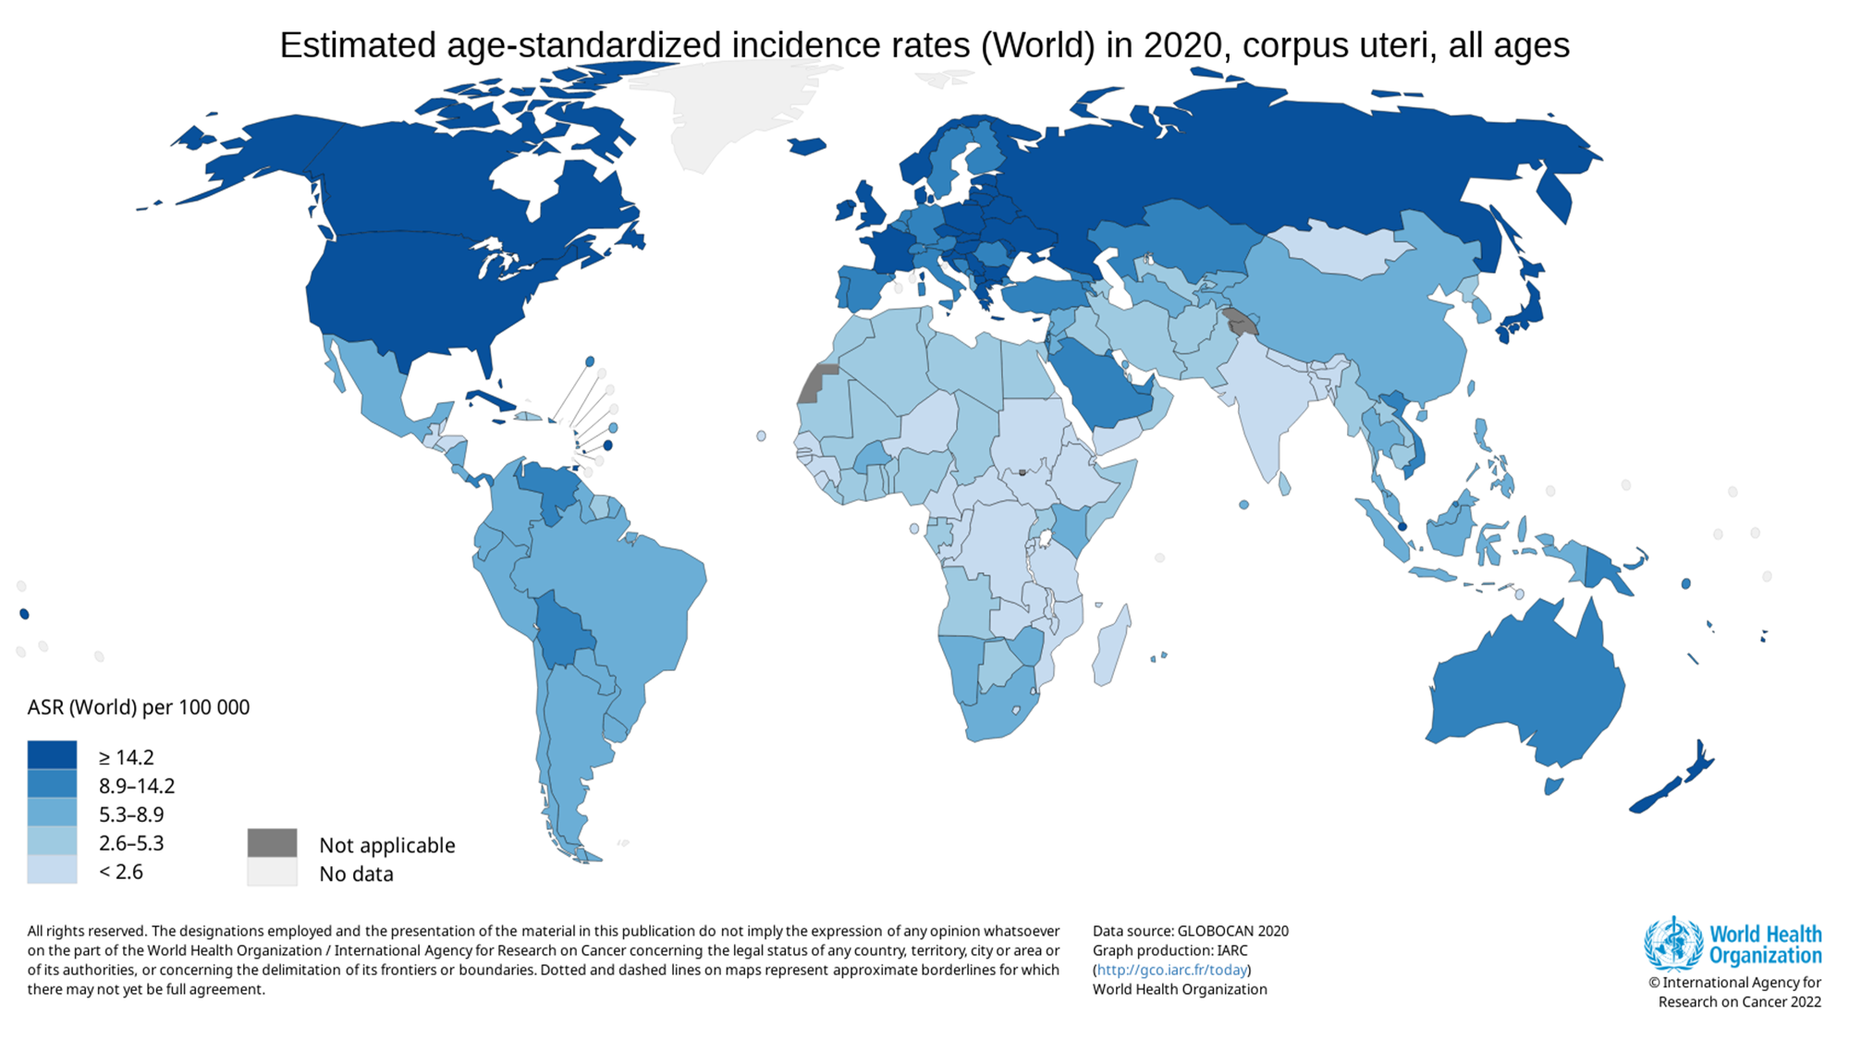
Endometrial cancer…….. as Cinderella
Despite being the most common gynecological cancer in the developed world and the only Gynecological Cancer with rising incidence and mortality
80% present with stage I disease with excellent prognosis
Treated everywhere
Very little interest for new agents and treatment modalities compared to the two stepsisters ovarian and cervical cancer

Slide 5

Cinderella was wearing very simple and poor dresses as any maid
Endometrial Cancer was thought to be a simple disease
1983 The Bokhman’s dualistic model
 | Type I | Type II
Precursor: estrogen related | Yes | No
Frequency | 80% | 20%
Histology | Endometrioid | CCC, serous, mucinous
Prognosis | Good | Bad

Slide 6




Invitation to the ball
The Fairy Godmother insists that Cinderella attends the ball and demonstrates her magical abilities..

Slide 7

…………..as she transforms a pumpkin into a coach, mice into horses, Major into a coachman, and Bruno into a footman

Slide 8


…….before transforming Cinderella's ruined dress into a beautiful, sparkling ball gown, complete with glass slippers

Slide 9
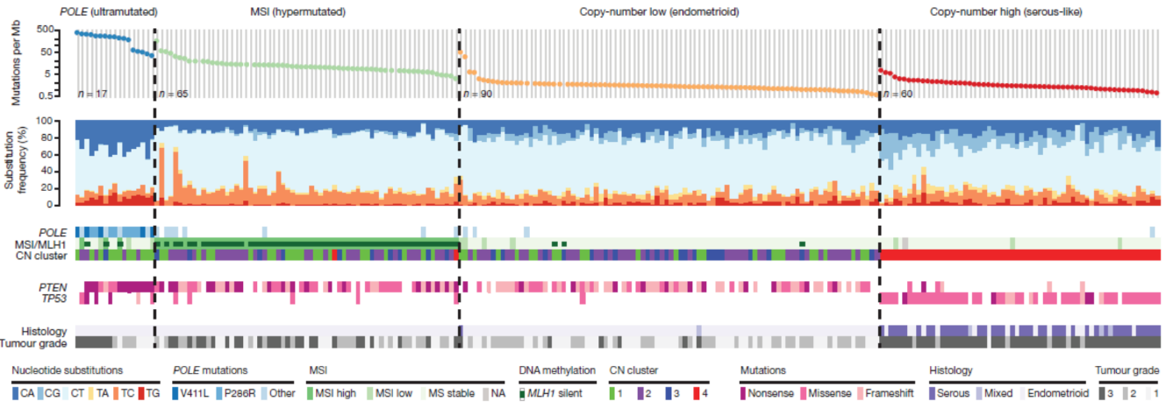
Endometrial cancer classification:
The fulfillment of a ProMisE
Bokhman :
a dualistic model
for endometrial tumorigenesis
TCGA molecular model
1983
2013
2014-2018
ProMisE/TransPORTEC: a simplified molecular model
Bokhman J.V., Gyn Onc 1983. Suarez A.A., Felix A.S., Cohn D. E. Gyn Onc 2017. TGCA, Nature 2013
Stelloo E. et al, Gyn Onc 2014; Stelloo et al, Clin Cancer Research 2016; Talhouk A. et al, Gyn Onc 2016; Kommos S. et al, Annals of Oncology, 2018: Abdulfatah et al, Gyn Onc 2019. Concin N. et al, IJGC 2021
Notes:
2013: TCGA molecular model An opportunity to do better…extensive genomic and proteomic analyses four molecular prognostic categories more objective molecular classification
The 5th edition of the World Health Organization (WHO) Classification of Tumours of the Female Genital Tract, published in 2020, highlights the proposed new molecular classification system for ECs and how it relates to the traditional histomorphologic classification [1].
As this molecular classification has been integrated into key guidelines [2,3], it is important that clinicians are aware of this new system, familiar with how to interpret molecular results provided in pathology reports, and aware of the implications these features have on clinical care [4].

Slide 10
Clinical implications
Molecular classification’s roles
Prognostic factor
Estimate PFS and OS according to molecular class
Risk Assessment
More objective attribution to a specific risk class
Predictive factor
Identification of patients who may be more sensitive to different treatment options
Genetic screening
Identification of patients who may harbour genes’ mutations (Lynch syndrome)

Slide 11
Prognostic role
Unselected cohorts
N=142
N=319
N=451
POLE
MMRd
NSMP
p53
Prognostic accuracy of surrogate markers is validated in several unselected ECs cohorts
Talhouk at al, BJC 2015. Talhouk et al, Cancer 2017. Kommoss et al, Annals Onc 2018.

Slide 12

Classical risk factors
Grade
Myometrial invasion
Histologic subtype
LVSI
Stage
Age

Slide 13
ESGO-ESTRO-ESP
(2020)
ESMO
(2022)
FIGO Staging 2023

Slide 14

Predictive role
PORTEC-3
xx
Great benefit from CT
No benefit from CT
No statistically significant benefit from CT
No added benefit from CT
14
Leon-Castillo et al, JCO 2020
Notes:
Molecular classification predictive of benefit from adjuvant chemotherapy?
No advantages from adj Tx in POLE group
P53 group, as aspected, is the one which benefits the most from CT
No differences between outcomes of Rx arms within MMRd. Partially explained by increased radiosensitivityof MMRdECs? Reijnen et al Gyn Onc2019

Slide 15
Future directions

Slide 16

Sistemic treatment : one size does not fit all !!!!

Slide 17
Standard of Care chemotherapy for Advanced/Recurrent Endometrial Cancer
Paclitaxel + Carboplatin¹
1.0
+
Treatment Group
Pac/Carbo
TAP
Event
438
427
Total
672
656
Median
37.0
41.1
+
+
+
+
+
+
+
+
+
+
+
+
+
+
+
+
+
+
+
0.8
+
+
Stratified HR: 1.002
90% CI: 0.895-1.121
+
+
+
+
+
+
+
+
+
+
+
+
+
+
+
+
+
+
+
+
+
+
0.6
+
+
+
+
+
+
+
+
+
+
+
+
+
+
+
+
+
+
+
+
+
OS Probability
+
+
+
+
+
+
+
+
+
+
+
+
+
+
+
+
+
+
+
+
+
0.4
+
+
+
+
+
+
+
+
+
+
+
+
+
+
+
+
+
+
+
+
+
+
+
+
+
+
+
+
+
+
+
+
+
+
+
+
+
+
+
+
+
+
+
+
+
+
+
+
+
+
+
+
+
+
+
+
+
+
+
+
+
+
+
+
+
+
+
+
+
+
+
+
+
+
+
+
+
+
+
+
+
+
+
+
+
+
+
+
+
+
+
+
+
+
+
0.2
GOG 209 established Pac/Carbo as SoC
+ Censored
0
0
72
12
24
36
48
60
84
96
108
120
132
144
156
168
Mo
1. Miller. JCO. 2020;38:3841. 2. Fader. Clin Cancer Res. 2020;26:3928.
Notes:
Carbo, carboplatin; OS, overall survival; Pac, paclitaxel; PFS, progression-free survival; SoC, standard of care; UPSC, uterine papillary serious carcinoma.

Slide 18
Unmet Need in Second-Line Endometrial Cancer
Objective Response Rates
Chemotherapy^{[a]}
15% to 16%*
MTOR Inhibitor^{[b-d]}
4% to 7%
Everolimus-letrozole^{[e,f]} 24%
MA/TAM^{[g]} 19%
Bevacizumab^{[h]} 13.5%
Cediranib^{[i]} 12.5%
* Ixabepilone vs. doxorubicin vs paclitaxel (phase 3)
a. McMeekin S, et al. Gynecol Oncol. 2015;138:18-23; b. Oza AM, et al. J Clin Oncol. 2011;29:3278-3285; c. Colombo N, et al. Br J Cancer. 2013;108:1021-1026; d. Tsoref D, et al. Gynecol Oncol. 2014;135:184-189; e. Slomovitz BM, et al. Cancer. 2010;116:5415-5419; f. Slomovitz BM, et al. SGO 2018; g. Lee W-L, et al. J Cin Med Assoc 2014;77:221-226; h. Aghajanian C, et al. J Clin Oncol 2011;29:2259-2265; i. Bender D, et al. Gynecol Oncol 2015;138:507-512.
Notes:
Reference(s)
McMeekin S, Dizon D, Barter J, et al. Phase III randomized trial of second-line ixabepilone versus paclitaxel or doxorubicin in women with advanced endometrial cancer. Gynecol Oncology 2015;138:18-23.
Oza AM, Elit L, Tsao M-S, et al. Phase II Study of Temsirolimus in Women With Recurrent or Metastatic Endometrial Cancer: A Trial of the NCIC Clinical Trials Group. J Clin Oncol. 2011;29:3278-3285.
Colombo N, McMeekin DS, Schwartz PE, et al. Ridaforolimus as a single agent in advanced endometrial cancer: results of a single-arm, phase 2 trial. Br J Cancer. 2013;108:1021-1026.
Tsoref D, Welch S, Lau S, et al. Phase II study of oral ridaforolimus in women with recurrent or metastatic endometrial cancer. Gynecol Oncol. 2014;135:184-189.
Slomovitz BM, Lu KH, Johnston T, et al. A phase 2 study of the oral mammalian target of rapamycin inhibitor, everolimus, in patients with recurrent endometrial carcinoma. Cancer. 2010;116:5415-5419.
Slomovitz BM, Filiaci VL, Coleman RL, et al. GOG 3007, a randomized phase II (RP2) trial of everolimus and letrozole (EL) or hormonal therapy (medroxyprogesterone acetate/tamoxifen, PT) in women with advanced, persistent or recurrent endometrial carcinoma (EC): a GOG foundation study. Presented at: 2018 Society of Gynecologic Oncology Annual Meeting on Women’s Cancer; March 24, 2018-March 27, 2018; New Orleans, LA.
Lee W-L, Yen M-S, Chao K-C, et al. Hormone therapy for patients with advanced or recurrent endometrial cancer. J Chin Med Assc. 2014; 77:221-226.
Aghianian C., Sill MW, Darcy KM. Phase II trial of bevacizumab in recurrent or persistent endometrial cancer: a Gynecologic Oncology Group study. J Clin Oncol. 2011;29:2259-2265.
Bender D, Sill MW, Lankes HA, et al. A Phase II evaluation of cediranib in the treatment of recurrent or persistent endometrial cancer: An NRG Oncology/Gynecologic Oncology Group Study. Gynecol Oncol. 2015; 138:507-512.
Abbreviations:
mTOR = mammalian target of rapamycin
MA = megestrol acetate
TAM = tamoxifen

Slide 19

How to personalize sistemic treatment???????
The Duke slides the slipper onto Cinderella's foot, and it fits perfectly.

Slide 20
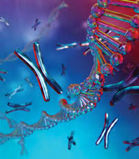
Can Molecular profiling improve the systemic treatment of endometrial cancer ?

Slide 21
Potential Therapeutic Impact of TGCA Classification of Endometrial Cancer
 | POLE | MSI | Copy Number Low | Copy Number High
MSI/MLH methylation | Mixed MSI high, low, stable | MSI high | MSI stable | MSI stable
Molecular profile | POLE (100%) PTEN (94%) PIK3CA (71%) FBXW7 (82%) ARID1A (76%) KRAS (53%) PD1/PD-L1 overexpression | PTEN (88%) RPL22 (37%) KRAS (35%) PIK3CA (54%) ARID1A (37%) PD-1/PD-L1 overexpression | PTEN (77%) CTNNB1 (52%) PIK3CA (53%) ARID1A (42%) FGFR2 (10.9%) | TP53 (92%) PPP2R1A (22%) FBXW7 (22%) PIK3CA (47%) PTEN (11%) FGFR (7%) HER2 (25%)
Potential drugs | PI3K/PTEN/AKT/ mTOR pathway Anti-PD-1/PD-L1 Hormones | PI3K/PTEN/AKT/mTOR pathway Anti-PD-1/PD-L1 Hormones | PI3K/PTEN/AKT/mTOR pathway Hormones FGFR-I | HER2- I PI3K- I PARP-I Wee-1 I FGFR-I
Stelloo E, et al. Clin Cancer Res. 2016;22;4215-4224.
Notes:
[07:51]
References
Stelloo E, Nout RA, Osse EM, et al, Improved risk assessment by integrating molecular and clinicopathological factors in early-stage endometrial cancer—combined analysis of the PORTEC cohorts. Clin Cancer Res. 2016; 22;4215-4224.
Abbreviations:
MSI = microsatellite instability
POLE =
PD-1 =
PD-L1 =
PI3K =
PTEN =
PIK3CA =

Slide 22














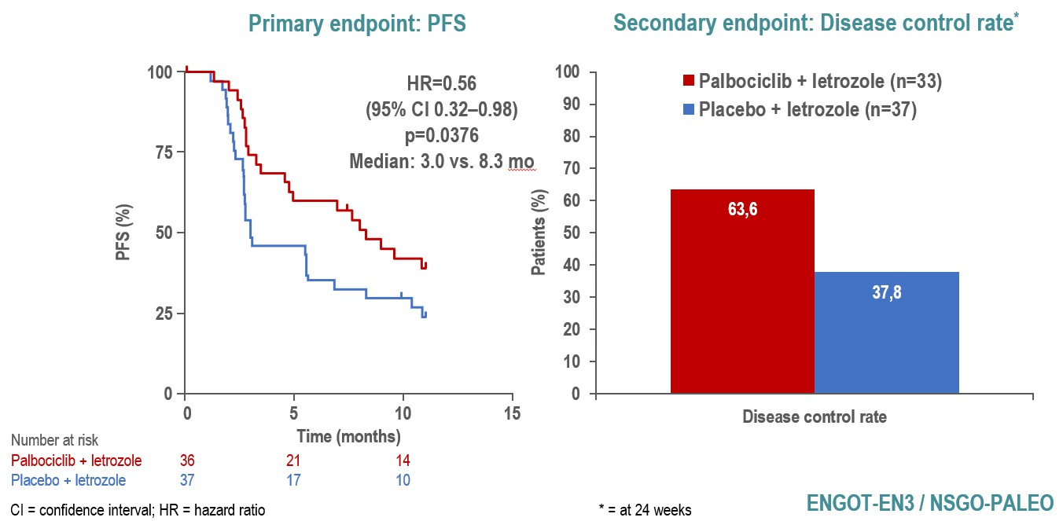
ENGOT-EN3/NSGO-PALEO
Endometrial Cancer
Randomization: 1:1
n = 78
ARM A
Letrozole, 2.5mg d 1-28 every 28 days Placebo 125mg d 1-21 every 28 days Until progression
Primary stage 4 or relapsed disease
ENGOT model: A Sponsor: NSGO-CTU Status: Trial closure
Last patient randomized: 21-12-2018
Total patient enrolled: 78 patients randomized
NSGO-CTU PM: Christel Johanneson Bertolt
ER positive endometrioid
adenocarcinoma
Randomize
ARM B
Letrozole, 2.5mg d 1-28 every 28 days Palbociclib 125mg d 1-21 every 28 days Until progression
Stratification:
Number of prior lines (primary adv disease vs. 1st relapse vs.
≥2 relapses)
Measurable vs. evaluable disease
Prior use of MPA/Megace
PFS and OS data presented by Mirza et al.,
oral presentation, ESMO 2020
CSR and manuscript writing is ongoing
Mirza et al. ESMO 2020

Slide 23

ENGOT-en17/GINECO/EQ132-303/GOG-3075
Grade 1 or Grade 2
Endometrioid
No prior therapy for metastatic disease
No prior endocrine therapy
Stage IVB or Stage III/IV with measurable disease
ECOG PS 0-1
n = 320
Letrozole 2.5 mg PO QD + Lerociclib 150 mg PO BID
R
1:1
Letrozole 2.5 mg PO QD + Placebo
Double-Blinded
Stratification variables:
Tumor Stage (III vs. IV vs. recurrent )
Tumor Grade (1 v. 2)
Geographic Location
Hazard ratio for PFS: 0.63
Significance level: 0.025 (1-sided)
Randomization ratio: 1:1
Median PFS in the control arm: 5 months
Targeted PFS in the experimental arm: 7.94 months
Primary endpoint: PFS by BICR Secondary endpoints: PFS by IA, OS, ORR, DoR, QoL, AEs

Slide 24
Potential Therapeutic Impact of TGCA Classification of Endometrial Cancer
 | POLE | MSI | Copy Number Low | Copy Number High
MSI/MLH methylation | Mixed MSI high, low, stable | MSI high | MSI stable | MSI stable
Molecular profile | POLE (100%) PTEN (94%) PIK3CA (71%) FBXW7 (82%) ARID1A (76%) KRAS (53%) PD1/PD-L1 overexpression | PTEN (88%) RPL22 (37%) KRAS (35%) PIK3CA (54%) ARID1A (37%) PD-1/PD-L1 overexpression | PTEN (77%) CTNNB1 (52%) PIK3CA (53%) ARID1A (42%) FGFR2 (10.9%) | TP53 (92%) PPP2R1A (22%) FBXW7 (22%) PIK3CA (47%) PTEN (11%) FGFR (7%) HER2 (25%)
Potential drugs | PI3K/PTEN/AKT/ mTOR pathway Anti-PD-1/PD-L1 Hormones | PI3K/PTEN/AKT/mTOR pathway Anti-PD-1/PD-L1 Hormones | PI3K/PTEN/AKT/mTOR pathway Hormones FGFR-I | HER2- I PI3K- I PARP-I Wee-1 I FGFR-I
Stelloo E, et al. Clin Cancer Res. 2016;22;4215-4224.
Notes:
[07:51]
References
Stelloo E, Nout RA, Osse EM, et al, Improved risk assessment by integrating molecular and clinicopathological factors in early-stage endometrial cancer—combined analysis of the PORTEC cohorts. Clin Cancer Res. 2016; 22;4215-4224.
Abbreviations:
MSI = microsatellite instability
POLE =
PD-1 =
PD-L1 =
PI3K =
PTEN =
PIK3CA =

Slide 25
Carboplatin/paclitaxel+/-Trastuzumab (NCT01367002)
Updated Survival analysis stage III/IV
PFS vs Trastuzumab, Advanced (IIIC or IV)
With Number of Subjects at Risk
Overall Survival vs Trastuzumab, Advanced (IIIC or IV)
With Number of Subjects at Risk
1.0
Censored
1.0
Censored
0.8
0.8
Proportion progression-free
0.6
Proportion Alive
0.6
0.4
0.4
0.2
0.2
0.0
No 17
Yes 19
0.0
No 17
Yes 19
4
14
3
7
3
5
3
4
3
2
2 0
0
13
19
8
14
3
7
3
6
3
4
2 0
0
17 4 3 3 3 3 2 0
19 14 7 5 4 2 0
17 13 8 3 3 3 2 0
19 19 14 7 6 4 0
0 12 24 36 48 60 72 84
Months since on-treatment date
Trastuzumab No Yes
0 12 24 36 48 60 72 84
Months from on-treatment date
Trastuzumab No Yes
Trastuzumab No Yes
Trastuzumab No Yes
In a subset analysis of pts restricted to stage IIIC/IV disease, the addition of trastuzumab (n=17) continued to provide both (left) PFS benefit over control (n=19) and OS benefit over control (21.1 versus 31.9 months, HR 0.440 90% CI 0.219-0.882 p=0.0230).
Amanda N. Fader et al.,J Clin Oncol. 2018 Jul 10;36(20):2044-2051
Amanda N. Fader et al. , JCO 2020

Slide 26
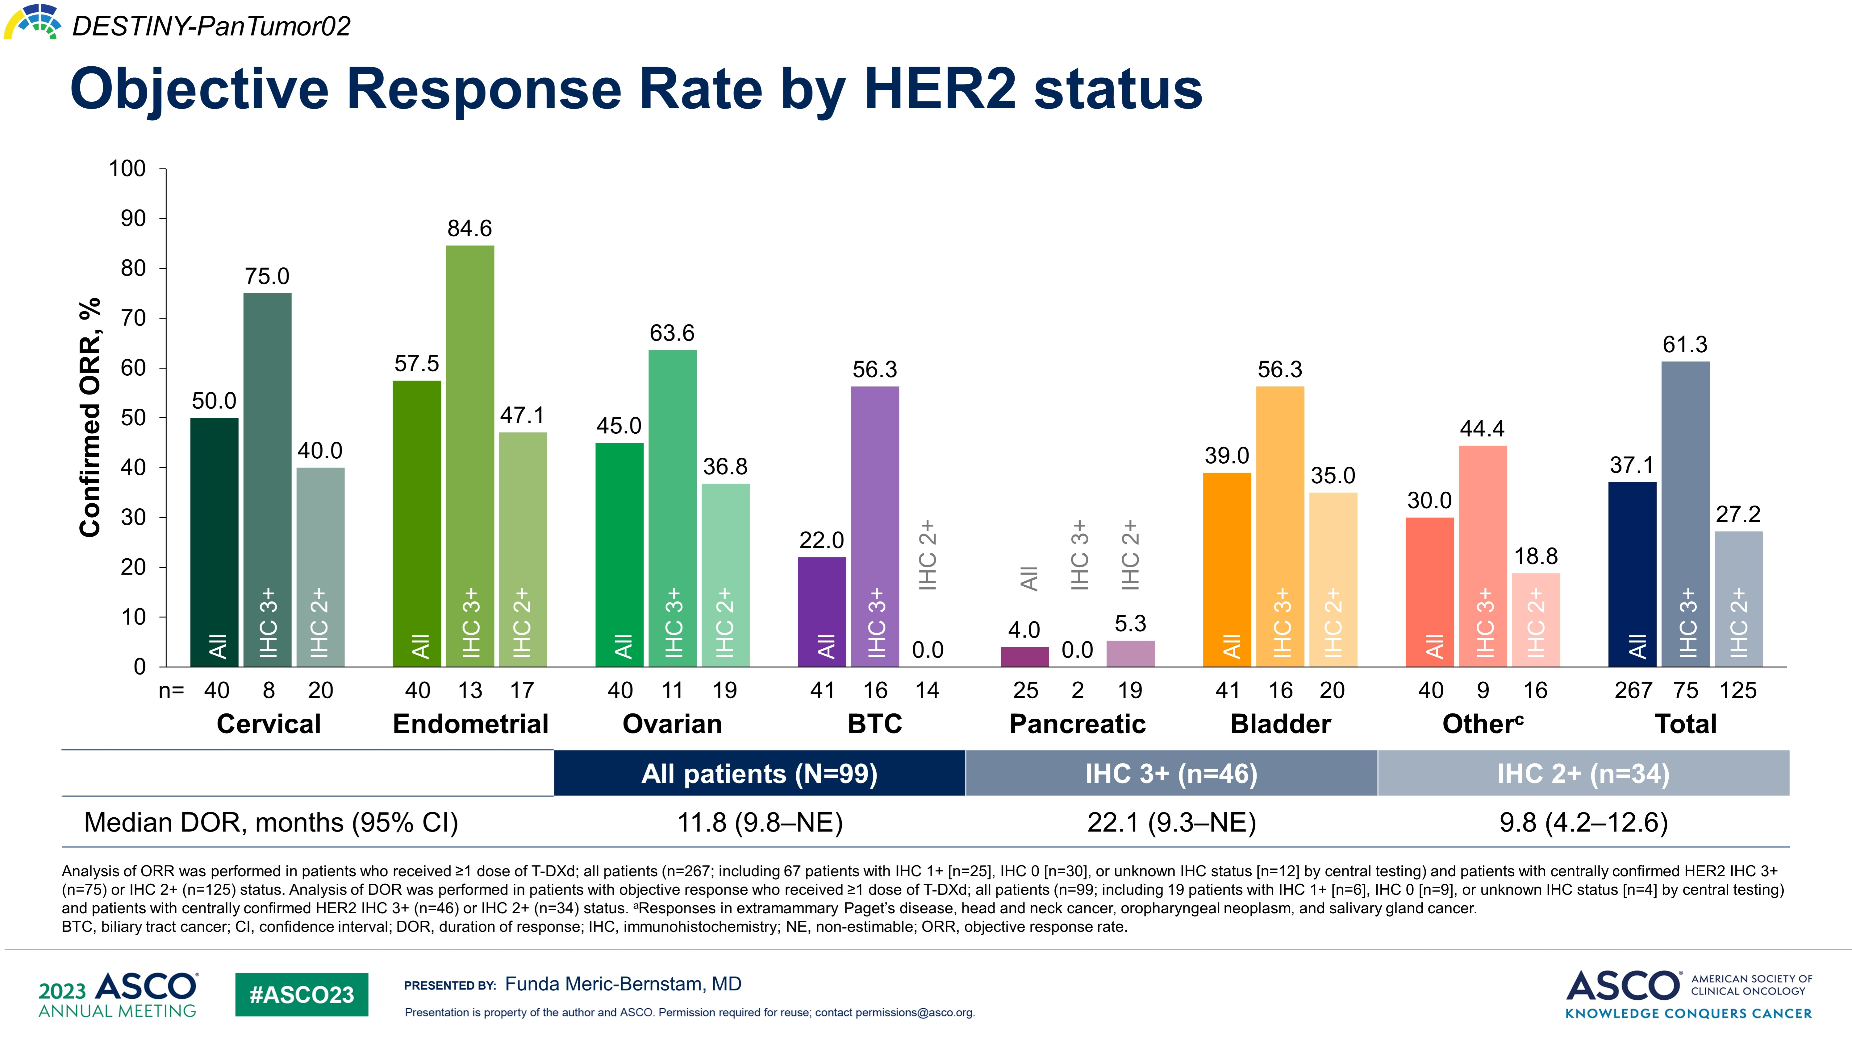
Objective Response Rate by HER2 status
Trastuzumab Deruxtecan
Content of this presentation is the property of the author, licensed by ASCO. Permission required for reuse.

Slide 27
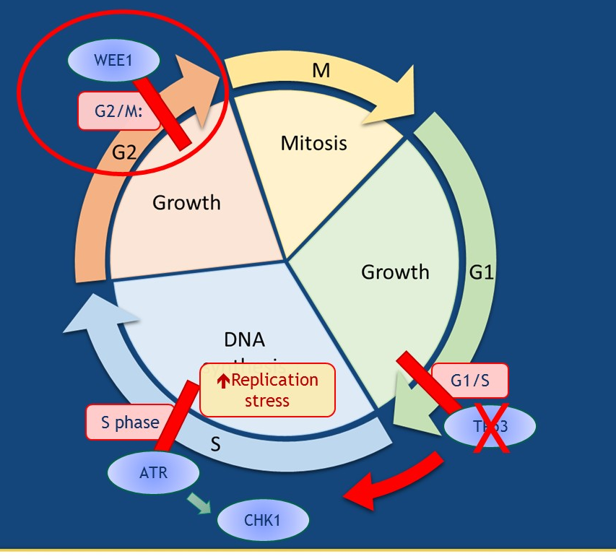
Adavosertib (AZD1775) inhibits WEE1 and may be most active in p53-mutant background
Cell cycle checkpoints slow down the cell cycle
Allow time for appropriate DNA replication
Prevent progression to mitosis with DNA damage or underreplicated DNA
Cells with TP 53 mutation/loss lose their G1/S checkpoint
Leads to early entry into S phase
Increases replication stress
Increases dependency on the G2/M checkpoint
WEE1 is a Key regulator of G2/M checkpoint
WEE1 inhibition leads to disregulation of the G2/M checkpoint and to mitotic catastrophy
Adavosertib | C27H32N8O2 - PubChem (nih.gov)

Slide 28

Deep and sustained responses were observed in some patients
ADAGIO: Adavosertib in previously platinum treated endometrial cancer
Depth of response by BICR
Adavosertib 300 mg qd
ORR, n (%) † (95% CI) | 27 (26.0) (17.9–35.5)
Disease control rate, n (%)‡ (95% CI) | 56 (51.4) (41.6–61.1)
†
†
†
†
†
†
Best change from baseline in target lesion size (%)
BOR
Complete response
Partial response
Stable disease
Progressive disease
Not evaluable
†Indicates an imputed value; *Indicates progression due to non-target and/or new lesions
BICR, blinded independent central review; BOR, best overall response; qd, once daily

Slide 29
The most common treatment-related serious adverse events were neutropenia and sepsis
Total adavosertib 300 mg qd (N=109) | Number of patients (%) | Number of patients (%)
Total adavosertib 300 mg QD (N=109) | Grade 2 | Grade 3 | Grade 4 | Grade 5 | All
Neutropenia | 1 (0.9) | 0 | 7 (6.4) | 0 | 8 (7.3)
Sepsis | 0 | 0 | 4 (3.7)* | 1 (0.9) | 5 (4.6)
Vomiting | 1 (0.9) | 3 (2.8) | 0 | 0 | 4 (3.7)
Diarrhea | 0 | 3 (2.8) | 0 | 0 | 3 (2.8)
………while Wee1 inhibition results in antitumor activity and may remain a viable treatment target, the therapeutic window for adavosertib is narrow
Treatment-related serious adverse events recorded in ≥2% of patients are shown
*One patient had sepsis that was not associated with neutropenia/neutrophil count decrease
qd, once daily

Slide 30

P53: the other face of the coin

Slide 31
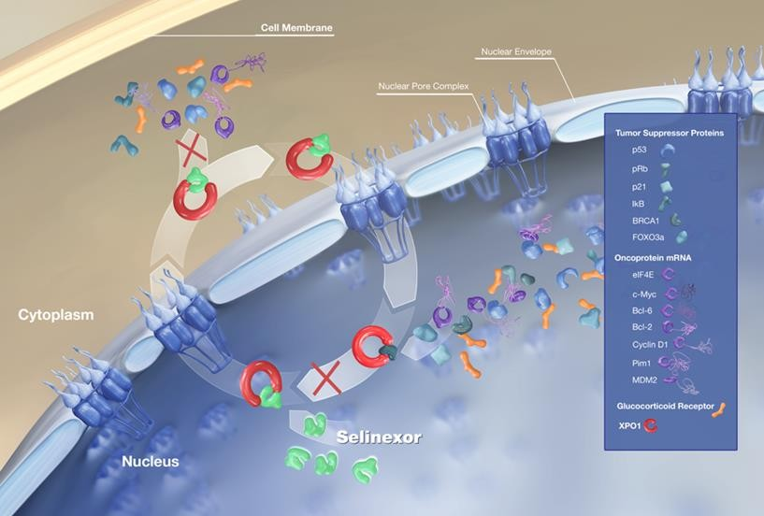
Selinexor: XPO1 inhibition
Exportin 1 (XPO1) is the major nuclear export protein for:¹
Tumor suppressor proteins (TSPs, e.g., p53, IkB, PTEN, and FOXO1)
Inhibition of XPO1 results in:¹
The increase in nuclear levels and activation
of TSPs
Reduction of oncoprotein levels
Selinexor is an oral selective XPO1 inhibitor
Preclinical data for selinexor:²
Reactivates multiple TSPs, including p53 wild
type, by preventing nuclear export
Fung HY, Chook YM. Atomic basis of CRM1-cargo recognition, release and inhibition. Semin Cancer Biol. 2014;27:52–61.
Tai YT, Landesman Y, Acharya C, et al. CRM1 inhibition induces tumor cell cytotoxicity and impairs osteoclastogenesis in multiple myeloma: molecular mechanisms and therapeutic implications. Leukemia. 2014;28(1):155–165.

Slide 32
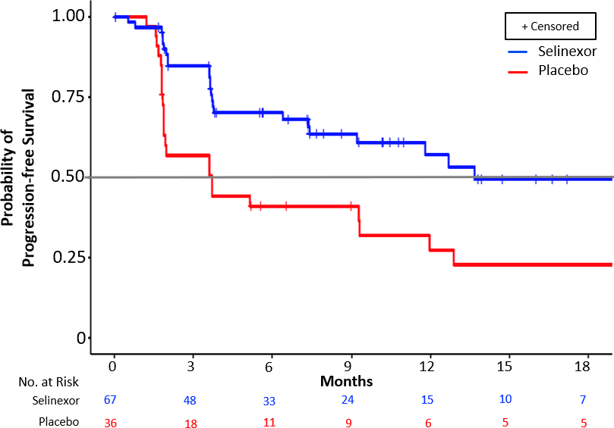

ENGOT-EN5/GOG-3055/SIENDO
SUBGROUP PFS: PATIENTS WITH WILD TYPE p53 EC
(BASED ON AUDITED STRATIFICATION FACTORS)
Median PFS
Selinexor (n=67): 13.7 mo (95% CI 9.20-NR) Placebo (n=36): 3.7 mo (95% CI 1.87-12.88)
HR (audited) = 0.375 (95% CI 0.210-0.670)
One-sided nominal P value = 0.0003
Vergote…..Mirza et al. SGO 2022
26
©2022 Karyopharm Therapeutics Inc. | Confidential & Proprietary
©️ M R Mirza

Slide 33
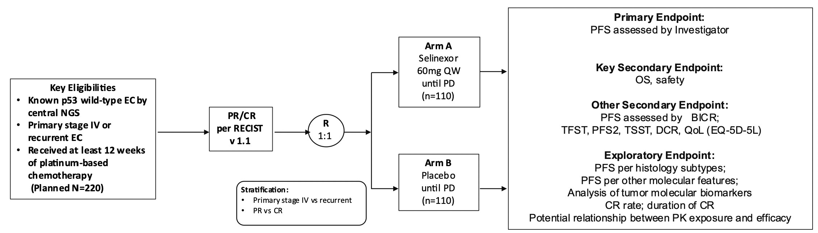
ENGOT-EN20 / XPORT
Vergote et al.
©2022 Karyopharm Therapeutics Inc. | Confidential & Proprietary
27
©️ M R Mirza

Slide 34

The perfect match : the prince

Slide 35
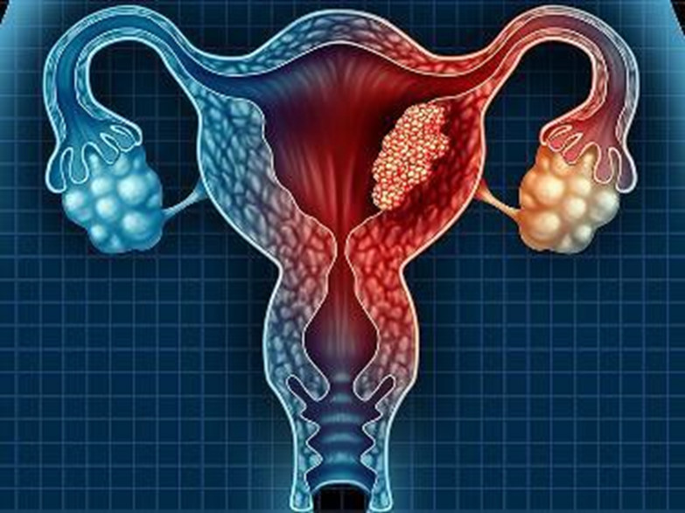
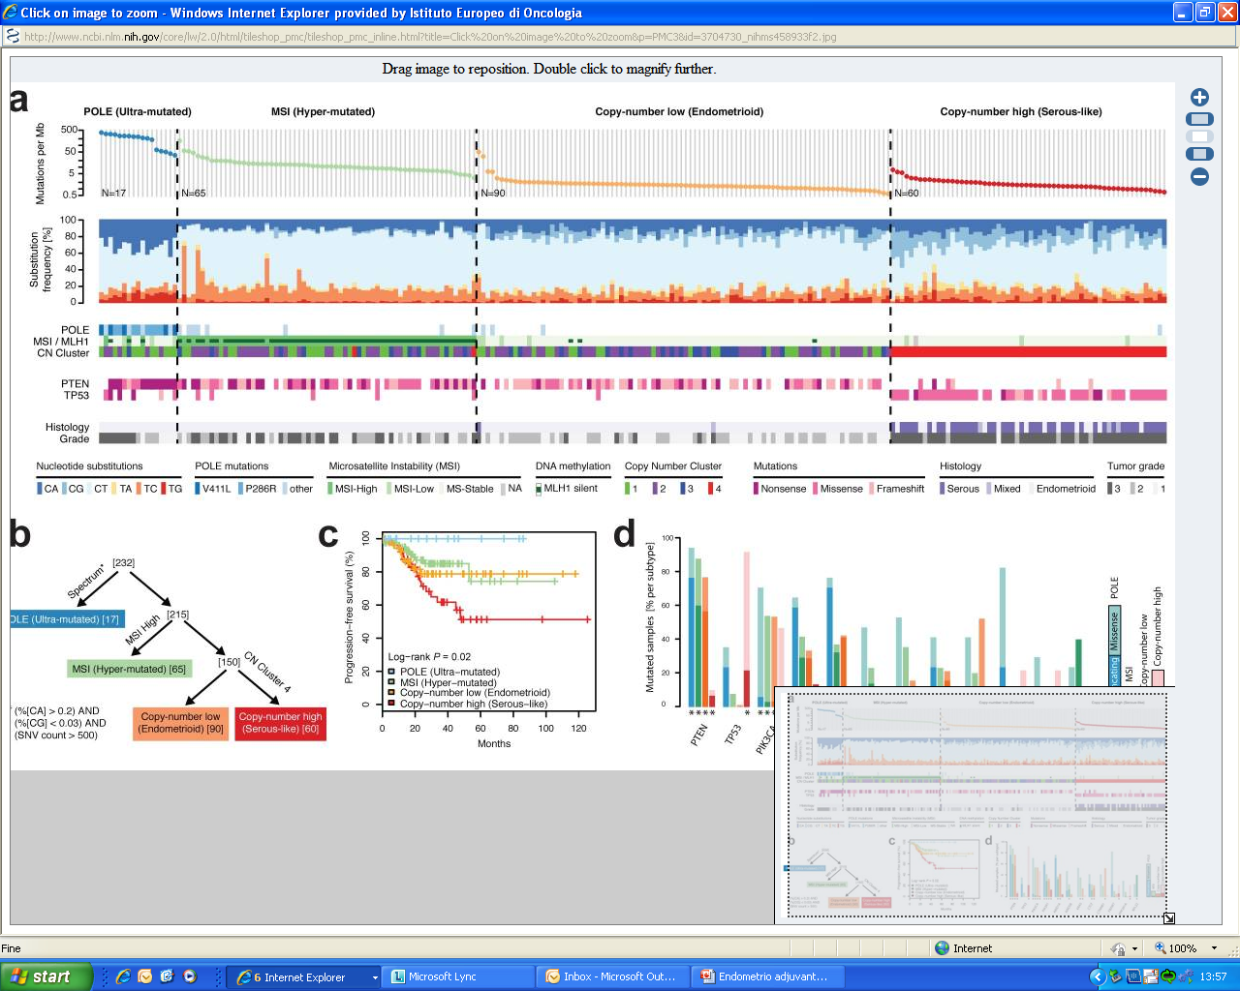
Endometrial carcinoma
Integrated Genomic Characterization of Endometrial Carcinoma
The Cancer Genome Atlas Research Network
Hot tumors
Good Response to Immunotherapy
Hot tumors
Good Response to Immunotherapy
Cold tumors
Poor Response to Immunotherapy
Nature. May 2,2013;497(7447): 67-73
Notes:
Strong evidence of the hetrogeneity of EC with respect to their biological, genetic and pathological features
DNA polymerae epsilon (POLE E) ultramutated group, characterized by very high mutation rate and few copy number aberrations
Microsatellite instable hypermutated group, characterized by microsatellite instability due to MLH1 promoter methylation, high mutation rates , few copy number aberrations
Copy number low ( endometrioid) omprising microsatellite stable grade 1 and 2 endometrioid tumors with low mutation rates and few copy numeber aberrations
Copy number high ( serous –like) characterized by extensive copy number aberrations and low mutation rates
Strong prognosis impact

Slide 36
Garnett study: ORR in dMMR: 45.5%
Probability of Survival: dMMR/MSI-H
Estimated probability of OS at
12 mo – 73.3% (65.2 – 79.8)
24 mo – 60.5% (51.5 – 68.4)
1.0
0.9
Estimated % probability of OS
12 mo
73.3% (65.2%–79.8%)
24 mo
60.5% (51.5%–68.4%)
0.8
0.7
0.6
0.5
Probability of overall survival
Median OS
NR (27.1–NR)
0.4
0.3
0.2
0.1
0.0
Censored
0
4
8
12
16
20
24
28
32
36
40
44
48
52
56
Time since start of study treatment (months)
Number of patients at risk
dMMR/MSI-H EC
153
132
112
95
84
70
60
52
38
32
22
13
5
0
0
dMMR, mismatch repair deficient; EC, endometrial cancer; MSI-H, microsatellite instability–high; NR, not reached; OS, overall survival.
Ana Oaknin, ASCO 2022

Slide 37


Dancing with the prince will be enough to become princess ?

Slide 38
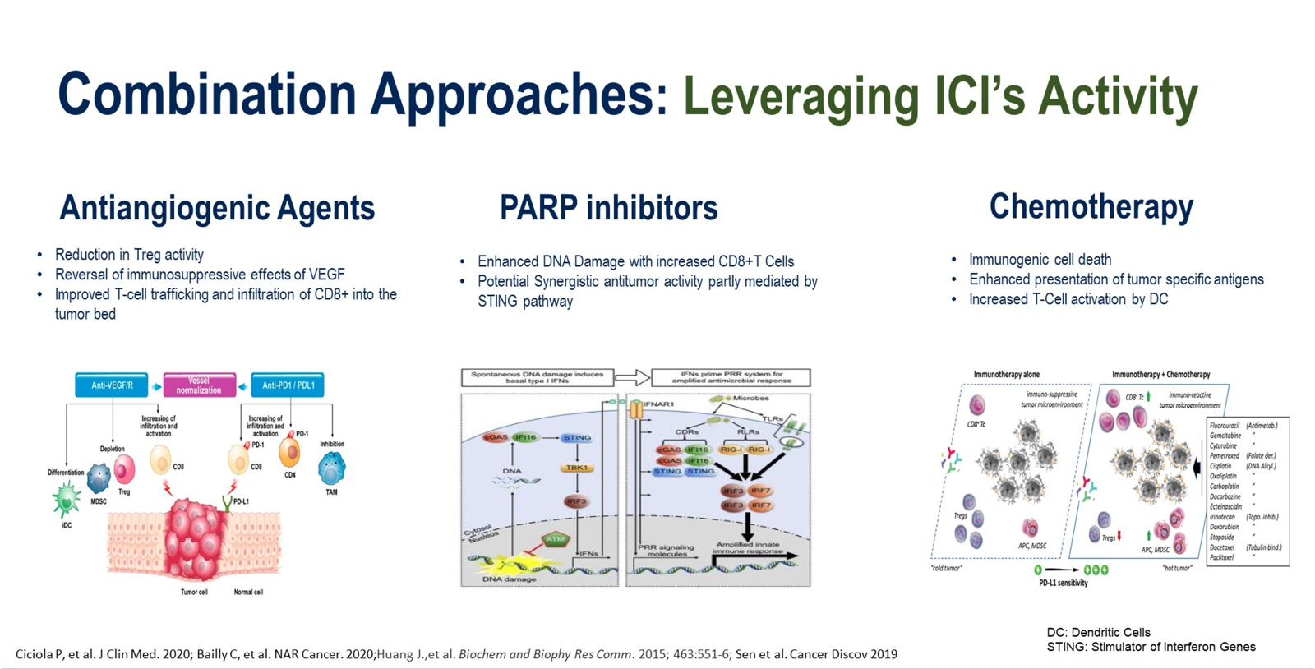

Slide 39
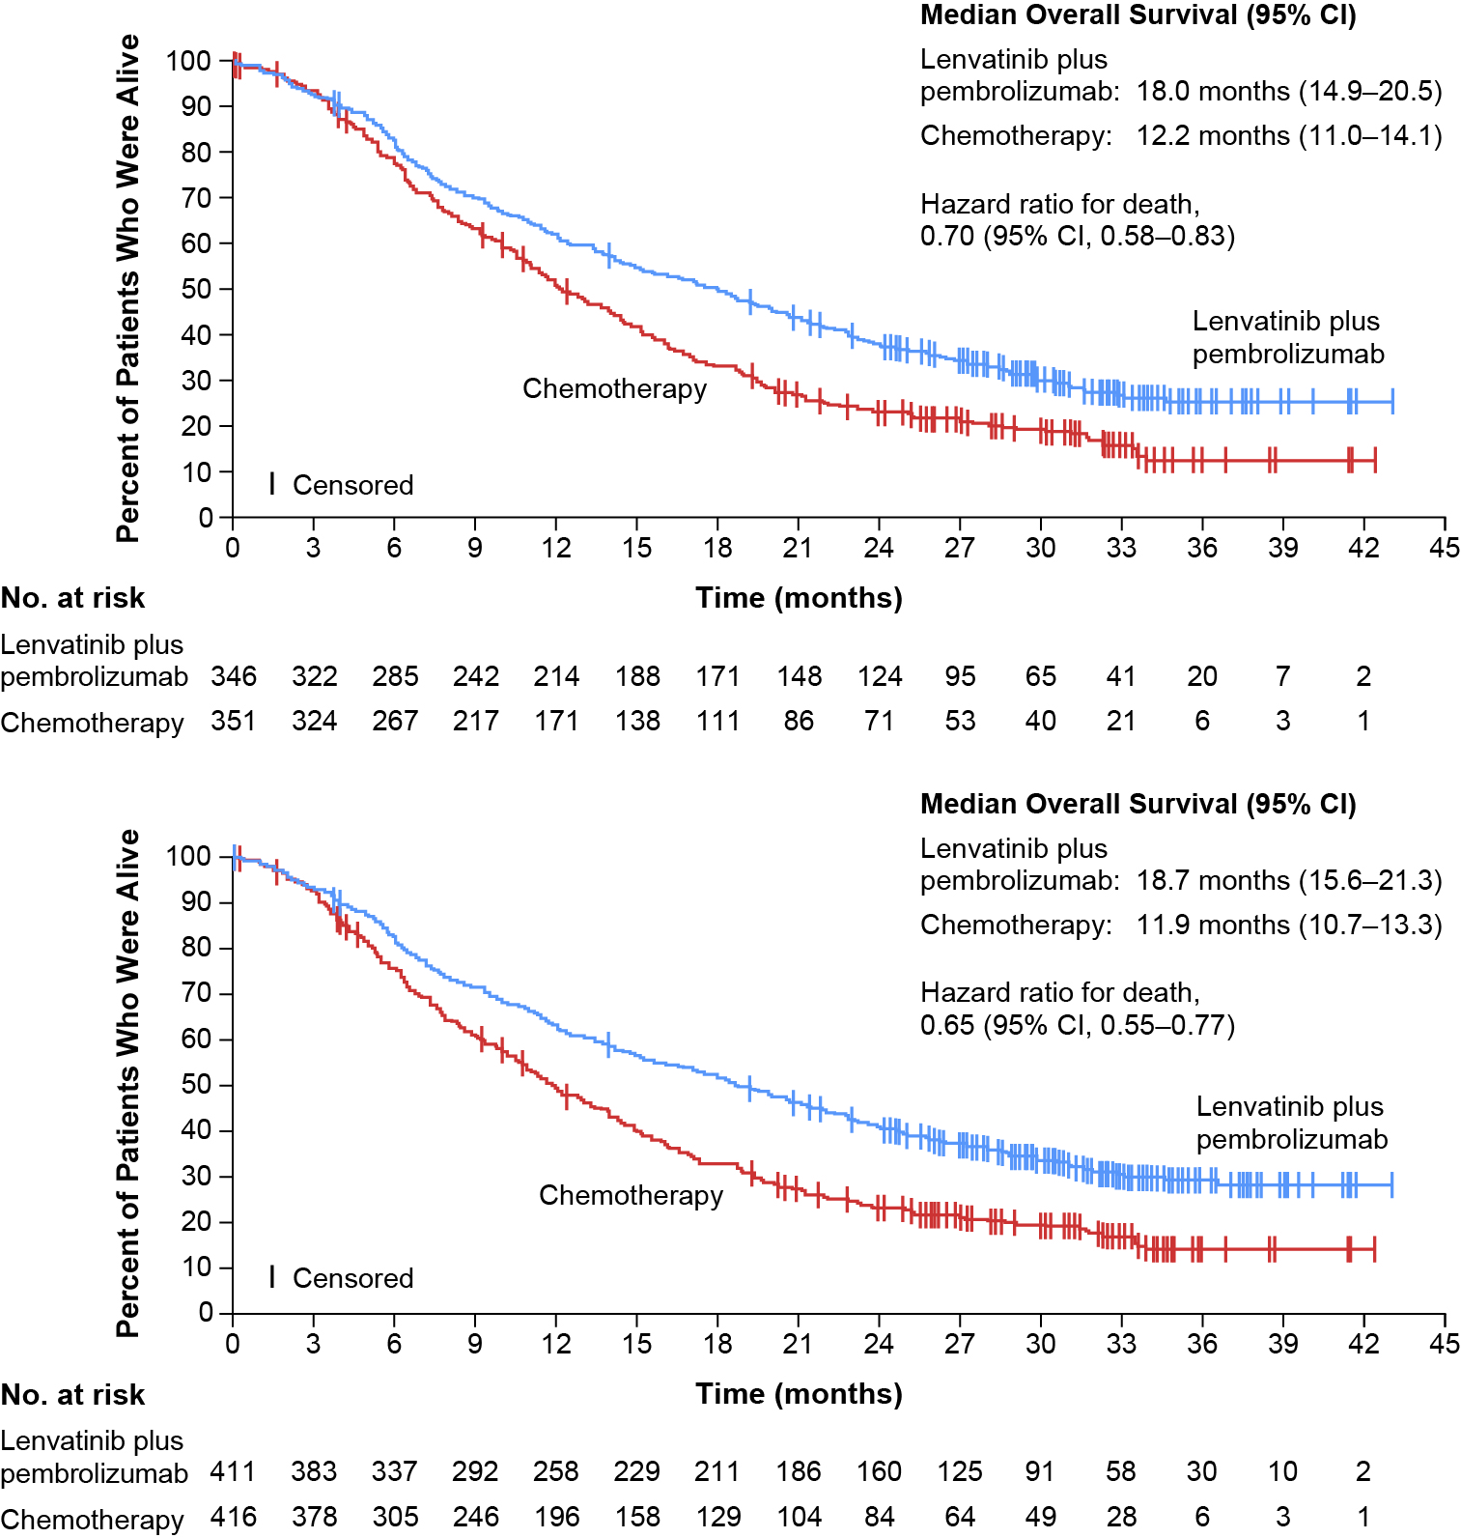
Continued OS benefit of lenvatinib plus pembrolizumab vs chemotherapy with follow-up extended by over 16 months
pMMR Population
All-Comer Population
OS favored lenvatinib plus pembrolizumab despite some pts in the chemotherapy arm receiving subsequent lenvatinib plus pembrolizumab.
In the chemotherapy arm, 10.0% of pts in the pMMR population and 8.7% of pts in the all-comer population received subsequent lenvatinib plus pembrolizumab.
After excluding these pts, the pMMR OS HR was 0.64 (95% CI, 0.54, 0.76); the all-comer OS HR was 0.60 (95% CI, 0.51, 0.71).
Vicky Makker, MD, ESMO 2022

Slide 40
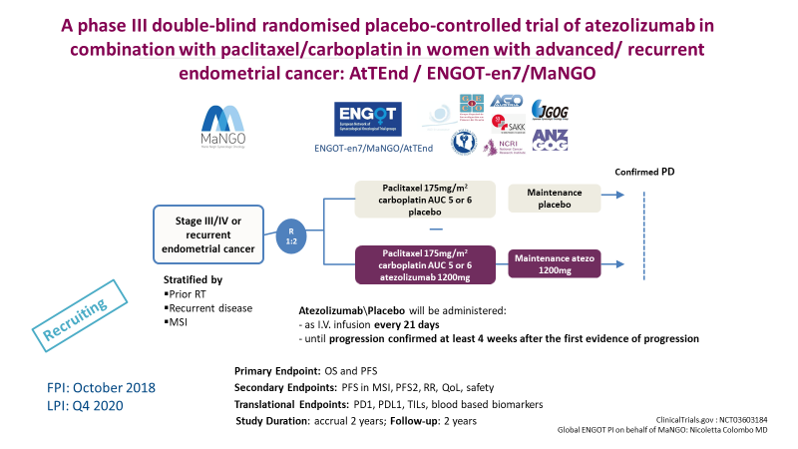
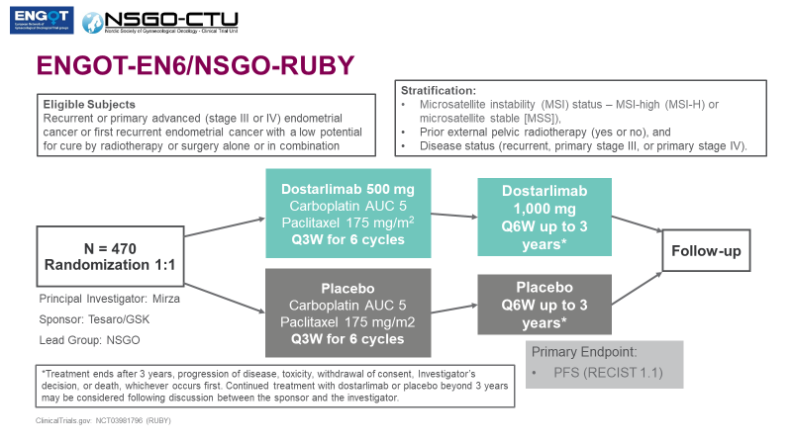
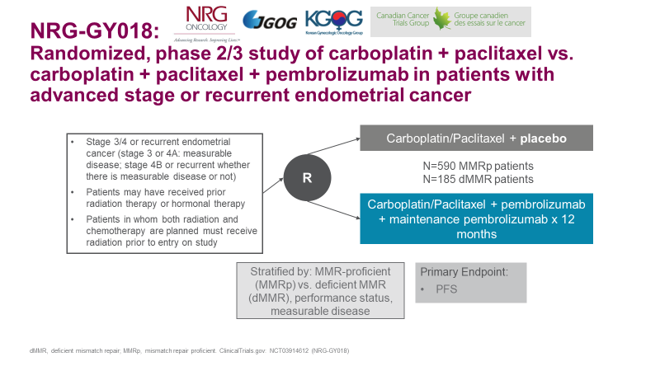
Will Chemotherapy +ICIs replace chemotherapy alone in all comers?

Slide 41

RUBY Primary Endpoint: PFS in dMMR/MSI-H Population
1.0
0.8
63.5%
HR 0.28
(95% CI, 0.162–0.495)
P<0.0001
61.4%
Dostarlimab + CP
0.6
Probability of Progression-free Survival
0.4
0.2
 | No. with event (%) | Median (95%CI), (mo)
Dostarlimab + CP | 35.8 | NE (11.8–NE)
Placebo + CP | 72.3 | 7.7 (5.6–9.7)
PFS maturity | 55.9
24.4%
15.7%
Placebo + CP
0.0
Censored
0
2
4
6
8
10
12
14
16
18
20
22
24
26
28
30
32
34
36
38
Chemotherapy Period
Months from Randomization
At Risk (Events)
Dostarlimab + CP
53(0) | 48(3) | 44(6) | 39(10) | 34(15) | 31(17) | 30(18) | 29(19) | 28(19) | 27(19) | 25(19) | 19(19) | 13(19) | 9(19) | 9(19) | 4(19) | 1(19) | 0(19)
65(0) | 57(4) | 54(7) | 34(24) | 26(32) | 14(41) | 12(43) | 12(43) | 11(44) | 8(46) | 8(46) | 7(47) | 4(47) | 3(47) | 3(47) | 2(47) | 1(47) | 0(47)
Placebo + CP
CP, carboplatin/paclitaxel; dMMR, mismatch repair deficient; HR, hazard ratio; MSI-H, microsatellite instability-high; NE, not estimable; PFS, progression-free survival.
Median duration of follow-up 24.79 months.
ENGOT-EN6-NSGO/GOG-3031/RUBY presented by Mansoor R Mirza at SGO 2023
NEJM 2023
Content of this presentation is copyright and responsibility of the author.
Permission is required for re-use.

Slide 42
RUBY Primary Endpoint: PFS in Overall Population
1.0
0.8
HR 0.64
(95% CI, 0.507–0.800)
P<0.0001
0.6
48.2%
Probability of Progression-free Survival
0.4
36.1%
Dostarlimab + CP
0.2
29.0%
 | No. with event (%) | Median (95%CI), (mo)
Dostarlimab + CP | 55.1 | 11.8 (9.6–17.1)
Placebo + CP | 71.1 | 7.9 (7.6–9.5)
PFS maturity | 63.2
18.1%
Placebo + CP
0.0
Censored
0
2
4
6
8
10
12
14
16
18
20
22
24
26
28
30
32
34
36
38
Chemotherapy Period
Months from Randomization
At Risk (Events)
Dostarlimab + CP
245(0) | 220(12) | 197(25) | 157(55) | 130(80) | 105(103) | 94(110) | 90(113) | 84(118) | 78(122) | 66(127) | 52(128) | 34(131) | 23(132) | 12(133) | 22(132) | 2(134) | 0(135)
249(0) | 219(14) | 200(29) | 144(77) | 103(115) | 74(141) | 59(155) | 57(157) | 48(166) | 42(170) | 39(170) | 32(172) | 20(175) | 14(176) | 13(176) | 5(177) | 2(177) | 1(177) | 1(177) | 0(177)
Placebo + CP
CP, carboplatin/paclitaxel; HR, hazard ratio; PFS, progression-free survival.
Median duration of follow-up 25.38 months.
ENGOT-EN6-NSGO/GOG-3031/RUBY presented by Mansoor R Mirza at SGO 2023
NEJM 2023
Content of this presentation is copyright and responsibility of the author.
Permission is required for re-use.

Slide 43
PFS per RECIST v1.1: dMMR Population
NRG-GY018 (NCT03914612)
Events,
n/N
Median
(95% CI), mo
HR (stratified; 95% CI)
100
Pembro + CT
26/112
NR (30.6–NR)
0.30 (0.19–0.48)
P = <0.00001
Proportion Alive and Progression-Free
90
Placebo + CT
59/113
7.6 (6.4–9.9)
80
74%
70
60
50
40
38%
30
20
10
0
0
6
12
18 24
Months from Randomization
30
36
42
Number at Risk (Cumulative number censored)
Placebo + CT | 113 (2) | 62 (24) | 24 (35) | 8 (47) | 4 (51) | 2 (52) | 0 (54)
Pembro + CT | 112 (1) | 80 (22) | 44 (46) | 22 (65) | 9 (78) | 8 (79) | 2 (84) | 0 (86)
Eskander, SGO 2023; NEJM 2023
Data cutoff date: December 16, 2022.

Slide 44
PFS per RECIST v1.1: pMMR Population
NRG-GY018 (NCT03914612)
100
90
80
70
60
50
40
30
20
10
0
 | Events, n/N | Median (95% CI), mo | HR (stratified; 95% CI)
Pembro + CT | 89/290 | 13.1 (10.5–18.8) | 0.54 (0.41–0.71) P < 0.00001
Placebo + CT | 133/292 | 8.7 (8.4–10.7)
Proportion Alive and Progression-Free
0
6
12
18 24
Months from Randomization
30
36
42
Number at Risk (Cumulative number censored)
Placebo + CT | 292 (14) | 129 (115) | 33 (141) | 10 (152) | 2 (157) | 1 (158) | 0 (159)
Pembro + CT | 290 (15) | 150 (112) | 45 (167) | 20 (185) | 7 (195) | 3 (198) | 0 (201)
Eskander, SGO 2023; NEJM 2023

Slide 45

Yes, Cinderella has become a princess !!!!

Slide 46




Endometrial cancer has become a princess because encountered not one but two princes

Slide 47

Will Cinderella( endometrial cancer) become a queen?

Slide 48
Endometrial Cancer: when will it become queen?
Role of immunotherapy in the early setting (neoadjuvant/ adjuvant setting)?
WILL ICIs replace chemotherapy in the front line setting of dMMR EC ?
Will Chemotherapy +ICIs replace chemotherapy alone in p-MMR?
Will pembrolizumab-Lenvatinib replace chemotherapy in front line? (For all, only for MSS? )
Will the addition of PARP-inhibitors improve outcome?
How to identify the bad d-MMR and the good pMMR ?
New drugs/ combinations for pMMR?
How to treat after ICI failure?

Slide 49

Cinderella became a queen in her live-action remake.
This is due to the fact that it was evidently shown that the throne was passed to Charming after his father died, and Cinderella married him as King.
By the way….

