Slide 1


ENGAGe-ENGOT Clinical Trials Project
Birthe Lemley working with Prof. Jalid Sehouli from ENGOT
The working group:
Charo Hierro, president of ASACO, Spain
Maria Papageorgiou, president of K.E.F.I. Greece
Janni Zmylon, member of KIU Denmark
20 patients from 12 different European countries representing the diseases cervical cancer, endometrial cancer, ovarian cancer, and rare cancers.

Slide 2
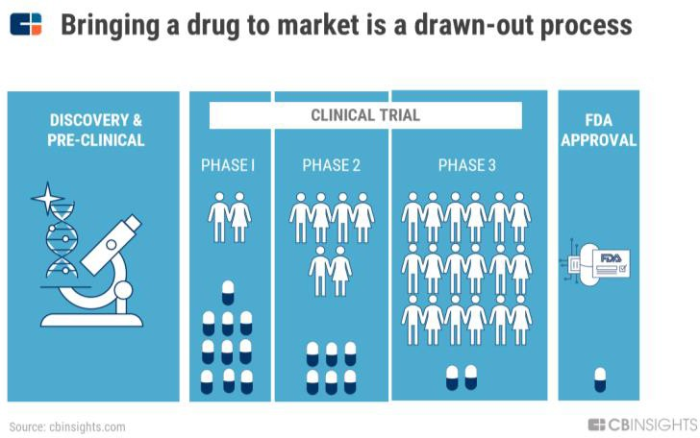
ENGAGe-ENGOT Clinical Trials Project
The 3 webinars from September 2, 2019
  Terminology in a clinical trial – Eduardo Alvarez, Clínica Universidad de Navarra
  Study methodology – single arm, dual arm, prospective, retrospective – Mansoor Mirza, Rigshospitalet
  Informed consent, PRO (Patient Reported Outcome), side effects - Kristina Lindemann, Oslo University Hospital
In 2021 an example of an actual trial - the PRIMA trial was chosen
Understanding a clinical trial regardless of the disease
The various steps in a trial and the terminology in a study
Presentation of the trial by the prime investigator Prof. Antonio González Martín, Clínica Universidad de Navarra

Slide 3

ENGAGe-ENGOT Clinical Trials Project
Educational materials so far:
3 Webinars on September 2, 2019
Report and summary of the webinars called the ‘Study book’
5 Webinars in the spring of 2021 – example the PRIMA trial.
Report and summary of the webinars called Study book 2
1 webinar on endometriel cancer in the autumn of 2021 (the Ruby trial)
Test for all participants – autumn of 2021
15 patients out of 20 have now received a certificate

Slide 4

ENGAGe-ENGOT Clinical Trials Project
Plans for 2022
1 webinar on genetics – personalized medicine
1 webinar on cervical cancer
1 webinar on explaining the content of a study protocol
Face-to-face meeting in Berlin August 20-21

Slide 5


ENGAGe-ENGOT Clinical Trials Project

Slide 6
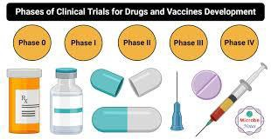
ENGAGe-ENGOT Clinical Trials Project
Patient perspective and insight on:
- Method of treatment – IV, capsules, tablets etc.
Questionnaires on QoL and side effects
Patient Reported Outcome (PRO)
Instrumental in:
Spreading the word about recruitment
Dissemination of the outcome of the trial
Approval of the drug in the various countries
Cross-border participation in clinical studies?

Slide 7

ENGAGe-ENGOT Clinical Trials Project
Course certificate
Advertise on ESGO ENGAGE and ENGOT websites that such a group of patients exist at ENGAGe
Who can use such a service?
ESGO, ENGOT, EORTC and other organisations
HTA (Health Technology Assessment) bodies
EMA
Foundations as a ‘patient reviewer’
Pharmaceutical companies
Surveys, consensus statements, as co-authors in articles in medical journals

Slide 8

ENGAGe-ENGOT Clinical Trials Project
https://engage.esgo.org/for-members/ct-project-participant/
Webinars
https://engage.esgo.org/for-members/ct-project-participant/webinars/
Study materials
https://engage.esgo.org/for-members/ct-project-participant/study-materials/
Examples of clinical trials supplied by pharma
Links to ENGOT ongoing clinical trials:
https://engot.esgo.org/clinical-trials/current-clinical-trials/ovarian/
https://engot.esgo.org/clinical-trials/current-clinical-trials/endometrial/
https://engot.esgo.org/clinical-trials/current-clinical-trials/cervial/
https://engot.esgo.org/clinical-trials/current-clinical-trials/vulvar/
https://engot.esgo.org/clinical-trials/current-clinical-trials/translational/
https://engot.esgo.org/clinical-trials/current-clinical-trials/basket/
Link to ENGOT closed clinical trials:
https://engot.esgo.org/clinical-trials/publications/

