Slide 1
Braiding Together Evidence, Equity & Advocacy for Cervical Cancer Prevention
Linda O Eckert, MD
Professor, Obstetrics & Gynecology
Adjunct Professor, Global Health
eckert@uw.edu
drlindaeckert.com
@drlindaeckert

Slide 2
32 years seeing patients: Prof in Ob/Gyn with ID Training
Researcher, published >80 papers, wrote chapters, etc
15 years as a WHO consultant: HPV Vaccine and Cx Ca Guidelines

Slide 3
Who Am I?
Everywhere I have seen women with advanced cervical cancer
Finally – in 2018, I reached point of “Enough” – seen enough. And we have enough.
Wrote book published in January: using the power of story
Survivor’s stories from 6 continents
Everyday language to talk about this preventable cancer
Tackles stigma, patriarchy, equity, supply economics, etc.

Slide 4
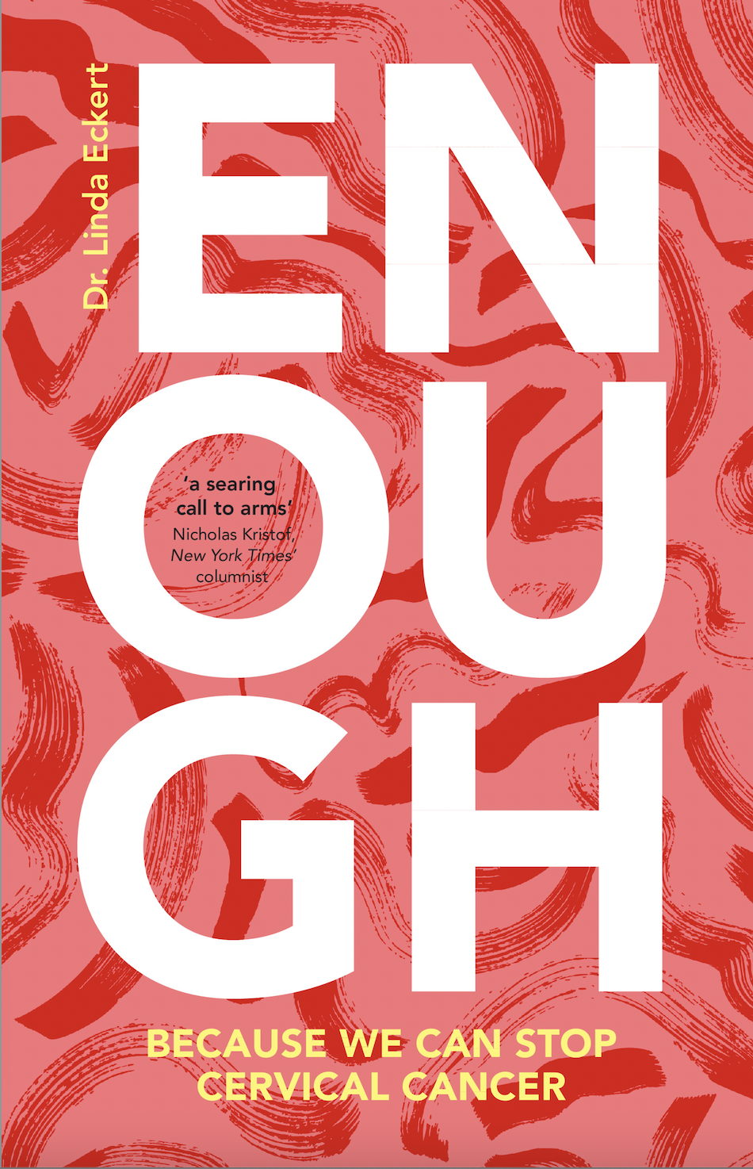
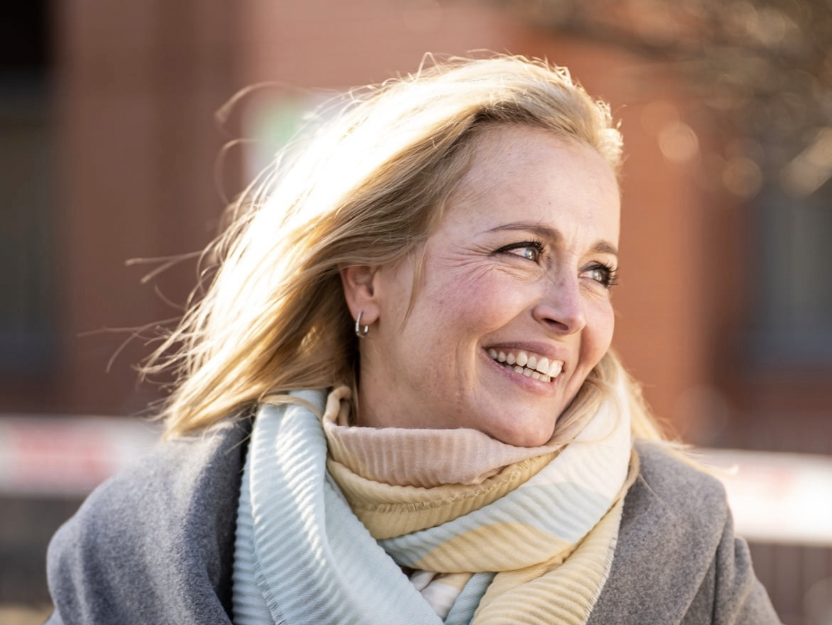
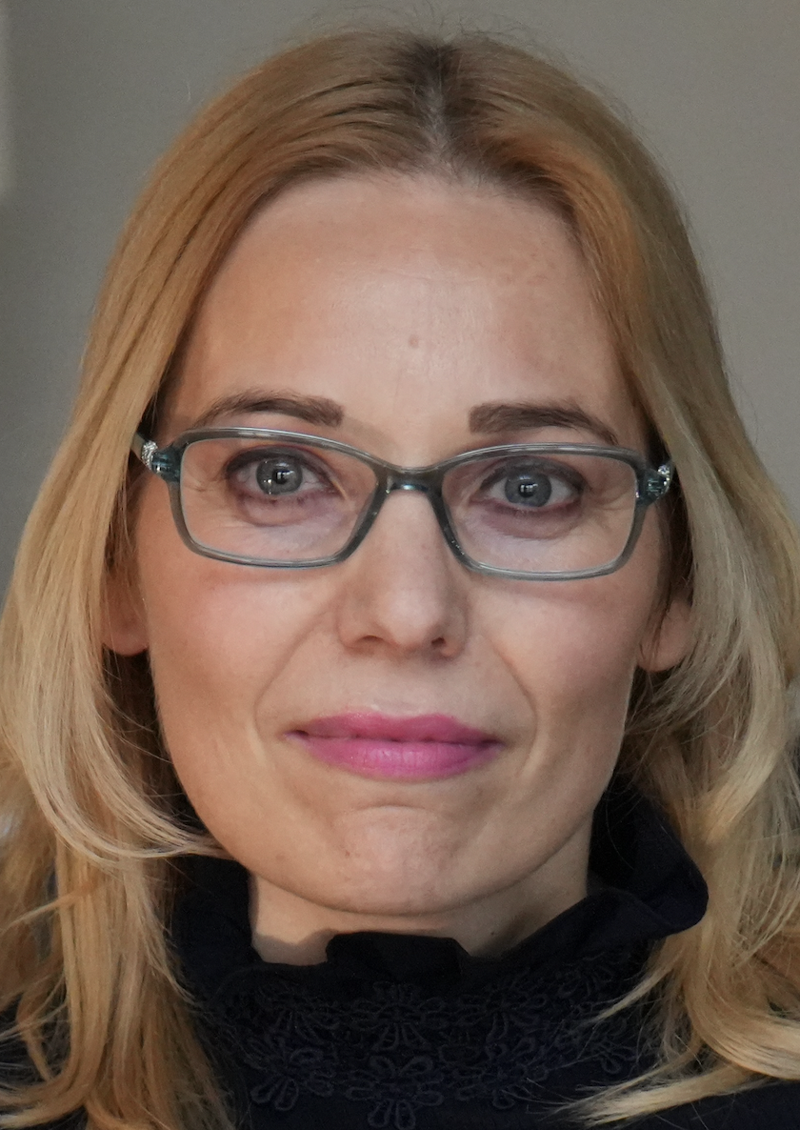

Slide 5
Partner with Advocates
Combining Data with Stories and
Advocacy IMPACT
All of us have a story, and all of us can be advocates
We just need to be open to the circles where we already are!
And, we just never know what will happen!!
You are having a great day of updates today- which is awesome- and also grounding your super-powers: collaboration and community!
Challenge us all to think of where our advocacy can go

Slide 6
Where to Go: Road to Advocacy
Advocacy via Community can lead to policy change
USA: Act Up, HIV/AIDs advocacy in 1980’s
FDA changed clinical trial policy
trial HIV drug pricing changed
Ireland: Story of Savita Halappanavar’s death in 2012
Led to step wise changes in policy
Constitutional Amendment for change in Reproductive Health Policy in 2018
https://www.history.com/news/act-up-aids-patient-rights
https://www.usnews.com/news/best-countries/articles/2022-06-27/the-story-behind-irelands-abortion-ban-and-its-reversal

Slide 7
Story to Combat intangibles
Again- as you think about the technical information you will be hearing –Hold onto the ideas of combining story with technical information to combat
Stigma
Access challenges
Inequity
Language
Knowledge
And that lessening cancer deaths is an intergenerational gift!

Slide 8
CervIcal cancer: Intergenerational impact
Without the mother: ¹⁻³
Increased anxiety & depression
Marry younger
Less likely to complete education
Get less health care
Generational poverty
Utilizing cancer mortality and fertility data, estimated number of orphans from cancer
In 2020: 1,047,000 orphans from maternal cancer
20% (n=210,000) from cervical cancer
25% (n=258,000) from breast cancer
27 yo colleague’s story– now parenting 6
Ellis J, Dowrick C, Lloyd-Williams M. J R Soc Med. 2013 Feb; 106(2): 57-67. doi: 10.1177/0141076812472623
Sundstrom K, Bencina G, Andersson M, Salomonsson S, Fang F, Wang J. Annals of Oncology. Vol 34, S2, S539, October 2023. DOI: https://doi.org/10.1016/j.annonc.2023.09.1988
Singhrao R, Huchko M, Yamey G. PLoS Med, 2013 Aug: 10(8): e1001499. doi: 10.1371/journal.pmed.1001499

Slide 9
CervIcal cancer: Intergenerational impact

Slide 10
It’s Cost Effectiveness
OXFAM estimates:
women’s contributions to families, communities, and countries measure well above 10.8 trillion USD,
more than three times the size of the global tech industry.¹
WHO health economy team²:
For lower income countries:
Each dollar spent on screening through 2050: $3.20 to the economy based on work force earnings
Add in unpaid labor: $26 dollars returned to economy for each dollar spent.
26:1 return!!!
¹https://www.oxfam.org/en/not-all-gaps-are-created-equal-true-value-care-work#:~:text=They%20carry%20out%2012.5%20billion,of%20the%20global%20tech%20industry. Accessed 10 Dec, 2023
²WHO: Global Strategy to Aceelerate the Elimination of Cervical Cancer as a Public Heatlh Problem. WHO, 17 Nov 2020. Global Strategy.

Slide 11
Cervical Cancer: Preventable
We already have the “Moonshot” for this cancer
It’s preventable:
We know what causes it,
how to find it,
how to treat it
even have a vaccine
YET DEADLY
Globally – kills a woman every 90 seconds
In US kills once every two hours
In UK kills once every 12 hours (3200 cases/year)
662,000 global cases in 2022¹
projected to reach 855,000 cases by 2040²
It’s not just about the science. Cervical Cancer is a case study in global public health
¹https://gco.iarc.who.int/media/globocan/factsheets/cancers/23-cervix-uteri-fact-sheet.pdf. Accessed 26 Feb, 2024
²https://gco.iarc.fr/tomorrow/en/dataviz/bubbles?sexes=1_2&cancers=23. Accessed 28 December, 2023.

Slide 12
Partner with Advocates
In my career- I’m now seeking opportunity for advocacy partnerships
Why?
Implementation assistance-no “science or guideline silos”
Advocates can teach us to use power of story
Together: Overcome the Intangibles
Stigma
Patriarchy
Societal value of people with cervixes!!!

Slide 13
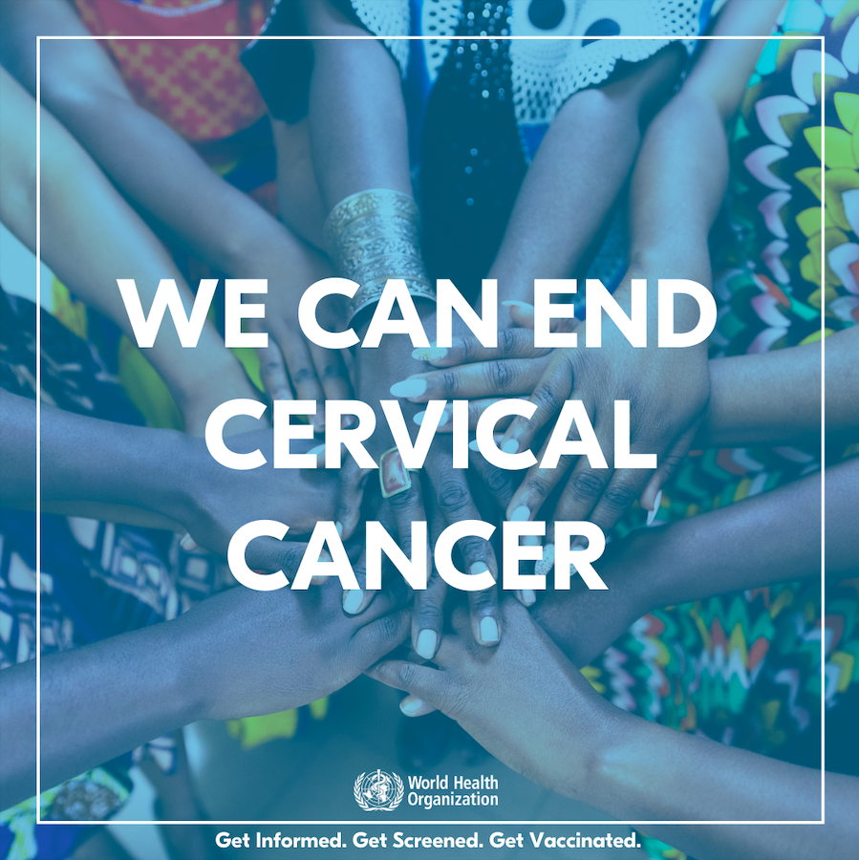
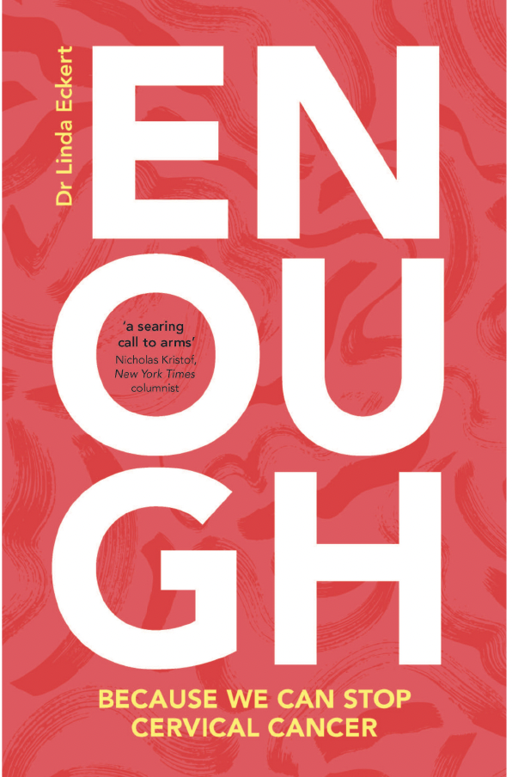
Let’s Go!!!!
@drlindaeckert drlindaeckert.com
We have Enough. We Are Enough

Slide 14
Global HPV Vaccine Coverage
Americas
Europe
Africa
SE Asia

Slide 15
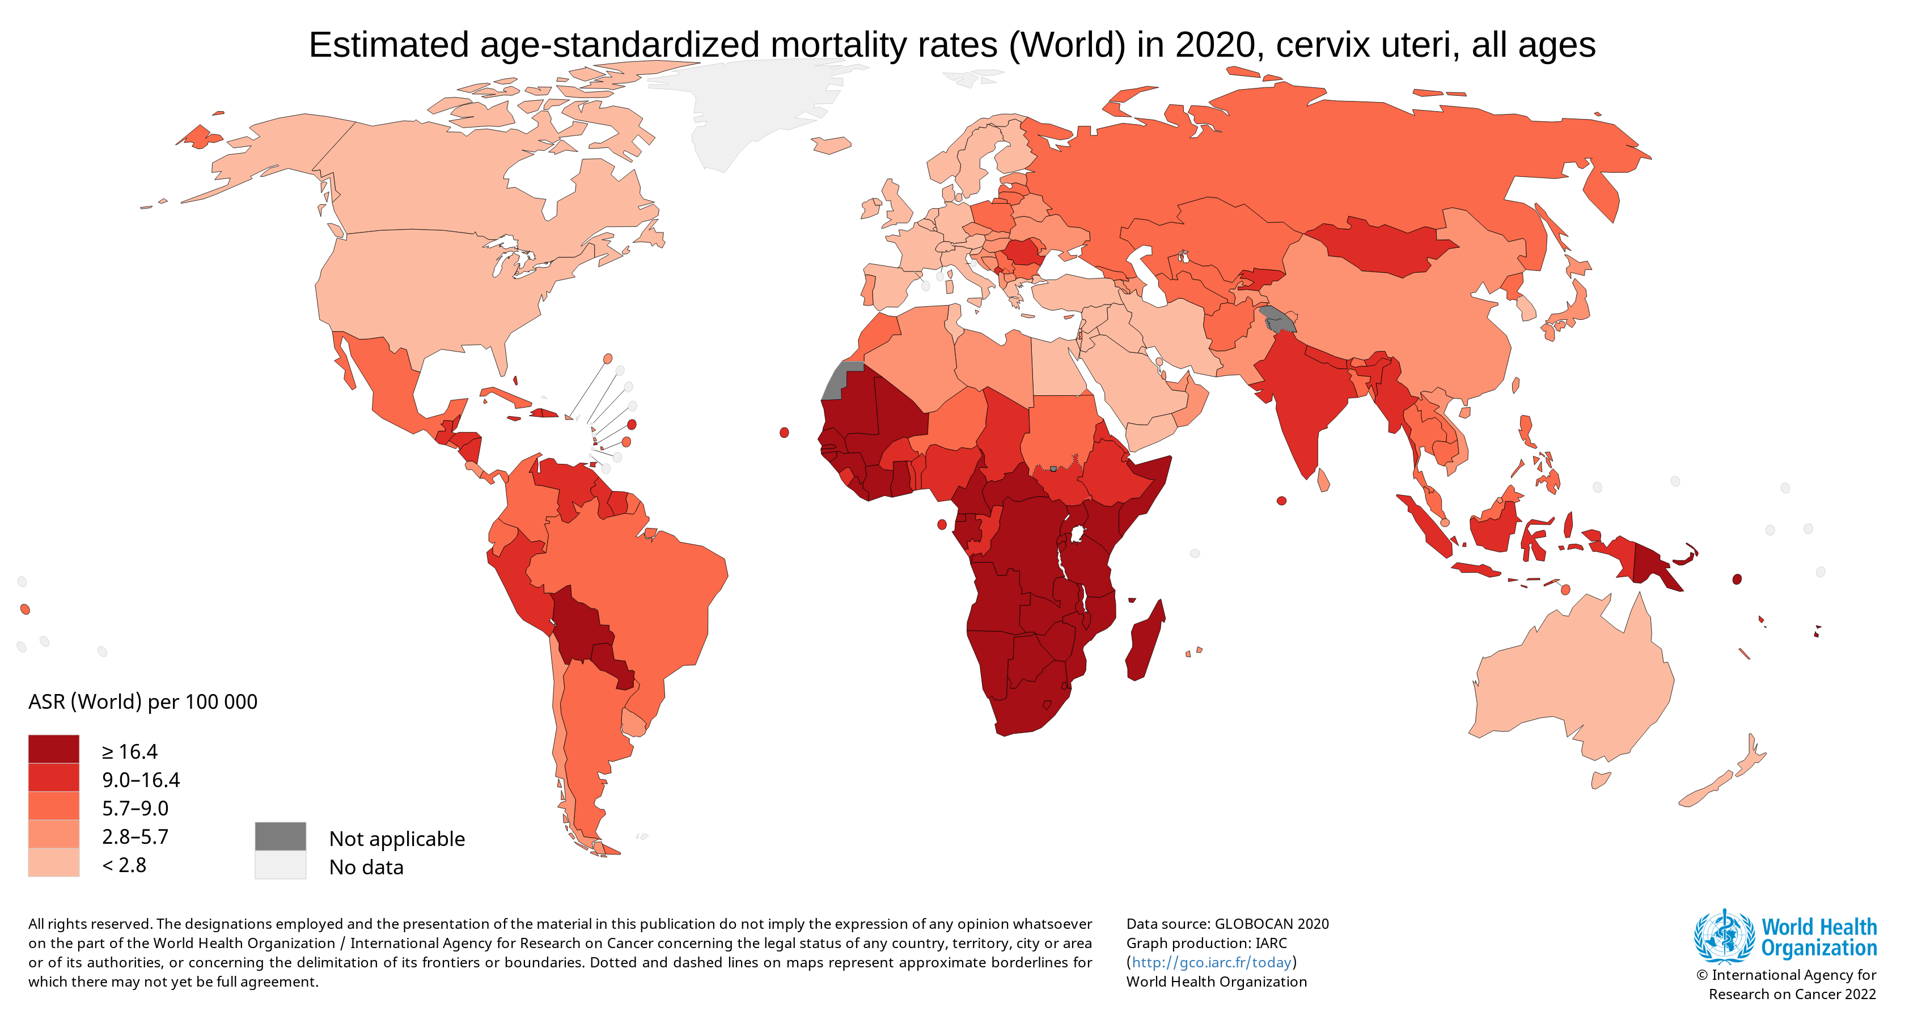
Global HPV Vaccine Coverage
A bit of a mismatch!
PATH, Global HPV Vaccine Introduction Overview, 2022

Slide 16
HPV Vaccine introductions
Well Kept Secret!

Slide 17
Global HPV Vaccine Shortage
28 Gavi eligible countries had to alter, delay or halt altogether HPV vaccine rollout
Gavi estimates between 2020-2025: 34,000,000 girls to missed out on HPV vaccine due to the global low income country supply constraint¹
In lower income settings, only need 70 girls vaccinated to prevent a case of cervical cancer²
HENCE global supply shortage: 485,000 lives (given no treatment or screening in most Gavi countries)
CDC modelling estimates that in US: 6500 40 yo’s need to be vaccinated to save a case of cervical cancer³
¹https://www.GAVI.org/sites/default/files/publications/2021-2025-GAVI-Investment-Opportunity.pdf
p 13
²https://www.thelancet.com/journals/langlo/article/PIIS2214-109X(20)30022-X/fulltext#sec1
³Meites E, Szilagyi PG, Chesson HW, Unger ER, Romero JR, Markowitz LE. Human Papillomavirus Vaccination for Adults: Updated Recommendations of the Advisory Committee on Immunization Practices. MMWR Morb Mortal Wkly Rep 2019;68:698–702. DOI: http://dx.doi.org/10.15585/mmwr.mm6832a3external icon

