Slide 1
Implementation of HPV self-collection in cervical screening
Matejka Rebolj
Wolfson institute of Population Health
Queen Mary University of London
ENGAGE Patient Advocacy Seminar, Barcelona, 8 March 2024

Slide 2
Happy
International Women’s Day

Slide 3

Cervical cancer is caused by human papillomavirus
1980s
Causative role of HPV established in the 1980s
Passed through any kind of sexual contact
Extremely common
70%
13 of >100
known genotypes can cause cervical cancer
HPV16/18 causes 70% of cervical cancers

Slide 4
Cervical cancer can be prevented
HPV vaccination:
prevention of persistent infections
Very effective when administered before the sexual debut
But only younger women are benefitting for now
Falcaro et al. Lancet 2021

Slide 5
Cervical cancer can be prevented
Screening:
treatment of preinvasive lesions
Very effective
Available to all women
(usually 20’s/30’s to 60’s)
Denmark
Finland
NORDCAN (https://nordcan.iarc.fr/en)

Slide 6
Yearly burden of cervical cancer (EU-27)
European Cancer Information System, https://ecis.jrc.ec.europa.eu/pdf/factsheets/cervical_cancer_en-Nov_2021.pd

Slide 7
Why has cervical cancer not yet been eradicated?
Prevention is highly, but not 100% effective
Women (girls) are not vaccinated
Women are not screened →
- many reasons: sociodemographic factors, cultural factors, lack of knowledge, embarrassment, lack of access because of practical issues
https://www.rivm.nl/bevolkingsonderzoek-baarmoederhalskanker/professionals/monitoring-en-evaluatie, https://www.sundhed.dk/sundhedsfaglig/kvalitet/kliniske-kvalitetsdatabaser/screening/livmoderhalskraeftscreening/, and https://digital.nhs.uk/data-and-information/publications/statistical/cervical-screening-annual/england-2022-2023 (and similar for earlier years)

Slide 8
New, better tools for screening
HPV test is a better screening test
Instead of cytology
as the first (“primary”) test
Negative: back to a routine recall
Positive: additional investigations
Rebolj et al, BMJ 2022

Slide 9
New, better tools for screening
Clinician collection: sample from the cervix
HPV self-collection
“As good as clinician collection”
https://www.mayoclinic.org/tests-procedures/pelvic-exam/about/pac-20385135, https://www.health.gov.au/self-collection-for-the-cervical-screening-test
Main advantages: convenience, privacy

Slide 10
What research studies have shown
10-30%
60%
40%
Of under-screened women take up the self-sampling offer when invited by mail
(“opt-in”,
“opt-out” offers)
Proceed to implementation
Of well-screened women might consider switching from clinician sampling to self-sampling
Of under-screened women take up the self-sampling offer when invited by their GP (“opportunistic offer”)
Drysdale et al. J Med Screen 2021, Lim et al. preprint 2023, Rebolj et al. Int J Cancer 2023

Slide 11








Denmark since 2017
Early adopter countries
Netherlands since 2017
Two approaches:
Only to under-screened women
- multiple research studies
- might lead to switching
As a choice to all women
- not studied in research studies
- a likely model for several countries (overburdened primary care, women’s preferences, ?same accuracy)
Australia since 2018
Italy since 2020 (regional and pilots)
Sweden since 2021
New Zealand since 2023
Elsewhere: Research and pilots

Slide 12
How does HPV self-sampling work
in routine health care?

Slide 13
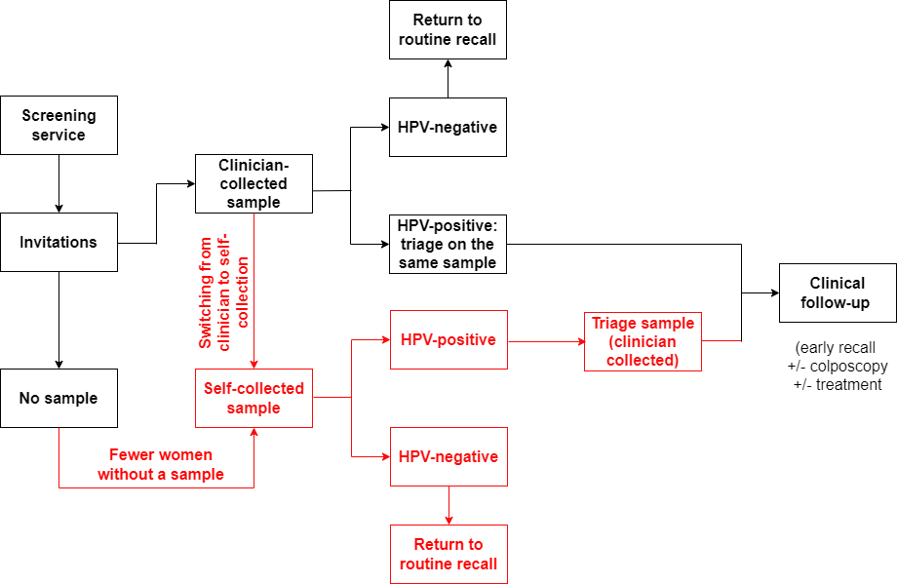
3
3
2
2
1

Slide 14
1

Slide 15
What have we learnt from early adopter countries?
Denmark (initially only the Capital region): under-screened women
An increase in the coverage by 3% (17% of under-screened women self-collected a sample)
Australia: initially only under-screened women
Initially disappointing results
Lack of clarity on regulatory approval, unclear messaging, strict requirement for collection at a health care facility
? Unified messaging and system support is required
Italy: under-screened ± well-screened women
Hard to increase coverage
? Some regions implemented as response to the COVID-19 pandemic
Netherlands: all women (initially as opt-in)
No increase in overall coverage, relatively little self-collection
? Uniform invitation letter: both well-screened and under-screened women

Slide 16
What can we do?
? Effective communication
? Practical obstacles
? Why not screened
Invitation letters
Other venues
(community-based etc.)
Help with planning
Improve the understanding of who are non-responders and the reasons behind it
? Multi-pronged offer
? Any other
Basic offer (opt-in, opt-out) + opportunistic + additional outreach
To be made part of the policy

Slide 17
2
2

Slide 18
Assumptions on HPV self-sampling test sensitivity
Context:
Very few manufacturer claims
Repurposing for self-sampling purposes
Some proposed, but no internationally agreed validation frameworks
A large number of research and local “validation” studies, mostly from women with abnormal cytology
Agreement:
Self-sampling is ~equally good as clinician sampling
(Meta-analysis of the available studies)

Slide 19

What have we learnt from early adopter countries?
Estimates: test sensitivity reduction of 10-25%
(for the detection of high-grade preinvasive lesions or worse)
(But: suboptimal study designs)
Why this difference?
Previous studies: women with abnormal cytology, hardly any lesions with HPV+/neg-cytology
HPV+/neg-cytology likely to emit a weaker signal to detect the infection → more difficult to detect
Early adopters: data correctly include women with HPV+/neg-cytology lesions
(Would self-sampling prevent fewer cervical cancers?)
https://encrypted-tbn0.gstatic.com/images?q=tbn:ANd9GcSHLllwS2k9XmKKallmCzOf1GujJNkzM7sq1A&usqp=CAU

Slide 20
How should we interpret these findings?
Self-collection is still a useful screening test, likely better than cytology
Accept: uncertainty about the reduction in the sensitivity
A potential for more cancers than with clinician sampling (in the worst-case scenario)
Especially an issue when women are given a choice
https://btshealth.com/light-at-he-end-of-the-tunnel/

Slide 21
What can we do?
Communication
Research
Mitigation
Communicate the uncertainty
Balanced, understandable
Without scaring women
away (It is not a bad test!
It is not a cost-cutting exercise!)
Stronger evidence
Improvement of the technology
Manage expectations
Consider adjusting screening intervals
Consider a different approach
for under-screened vs.
well-screened women

Slide 22
3
3

Slide 23
Screening only works if all the steps are completed:
If no
Clinician-collected sample for triage
, then no
Colposcopy referral
, then no
Treatment
Lesion detected
, then no

Slide 24
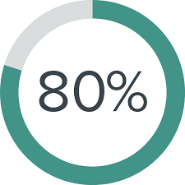
What have we learnt from early adopter countries?
Adherence:
80-90%
Even in previously well-screened women
Defeats the purpose of increasing the screening uptake
Mitigation:
Development and validation of biomarkers on self-collected samples
Support HPV-positive women in completing the follow-up

Slide 25

Summary
Exciting new option for cervical screening
Potential to reduce the burden of cancer among under-screened women
Effective routine implementation is not straightforward
  It is a complex intervention
How to design the service so that:
  The uptake will be significantly increased
  Women will be comfortable with making the choice
  Women will be satisfied with the choice they will make
  Women will complete the clinical follow-up

Slide 26
Questions?
m.rebolj@qmul.ac.uk

Slide 27
How does HPV self-sampling work outside of research studies?
1. Does it increase the number of women who undergo screening?
(screening uptake)
2. Does a negative self-sampling test identify women at low risk of a serious lesion?
(test sensitivity)
3. Do women with positive self-sampling tests proceed to treatment, if necessary?
(adherence to follow-up)

Slide 28
(Usual) differences between the two approaches of offering HPV self-sampling
When offered only to under-screened women:
An invitation addresses these women’s specific situations
Explains the risks of remaining unscreened (and those of undergoing screening)
The self-sampling kit offered as:
  Opt-in, opt-out, opportunistic
When offered as a choice to all women:
A standardised invitation
(In some countries) explains the risks of remaining unscreened and those of undergoing screening
The self-sampling kit offered as:
  Opt-in, opt-out

