Slide 1
Patient Advocacy Seminar - Guidelines
PRE Helps RE - Guidelines of Prehabilitation
Date: 9th March 2024
Name: Christina Fotopoulou, London, UK

Slide 2
Declaration of interests
Honoraria received for advisory boards from: AZ, MSD, Roche, GSK, Oncoinvent.

Slide 4



Slide 5
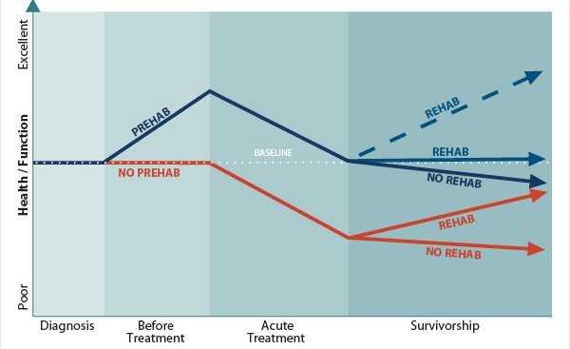
Surgery is also nothing else than a journey…

Slide 9
Frailty Index for prediction of surgical outcome in ovarian cancer: Results of a prospective study
Melisa Guelhan Inc et.al. Gynecol Oncol 2021
Highlights
•Frailty Index >0.26 is associated with severe postoperative complications in patients with ovarian cancer.
•Frailty Index can help surgeons to estimate the risk of postoperative complications in ovarian cancer.
•Besides tumor residuals and low albumin levels a Frailty Index >0.15 predicts poor survival in patients with ovarian cancer.
Prospective trial for patients undergoing cytoreductive surgery in advanced ovarian cancer
Evaluation of frailty index in 144 patients, endpoint severe postoperative complications

Slide 10
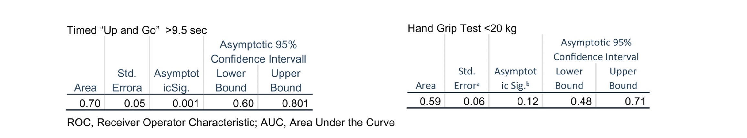
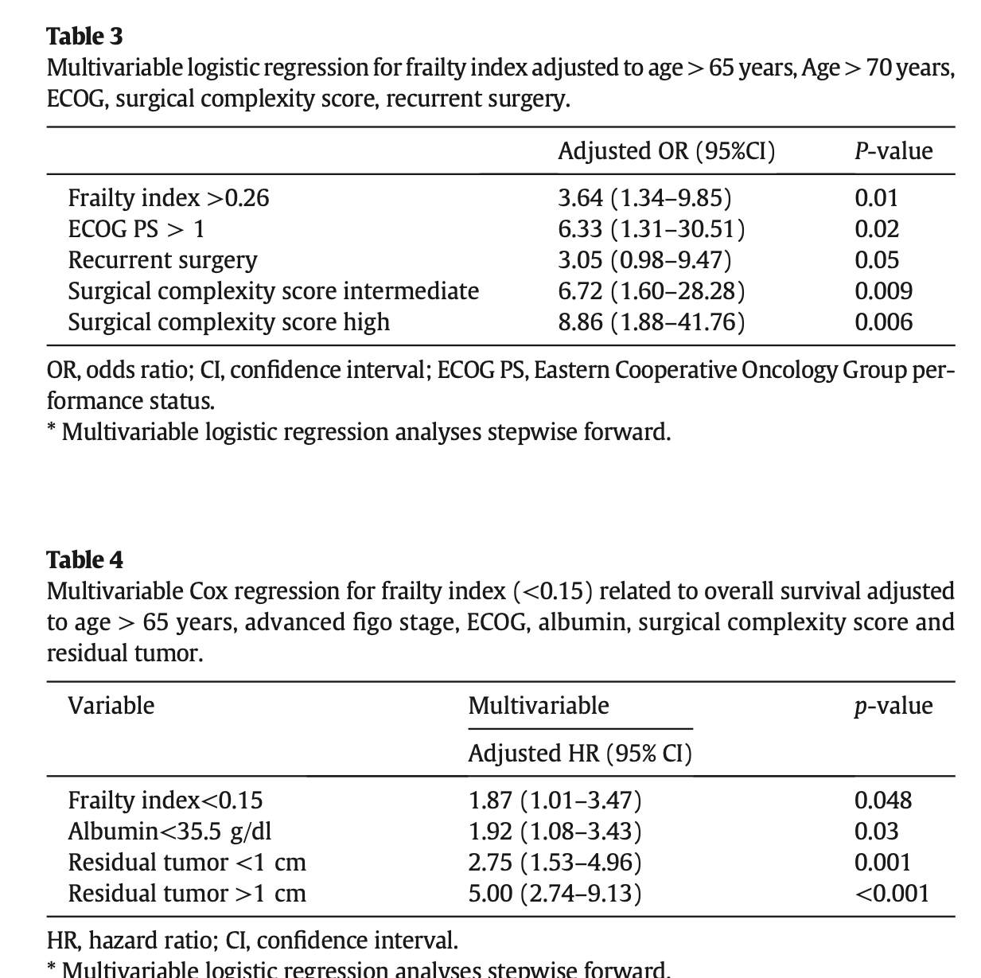
- strong association between preoperative „frailty“ and surgical morbidity
- assoociation with poor overall survival
- besides frailty, low albumin and postoperative residuals are risk factors

Slide 12
12

Slide 13
The concept of prehabilitation: “a process on the continuum of care that occurs between the time of cancer diagnosis and the beginning of acute treatment”
Prehabilitation includes:
physical and psychological assessments that establish a baseline functional level
identifies impairments
provides targeted interventions that improve a patient’s health to reduce the incidence and the severity of current and future impairments
Prehabilitation aims to:
optimize patients’ physical and mental well-being in anticipation of an upcoming stressor rather than a reactive process in which care is provided to restore wellness (ie, rehabilitation)

Slide 14
What does prehabilitation really include?
There is currently no consensus-based definition, but a multimodal approach that encompasses the following principles is gaining popularity:
aerobic and resistance exercises to improve physical function, body composition, and cardiorespiratory fitness
targeted functional exercises to minimize/prevent impairments
dietary interventions to support exercise-induced anabolism as well as mitigate disease and/or treatment-related malnutrition
psychological interventions to reduce stress, support behavior change, and encourage overall well-being.

Slide 15

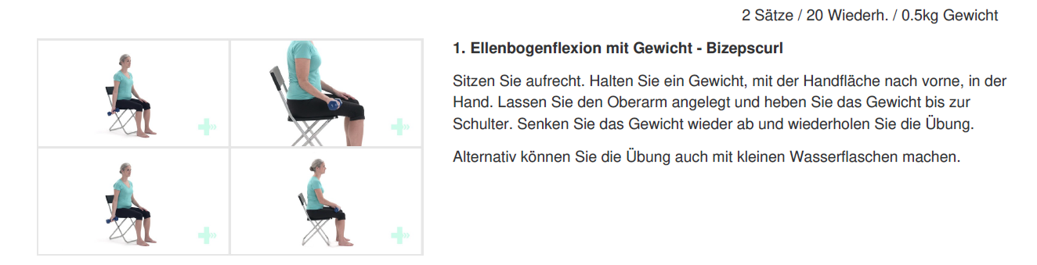
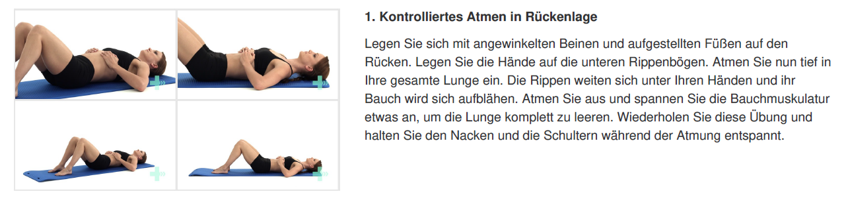
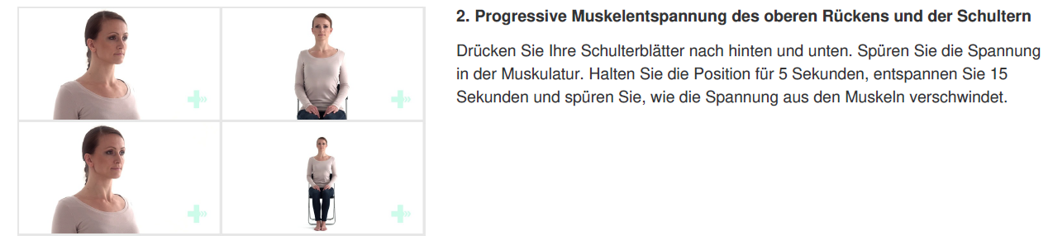
Targeted Exercise Program
Intervention
Functional exercise programm consisting of:
Body weight resistance program, targeting all major muscle groups
Breathing exercises for improved lung capacity
Relaxation exercises
Additional Recommendation:
Aerobic exercise 3x per week

Slide 16
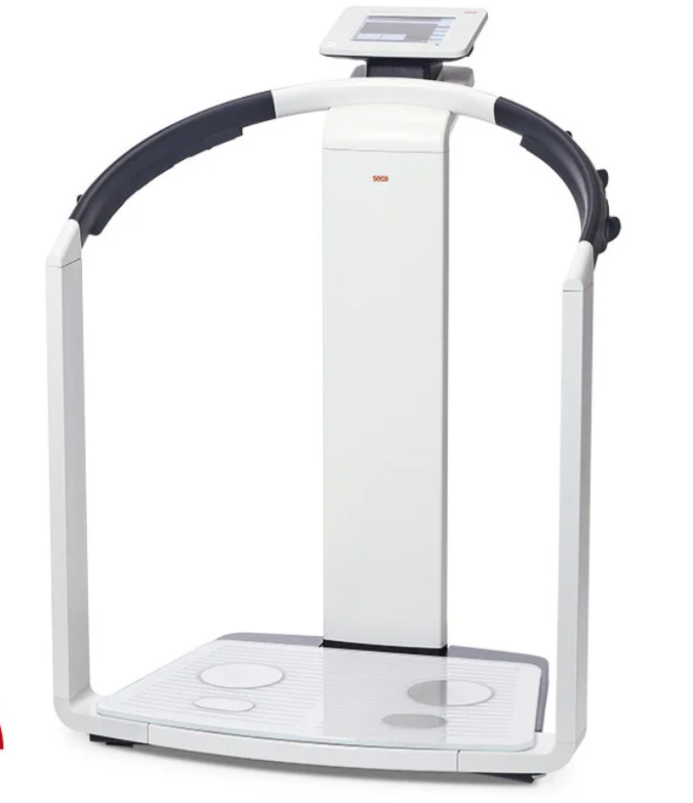
Nutrition Intervention
Intervention:
Food First approach with a recommendation for energy-dense food and food, which is rich in protein.
Determining the need for oral or parenteral supplements
Pre-operative Carboloading (ProvideXtra)

Slide 17

Mental Health/ Empowerment
-
Individual Coaching Sessions
Group Coaching Sessions 1x/ week
Education
Relaxation techniques/ exercises
Surgical Step

Slide 18


Preoperative optimization
Correct anemia (transfusion)
Protein drinks
Maintain physical activity
If patient has symptomatic ascites or pleura effusion then drain and replace with iv fluids accordingly (if theatre date not immediate)
Psychooncological/ CNS support

Slide 19
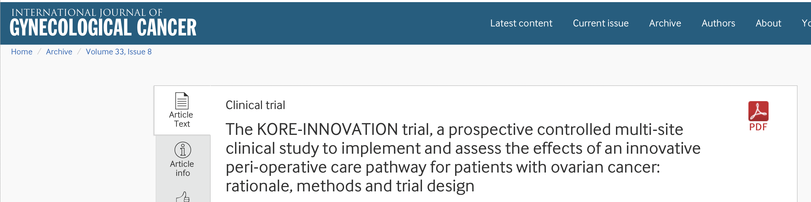
Aug 2023
Melisa Guelhan Inci, Jalid Sehouli, Eva Schnura, Marlene Lee, Stephanie Roll, Thomas Reinhold, Julia Klews, Lutz Kaufner, Phil Niggemann, Harald Groeben, Julia Toelkes, Anett Reisshauer, Max Liebl, Enrico Daehnert, Manuela Zimmerman, Barbora Knappe-Drzikova, Susanne Rolker, Björn Nunier, Engi Algharably, Adak Pirmorady Sehouli, Lena Zwantleitner, Andrea Krull, Florian Heitz, Beyhan Ataseven, Radoslav Chekerov, Philipp Harter, Stephanie Schneider.
Large prospectively RCT with 414 pt with advanced OC
Evaluation of trimodal prehab plus ERAS and preoperative Frailty assesment
Recrution completed in 2024 →results soon
Large prospectively RCT with 414 pat with advanced OC
The intervention group receives an additional multi-level study treatment: (1) standardized frailty assessment followed by (2) a personalized tri-modal pre-habilitation program and (3) peri-operative care according to an ERAS pathway.
Recruitment to be completed in 2024

Slide 20
thank you

