Slide 1
Treatment innovations in cervical cancer
ENGAGE Patient Advocacy Seminar
Date: March 8, 2024
Name: David Cibula

Slide 2
Declarations of interests
The authors declare no conflict of interest.

Slide 4
INNOVATIONS
De-escalation of radical surgical treatment in early stages
Fertility sparing treatment
Improvement of radiotherapy
Immunotherapy in advanced and recurrent tumors
Future trends

Slide 5
Stage IA – IIA – (IIB)
RADICAL SURGERY

Slide 6
Stage IA – IIA – (IIB)
RADICAL SURGERY
SLN instead of PLND
Abandoning LN staging
Abandoning parametrectomy
Cone instead of Radical trachelectomy

Slide 7
De-escalation trends
Only conisation without lymphadenectomy or radical hysterectomy in very small tumors

Slide 8
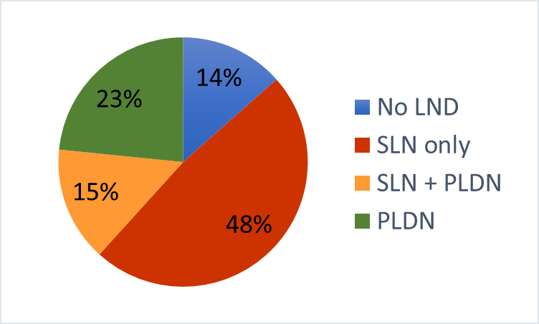
ESGO survey 2017 vs 2021
Management of stage IA2 / LVSI negative – lymph node dissection
2017
2021

Slide 9
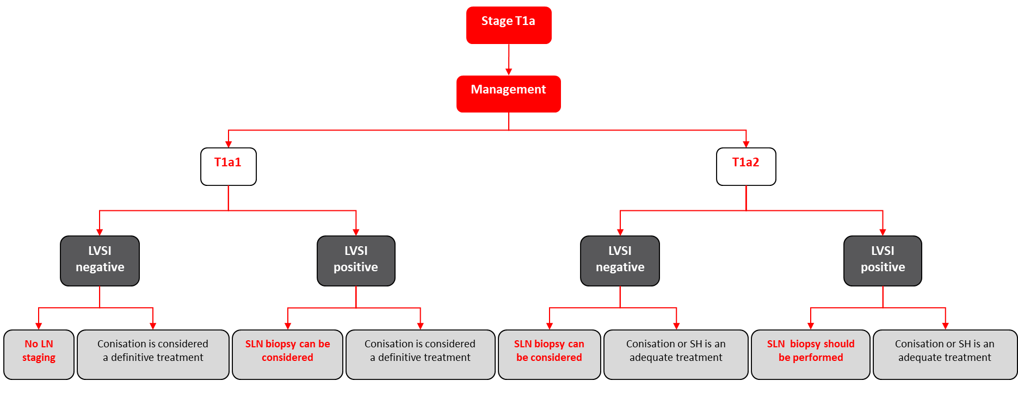
ESGO-ESTRO-ESP Cervical cancer Guidelines (2023) LN staging
Int J Gynecol Cancer. 2023 May 1;33(5):649-666

Slide 10
De-escalation trends
Removal of a few „sentinel lymph nodes“ instead of pelvic lymphadenectomy

Slide 11
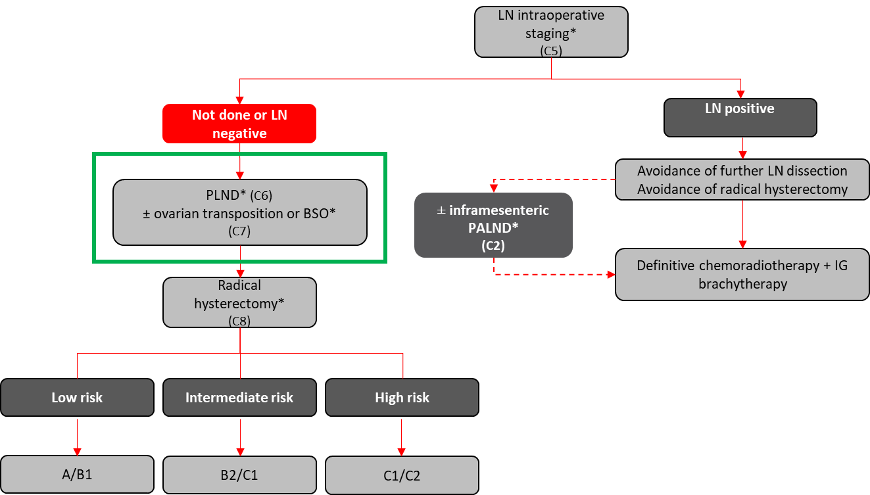
ESGO-ESTRO-ESP Cervical cancer Guidelines (2023) LN staging
Int J Gynecol Cancer. 2023 May 1;33(5):649-666
Int J Gynecol Cancer. 2023 May 1;33(5):649-666

Slide 12
SENTIX trial design
SLN biopsy in early cervical cancer

Slide 13
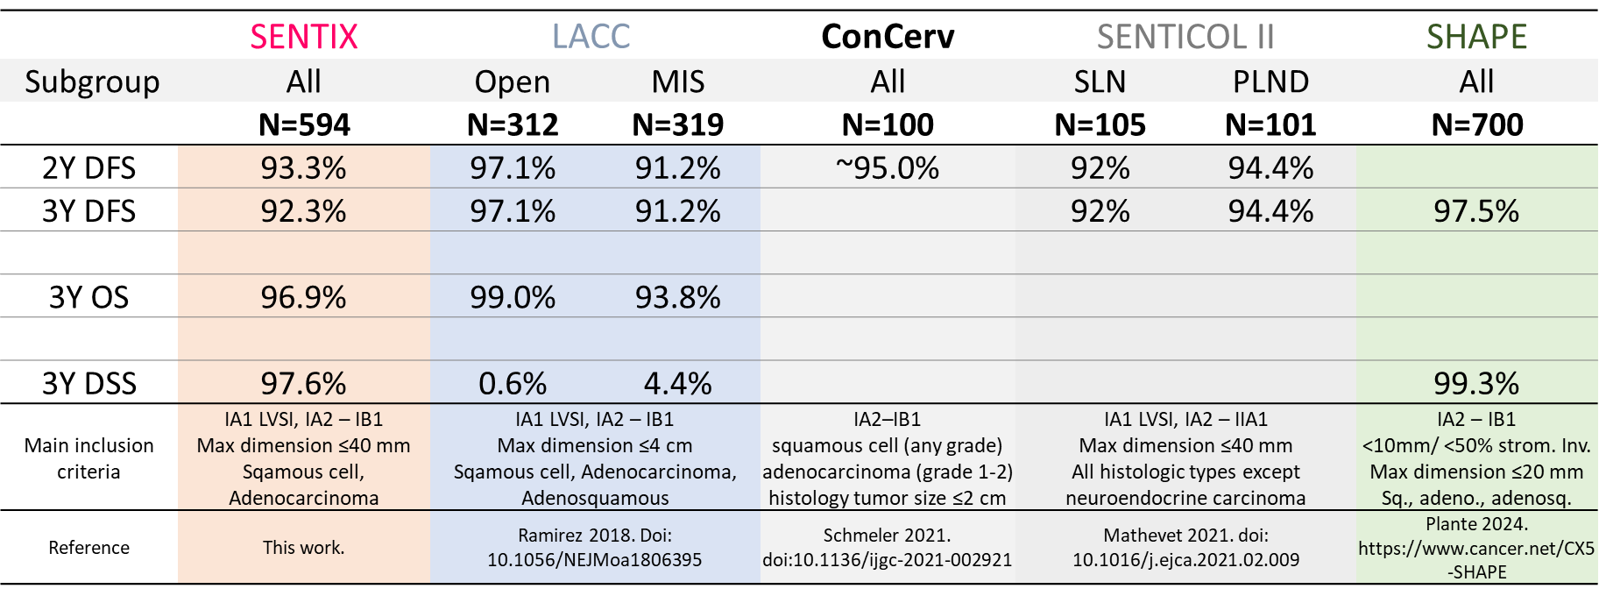
RESULTS

Slide 14
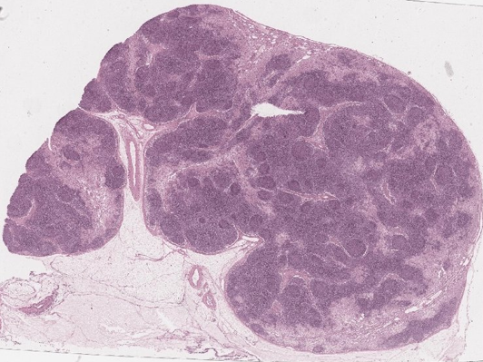
Intensive SLN ultrastaging
Two consecutive sections
(4 μm-thick) obtained in regular 150 μm intervals, which were cut from each paraffin block …
Until there was no lymph node tissue remaining.
After fixation in 10% buffered formalin, all SLNs were sliced at 2 mm intervals
and embedded in paraffin.
The 1st section was stained with H&E and the 2nd was examined immunohistochemically with antibody against cytokeratins (AE1 / AE3).
SLN
2 mm

Slide 15
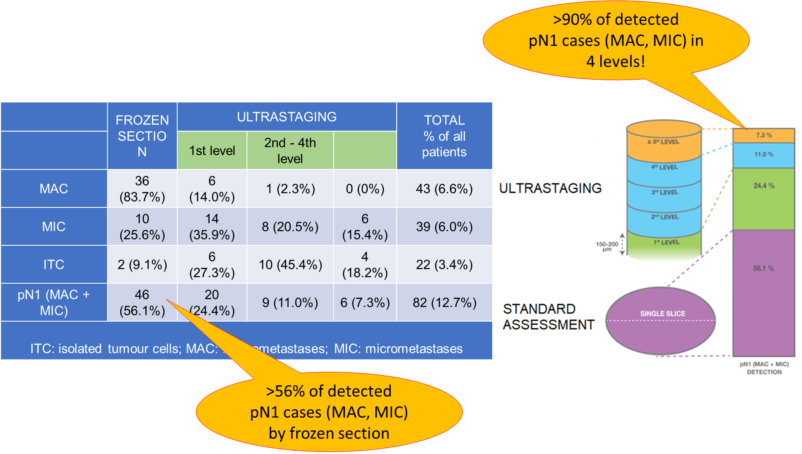
RESULTS
N = 647
FROZEN SECTION

Slide 16
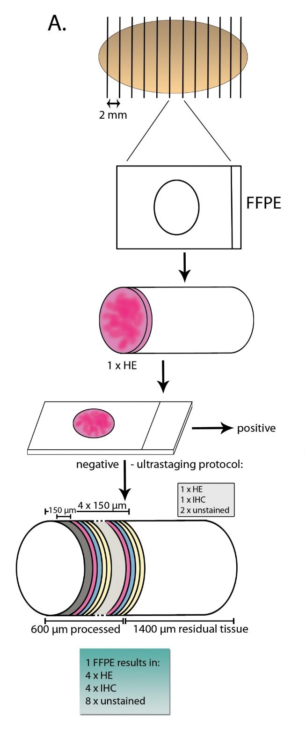
QI for LN staging
No of LN retrieved by surgeon
SLN biopsy and quality of ultrastaging

Slide 17
ENGOT-Cx24/SENTICOL III – study design SLN biopsy in early cervical cancer
Squamous or adenocarcinoma of the cervix,
Stage Ia1 with lympho vascular emboli , Ib1, Ib2, IIa1 (FIGO 2018)
Maximum diameter ≤ 40mm.
Frozen section
(bilateral detection, safety algorithm)
Patients with bilateral detection without macroscopic suspicious node and negative frozen section on SLN (pN0)
Patients with nodal involvement (pN1)
Randomisation
1 : 1
Arm A (experimental) :
SLN biopsy only
+ hysterectomy
or trachelectomy
Arm B (reference) :
SLN biopsy
+ Pelvic Lymphadenectomy
+ hysterectomy or trachelectomy
Followed in a separate cohort to record treatment and outcomes
DFS, RFS, QOL, OS

Slide 18
De-escalation trends
Hysterectomy instead of radical hysterectomy in small tumors

Slide 19
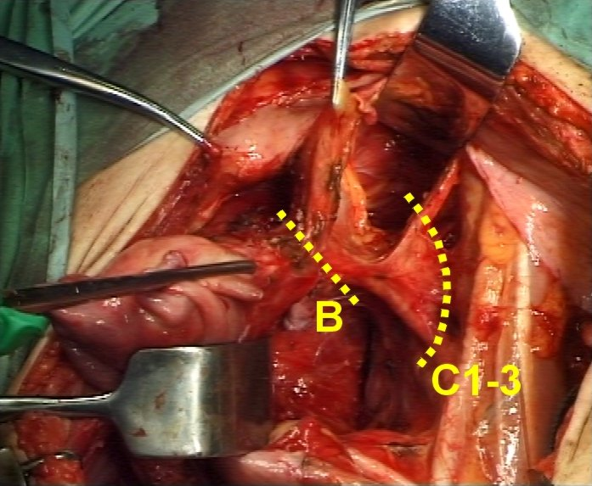
David‘s video/slides
B
C 1 - 2

Slide 21
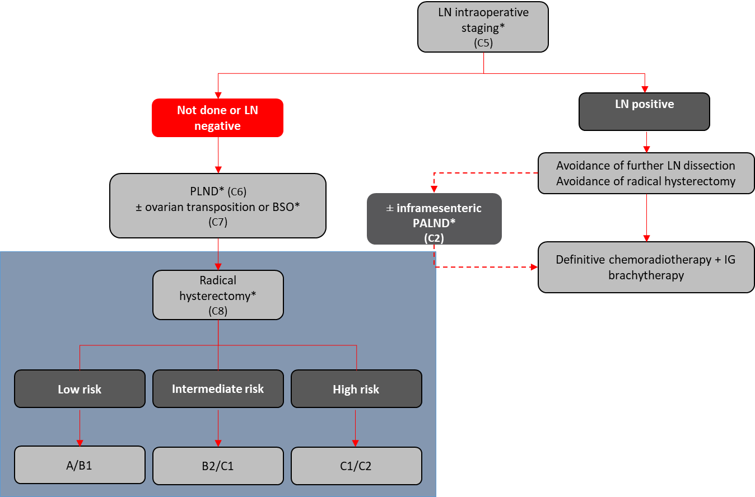
ESGO-ESTRO-ESP CERVICAL CANCER GUIDELINES (2023)
Int J Gynecol Cancer. 2023 May 1;33(5):649-666

Slide 23
Surgical management of IB stage
VVLR
N0; IA
SLN
SH or CONE
VLR
N0;< 2 cm
SLN + PLND
RH C1
LR
N0;2-4cm
No RF
SLN + PLND
RH C1/C2
IR
N0;>4cm OR
2-4 cm + RF
SLN + PLND
RH C2
+/- adj RT
HR
N1; IIB
Chemo-
radiation

Slide 24
Surgical management of IB stage
VVLR
N0; IA
SLN
SH or CONE
VLR
N0;< 2 cm
SLN
SH or CONE
LR
N0;2-4cm
No RF
SLN + PLND
RH C1/C2
IR
N0;>4cm OR
2-4 cm + RF
SLN + PLND
RH C2
OR
Chemoradiation
HR
N1; IIB
Chemo-
radiation
SHAPE

Slide 25
INNOVATIONS
De-escalation of radical surgical treatment in early stages
Fertility sparing treatment
Improvement of radiotherapy
Immunotherapy in advanced and recurrent tumors
Future trends

Slide 26
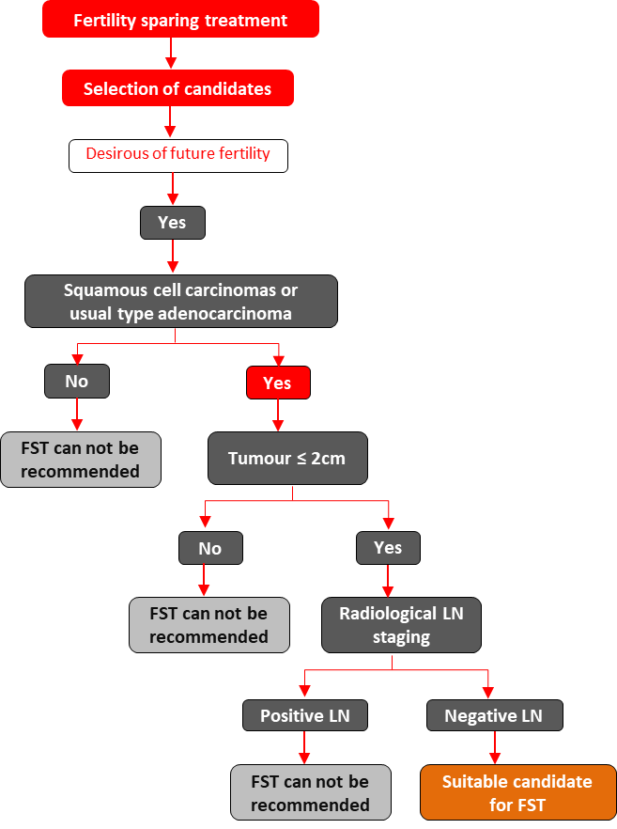

Slide 27
A = conization
B = simple trachelectomy (ST)
C = vaginal radical trachelectomy
D = abdominal radical trachelectomy
C

Slide 28
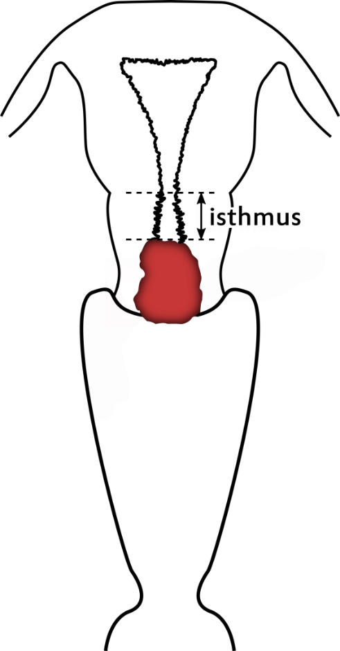
DE-ESCALATION TRENDS
The aim of FST must be the resection of invasive tumor with adequate free margins and preservation of the upper part of the cervix.

Slide 29
ESGO-ESTRO-ESP Clinical Practice Guidelines (2023)
Stage T1a1 and T1a2
Stage T1b1
Conisation or (Simple trachelectomy* (C13) + cerclage)
+ standard LN staging*
(C14)
LVSI negative
LVSI positive
Conisation or (simple trachelectomy* (C13) + cerclage)
+ standard LN staging* (C14)
Radical trachelectomy (type A/B) + cerclage + standard LN staging* (C14)
Radical trachelectomy (type B) + cerclage + standard LN staging* (C14)
Simple trachelectomy* (C13) + cerclage + standard LN staging*
(C14)

Slide 30
INNOVATIONS
De-escalation of radical surgical treatment in early stages
Fertility sparing treatment
Improvement of radiotherapy
Immunotherapy in advanced and recurrent tumors
Future trends

Slide 31
RADICAL SURGERY
SLN instead of PLND
Abandoning LN staging
Abandoning parametrectomy
Cone instead of radical
trachelectomy
Definitive
chemoradiation

Slide 32
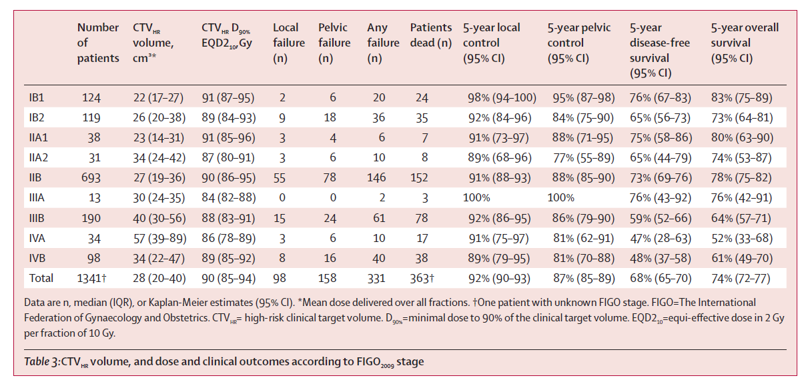
Outcome of chemoradiation in LACC EMBRACE 1 - prospective observational study
24 sites in Europe, Asia, North America
FIGO IB-IVA; 2008 - 2015
Standardized chemoradiation
45-50 Gy EBRT, 1.8-2Gy/f
wkl Cisplatin 40 mg/m2, 5-6 cycles
MRI-based IGABT
N=1341
IB1 124 (9.2%)
IB2 119 (8.9%)
IIA1 38 (2.8%)
IIA2 31 (2.3%)
IIB 693 (51.7%)
IIIA 13 (1.0%)
IIIB 190 (14.2%)
IVA 34 (2.5%)
IVB 98 (7.3%)
Missing 1 (0.1%)
Potter 2021; Lancet Oncology 22: 538-47

Slide 33
INNOVATIONS
De-escalation of radical surgical treatment in early stages
Fertility sparing treatment
Improvement of radiotherapy
Immunotherapy in advanced and recurrent tumors
Future trends

Slide 34
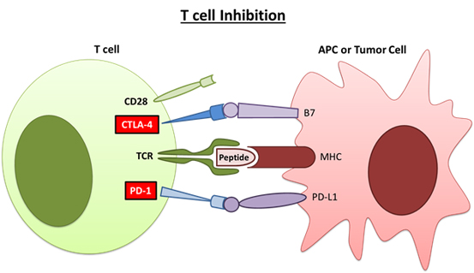
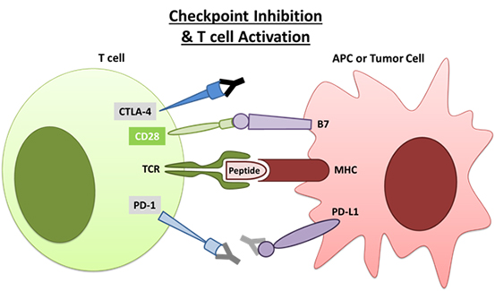

Slide 35
KEYNOTE-826: Randomized, Double-Blind, Phase 3 Study
Pembrolizumab 200 mg IV Q3W for up to 35 cycles
+
Paclitaxel + Cisplatin or Carboplatin IV Q3W for up to 6 cyclesª
±
Bevacizumab 15 mg/kg IV Q3W
Key Eligibility Criteria
Persistent, recurrent, or metastatic cervical cancer not amenable to curative treatment
No prior systemic chemotherapy (prior radiotherapy and chemoradiotherapy permitted)
ECOG PS 0 or 1
R 1:1
Placebo IV Q3W for up to 35 cycles
+
Paclitaxel + Cisplatin or Carboplatin IV Q3W for up to 6 cyclesª
±
Bevacizumab 15 mg/kg IV Q3W
Stratification Factors
Metastatic disease at diagnosis (yes vs no)
PD-L1 CPS (<1 vs 1 to <10 vs ≥10)
Planned bevacizumab use (yes vs no)
End Points
Dual primary: OS and PFS per RECIST v1.1 by investigator
Secondary: ORR, DOR, 12-mo PFS, and safety
Exploratory: PROs assessed per EuroQol EQ-5D-5L VAS
ªPaclitaxel: 175 mg/m². Cisplatin: cisplatin 50 mg/m². Carboplatin: AUC 5 mg/mL/min. The 6-cycle limit was introduced with protocol amendment 2, although participants with ongoing clinical benefit who were tolerating chemotherapy could continue beyond 6 cycles after sponsor consultation.
CPS, combined positive score (number of PD-L1–staining cells [tumor cells, lymphocytes, macrophages] divided by the total number of viable tumor
cells, multiplied by 100); PROs, patient-reported outcomes; VAS, visual analog scale. KEYNOTE-826 ClinicalTrials.gov identifier, NCT03635567.

Slide 36
KEYNOTE-826/MK-3475-826 Overall survival
Sub-group analysis

Slide 37
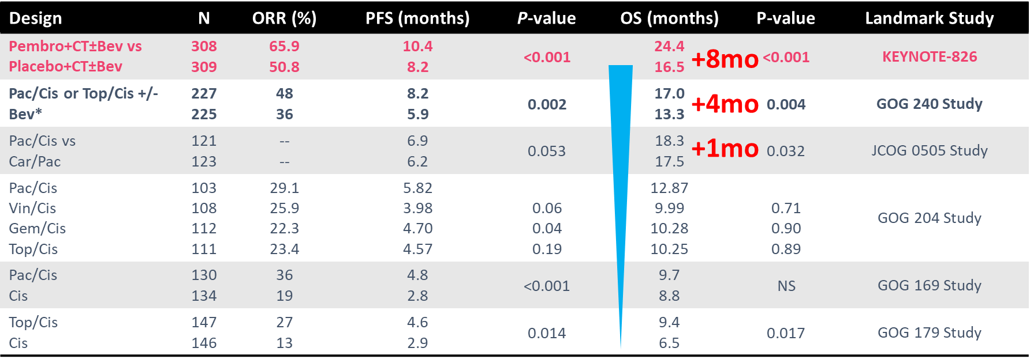
Evolution of 1L treatments of LACC

Slide 38
ESGO-ESTRO-ESP Cervical Cancer Guidelines 2023

Slide 39
ENGOT-cx11/GOG-3047/KEYNOTE-A18: Randomized, Double-Blind, Phase 3 Study
Cisplatin 40 mg/m² QW for 5 cyclesª + EBRT followed by brachytherapy +
Pembrolizumab 200 mg Q3W for 5 cycles
Pembrolizumab 400 mg Q6W for 15 cycles
Key Eligibility Criteria
FIGO 2014 stage IB2-IIB (node-positive disease) or FIGO 2014 stage III-IVA (either node-positive or node-negative disease)
RECIST 1.1 measurable or non-measurable disease
Treatment naïve
R 1:1
N = 1060
Cisplatin 40 mg/m² QW for 5 cyclesª + EBRT followed by brachytherapy +
Placebo Q3W for 5 cycles
Placebo Q6W for 15 cycles
Stratification Factors
Planned EBRT type (IMRT or VMAT vs non-IMRT or non-VMAT)
Stage at screening (stage IB2-IIB vs III-IVA)
Planned total radiotherapy dose (<70 Gy vs ≥70 Gy [EQ2D])
ªA 6th cycle was allowed per investigator discretion. EBRT, external beam radiotherapy; FIGO, International Federation of Gynecology and Obstetrics; Gy, grays; IMRT, intensity-modulated radiotherapy; Q3W, every 3 weeks; Q6W, every 6 weeks; RECIST, Response Evaluation Criteria in Solid Tumors; VMAT, volumetric-modulated arc therapy. ENGOT-cx11/GOG-3047/KEYNOTE-A18 ClinicalTrials.gov identifier, NCT04221945.
Presented by: Domenica Lorusso
Presented by: Domenica Lorusso
Content of this presentation is copyright and responsibility of the author. Permission is required for re-use.

Slide 40
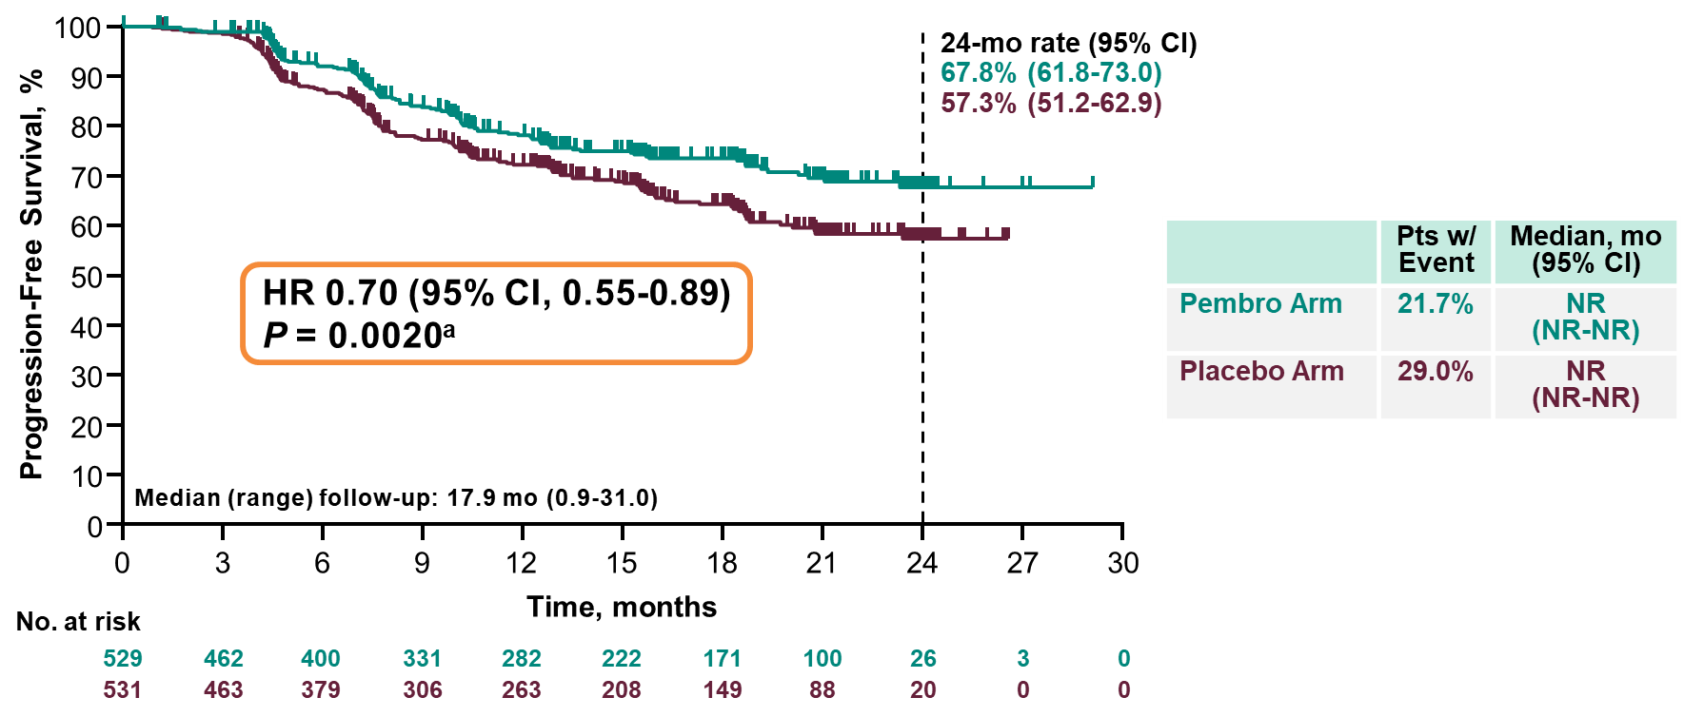
Primary Endpoint: Progression-Free Survival
Response assessed per RECIST v1.1 by investigator review or histopathologic confirmation. ªWith 269 events (88.5% information fraction), the observed P = 0.0020 (1-sided) crossed the prespecified nominal boundary of 0.0172 (1-sided) at this planned first interim analysis. The success criterion of the PFS hypothesis was met, and thus no formal testing of PFS will be performed at a later analysis. Data cutoff date: January 9, 2023.
Presented by: Domenica Lorusso

Slide 41
INNOVATIONS
De-escalation of radical surgical treatment in early stages
Fertility sparing treatment
Improvement of radiotherapy
Immunotherapy in advanced and recurrent tumors
Future trends

Slide 42
FUTURE TRENDS
Diagnostics
More accurate detection of metastases (IA)
New prognostic markers (radiomics; tumor microenvironment)
Treatment
Active immunotherapy (vaccines)
Antibody drug conjugates (TV)

Slide 43
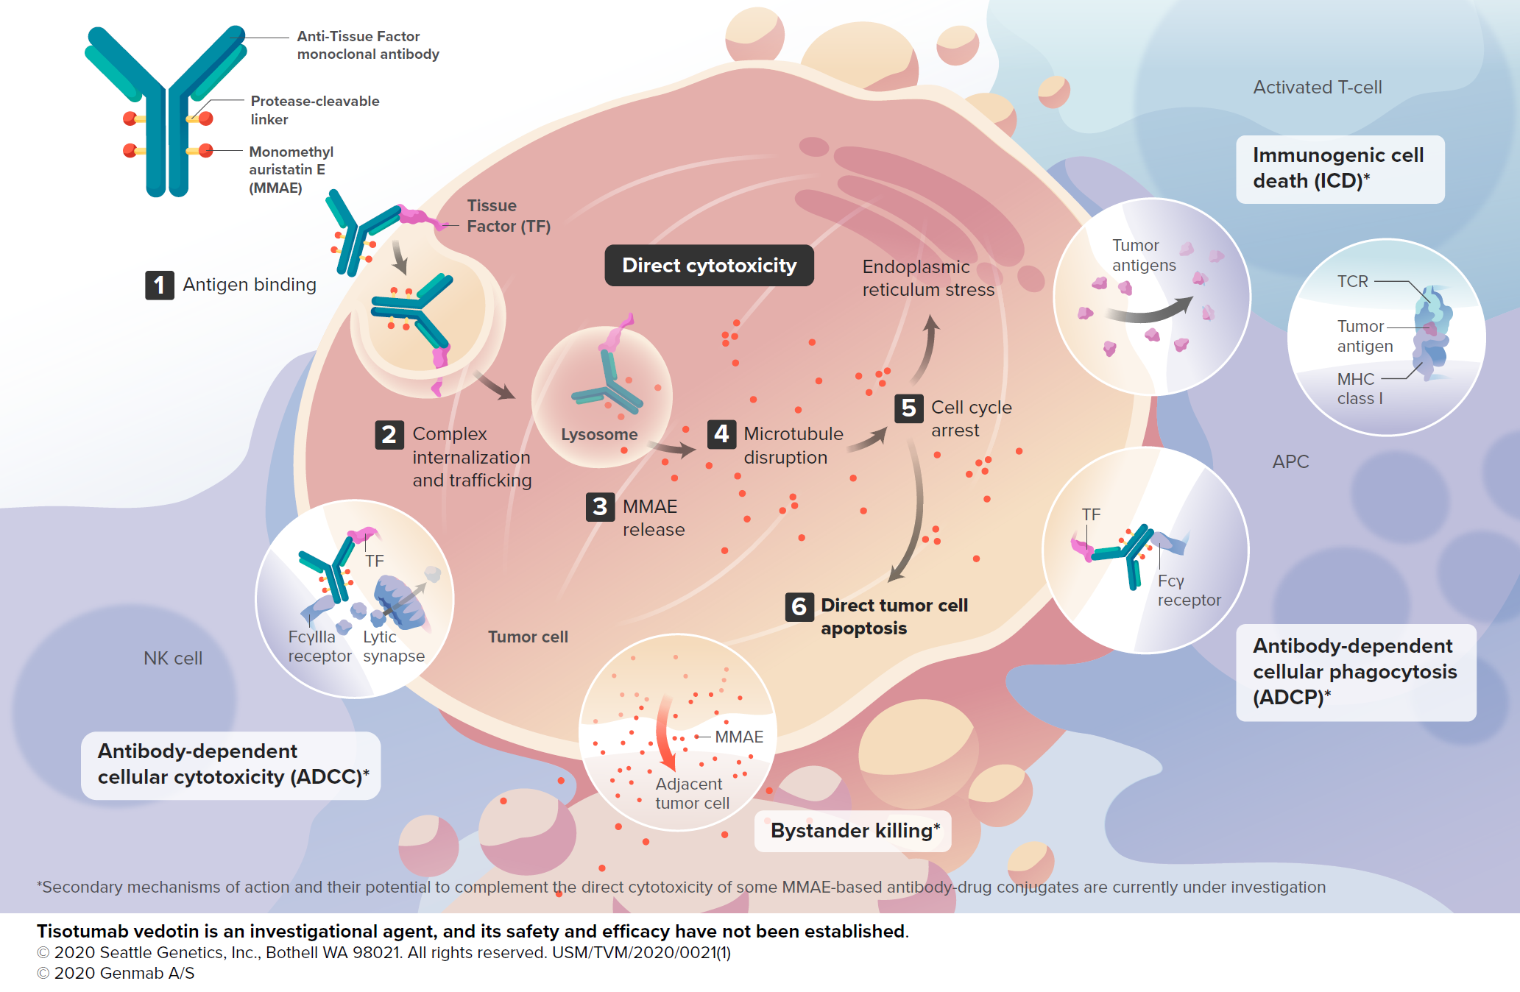
Antibody-drug conjugates: Tisotumab Vedotin
Tisotumab vedotin is an investigational antibody-drug conjugate directed to tissue factor (TF) and covalently linked to the microtubule-disrupting agent MMAE via a protease-cleavable linker^{1,2}
TF is highly prevalent in cervical cancer and other solid tumors and is associated with cancer pathophysiology and poor prognosis³⁻⁵
TF is co-opted by tumor cells to promote tumor growth, angiogenesis, and metastasis⁶
In normal physiology, TF’s primary role is to initiate the coagulation cascade after vascular injury⁶
Tisotumab vedotin has multiple anti-tumor effects^{1,2,7}
1. Breij EC et al. Cancer Res. 2014;74(4):1214-1226. 2. De Goeij BE et al. Mol Cancer Ther. 2015;14(5):1130-1140. 3. Pan L et al. Mol Med Rep. 2019;19:2077-2086. 4. Cocco E et al. BMC Cancer. 2011;11:263. 5. Zhao X et al. Exp Ther Med. 2018;16:4075-4081. 6. Forster Y et al. Clin Chim Acta. 2006;364:12-21 7. Alley SC et al. American Association for Cancer Research Annual Meeting; March 29 – April 3, 2019; Atlanta, GA, USA; Abstract #221. ADCC, antibody-dependent cellular cytotoxicity; ADCP, antibody-dependent cellular phagocytosis; MMAE, monomethyl auristatin E; MOA, mechanism of action; TF, tissue factor.

Slide 44
Therapeutic HPV vaccines
Background
HPV evades the immune system
Low levels of viral protein
Replicates without cell death and resulting in pro-inflammatory mechanisms
HPV replication occurs in an immunologically isolated site
Little activation of adaptive immunity by natural infection
Therapeutic HPV vaccines and HPV progression²
Formation of lesions
SIL/CIN
Cervical carcinoma
Progression to cancer
HPV
Normal basal epithelial cells
Regression
Infection
Apoptosis of tumor cells or virus-infected cells
T Cell interaction with tumor cells
HPV-antigen-specific T cells
Vaccines
Goal: Elimination of HPV induced lesions via activation of T-cell immune response against HPV infected cells
Principle: Induction of specific T-cell response against HPV E6/E7 epitopes presented by tumor/dysplastic cells
Various different approaches (peptids/protein-based, DNA based, cellular approach)
Dendritic cell
NaiveT cells
Therapeutic HPV vaccines
Viral vector
Bacterial vector
Protein/peptide
DNA
RNA
Cell-based
Notes:
HPV evades the immune system
Low levels of viral protein
Replicates without cell death and resulting in proinflammatory mechanisms
HPV replication occurs in an immunologically isolated site
HPVs are non-enveloped, double-stranded, circular DNA, onkoproteine
viruses of the family Papovaviridae whose genome encodes six ‘early’ proteins (E1, E2, E4,
E5, E6 and E7) and two ‘late’ proteins (L1 and L2).
The HPV early proteins
are potential target antigens since they are expressed throughout the life cycle and help
regulate progression of the disease. In particular, the HPV-encoded proteins E6 and E7
represent ideal targets for the development of therapeutic HPV vaccines. Firstly, E6 and E7
proteins are constitutively expressed by HPV-associated tumors. Secondly, because E6 and
E7 are critical for the induction and maintenance of cellular transformation in HPV-infected
cells, it is unlikely that the tumor cells can escape immune attack through antigen loss.
Thirdly, as E6 and E7 are foreign proteins, immunization against HPV-associated tumors
circumvents some common cancer-vaccine-associated problems such as immune tolerance.

