Slide 1


Empowering Women’s Health: Understanding Ovarian and Cervical Cancers
Raise awareness and empower Albanian women to detect and prevent ovarian and cervical cancers.
EUROPA DONNA
ALBANIA

Slide 2



Europa Donna Albania
EDA is a sub branch of “Europa Donna”, which is an European non-profit organization composed of many subbranches all over Europe.
EUROPADONNA is a Europe-wide Coalitionof affiliated groups of women that facilitates the exchange and spread of pertinent information concerning breast cancer through the different cultures it represents.
These organizations have come together to raise awareness regarding breast cancer and to support the European women in their task to ask for better informing conditions about the breast cancer, to ask for the appropriate diagnosis and curing, and the raising of funds for the scientific research about breast cancer.
EDUCATION
INFORMATION
ADVOCACY AND LOBBYING

Slide 3
Ovarian cancer is often associated with patients who have had breast cancer, hence the critical importance of screening for ovarian cancer among these individuals.
This necessitates a heightened awareness among both doctors and patients, particularly women in Albania.

Slide 4

2%
of all cancer cases in Albania are ovarian cancer.
Based on reported data of Albania Cancer Register, 2022

Slide 5
5%
of all cases in women are ovarian cancer
Based on reported data of Albania Cancer Register, 2022

Slide 6
Elevating Awareness: Addressing the Silence on
Ovarian Cancer in Albania
Almost 80% of women diagnosed are post menopausal
Impact of Post Menopausal Diagnosis.
Treatment needs to be individual not based on chronology, taking into account quality of life, lifestyle, and comorbidities.

Slide 7

Community Collaboration: Raising Cervical and Ovarian Cancer Awareness
  Over the past few months, we have actively raised awareness about cervical and ovarian cancer through our initiatives and media outreach.
  Medical professionals specializing in cancer care, along with technicians from the Institute of Public Health, have supported our efforts by providing information and raising awareness about ovarian cancer

Slide 8
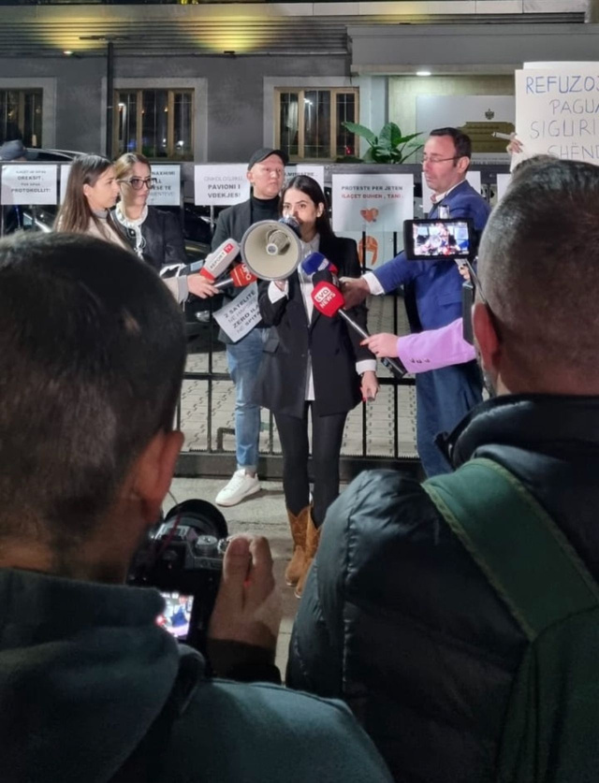
Media coverage:
Peaceful protests for the oncological treatment situation in Albania in front of MoH.
12

Slide 9
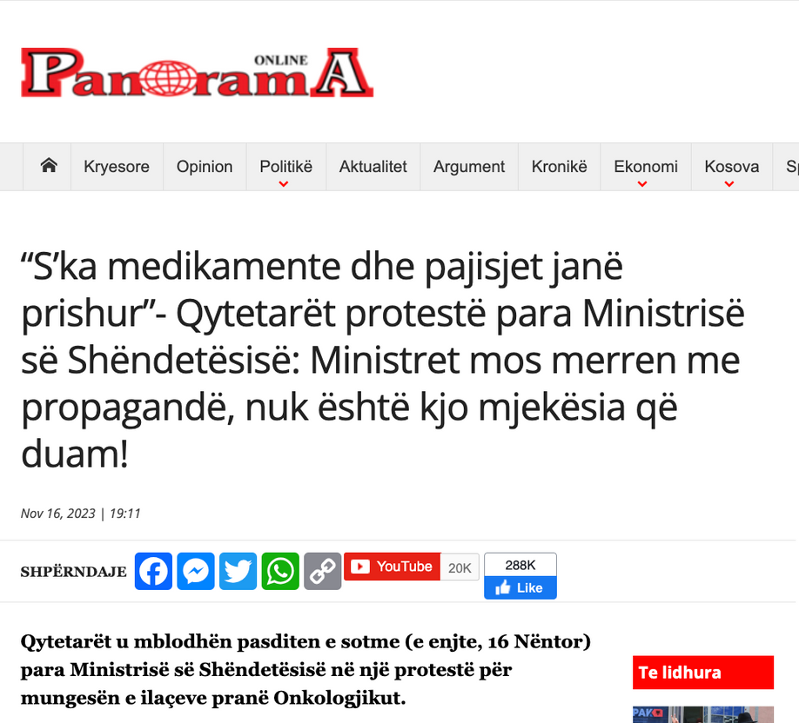
Panorama Newspaper
one of the most important media in Albania
Citizens gathered this afternoon (Thursday, November 16) in front of the Ministry of Health in a protest about the lack of medicines near the Oncology Department.

Slide 10
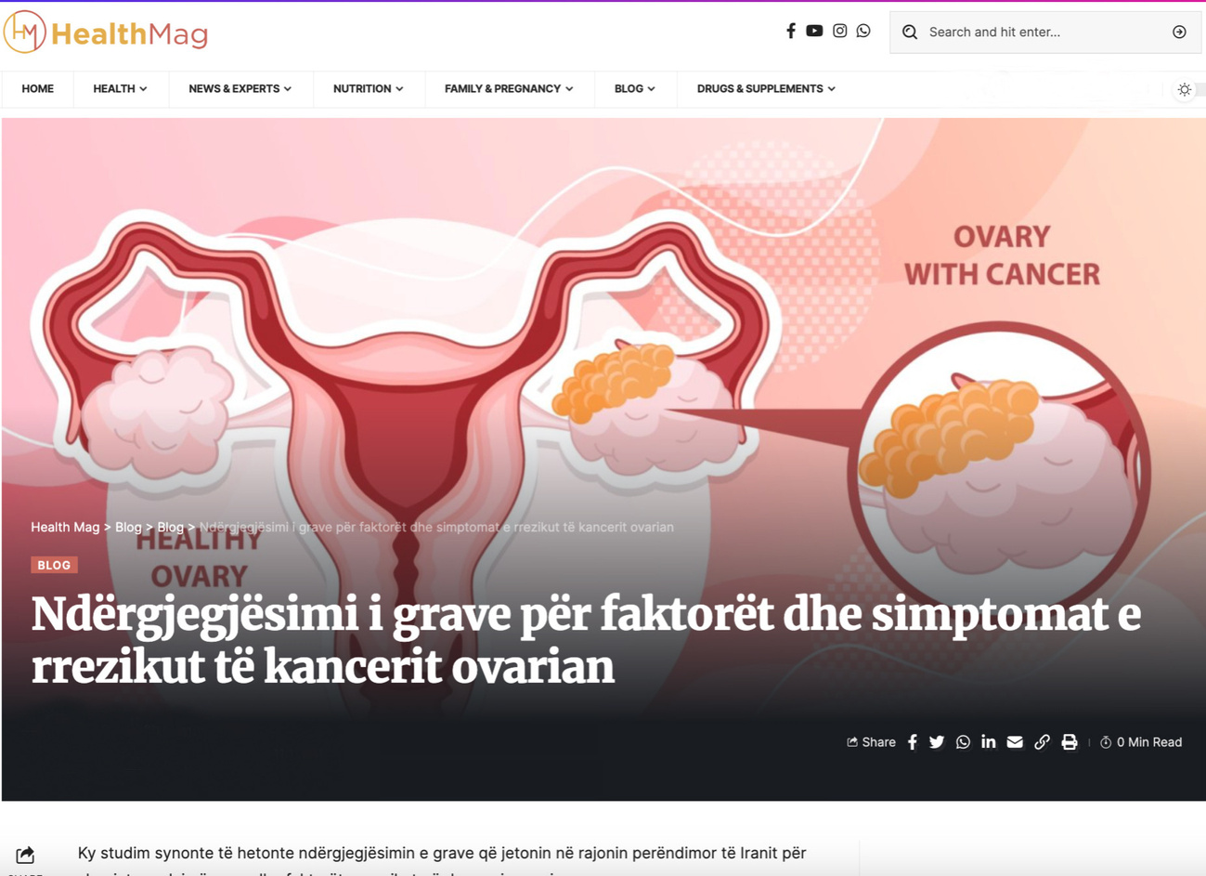
Health Mag
Women's awareness of ovarian cancer risk factors and symptoms especially for the Breast Cancer Patients.

Slide 11
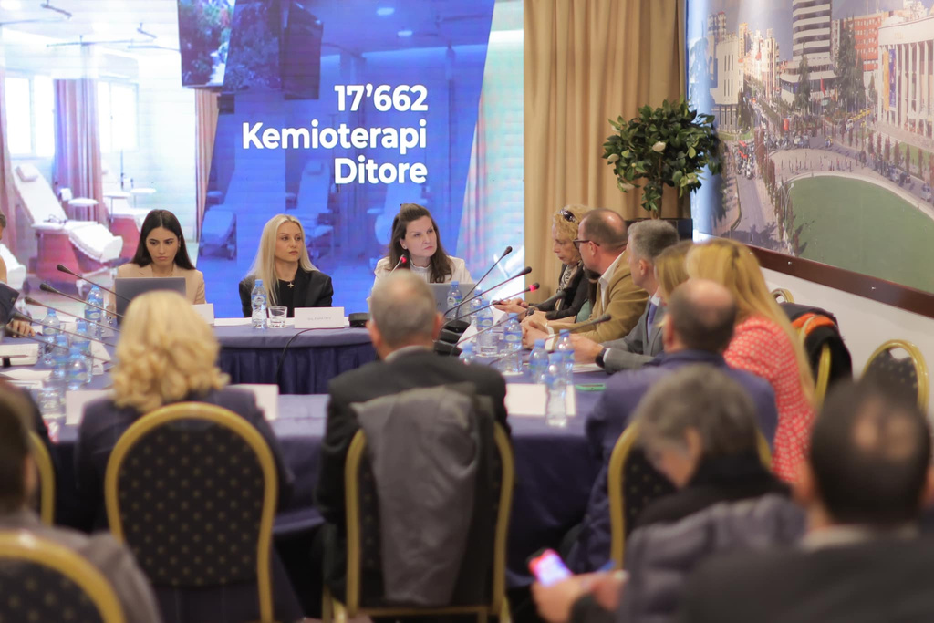
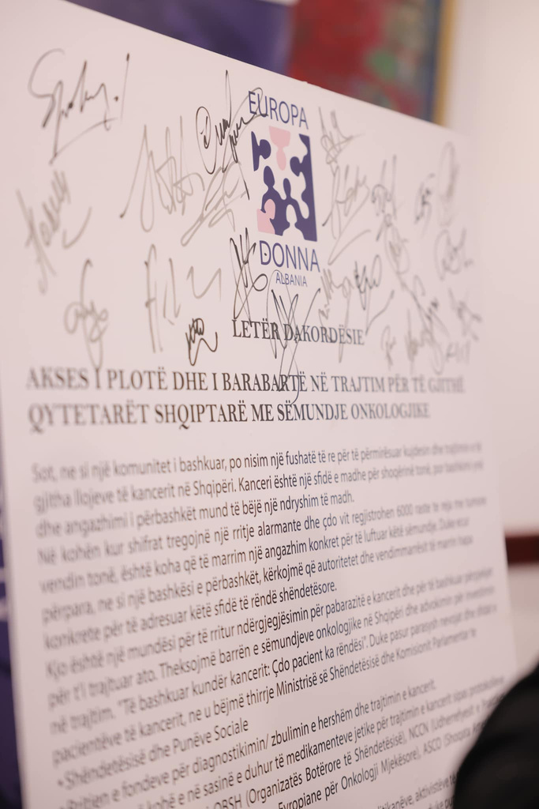
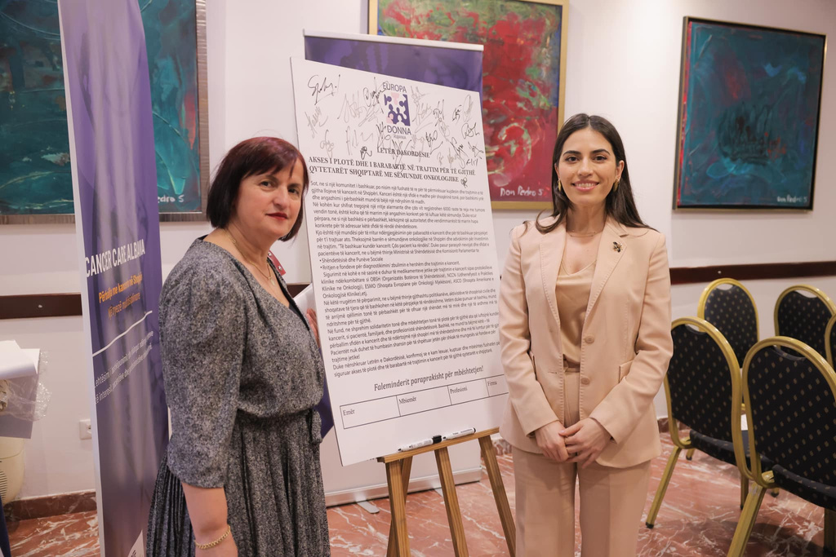
Cancer Care Albania
Europa Donna Albania organized a significant initiative called "Cancer Care Albania”. For the first time, a Patient Organization successfully convened all stakeholders at a single table to discuss matters concerning Cancer and Oncology.
Attendees signed the 'Letter of Agreement,' emphasizing the need for increased funding for diagnosis and treatment, as well as timely provision of essential drugs aligned with international clinical protocols.

Slide 12

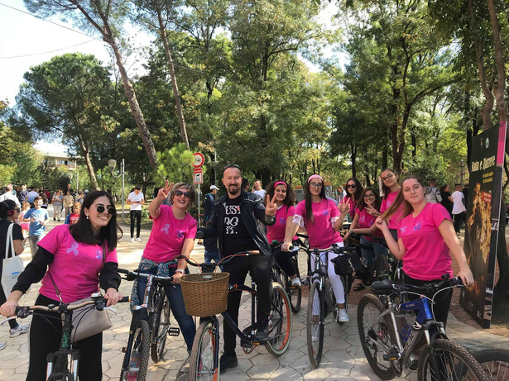

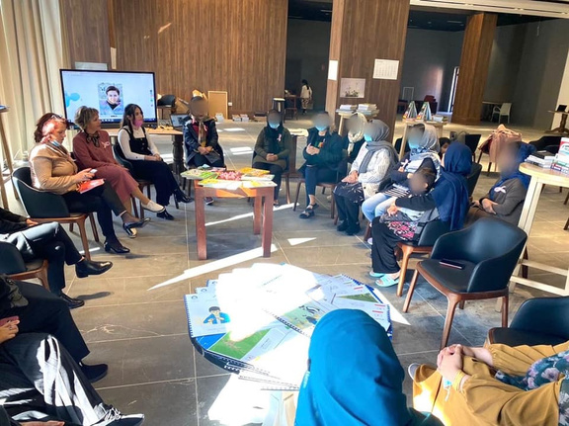
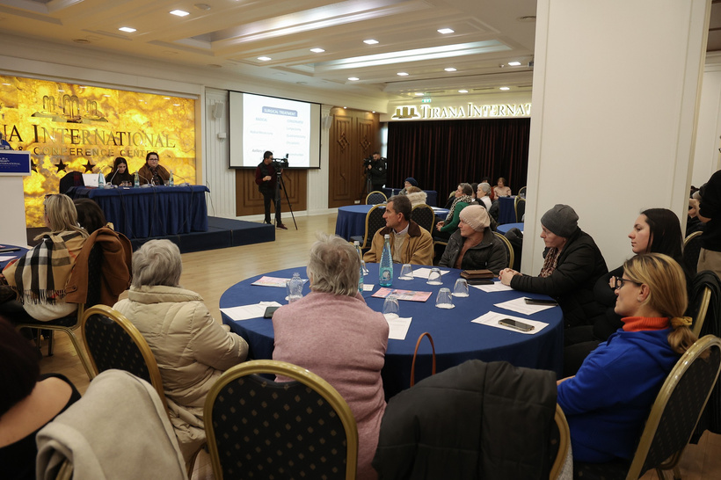

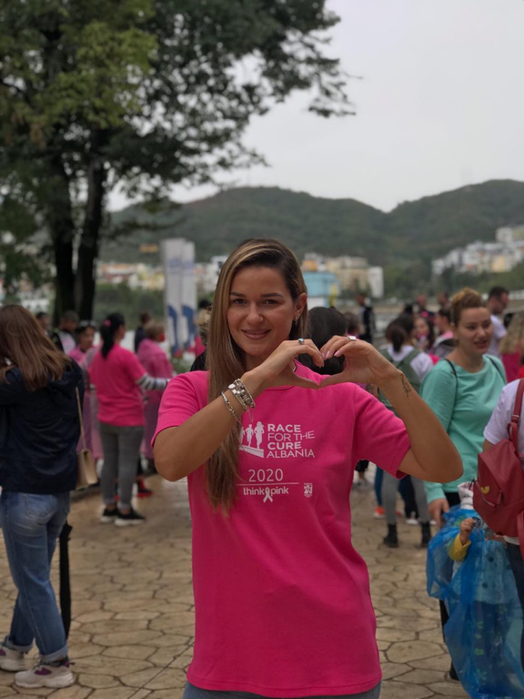
Europa Donna Albania
Some of our activities over the years

Slide 13
"Knowledge is power. Information is liberating. Education is the premise of progress, in every society, in every family."
- Kofi Annan

Slide 14

Thank You

