Slide 1


Let’s change direction - Cambiamo rotta
Advocacy campaign for the new unmet needs of italian women affected by ovarian cancer
PAS Engage 2024
Project Manager:
Nicoletta Cerana – ACTO Italia – Alleanza Contro il Tumore Ovarico

Slide 2
Let’s change direction: the reason why and the aims
One reason
The extraordinary therapeutic revolution in ovarian cancer has increased patient survival rates but has also created new and diverse needs that are currently unknown and unmet.
Three main goal
Identifying the new unmet needs
Drawing the attention of national health and political institutions as well of public opinion towards the new unmet needs
Opening a public discussion on concrete responses in terms of care pathways

Slide 3
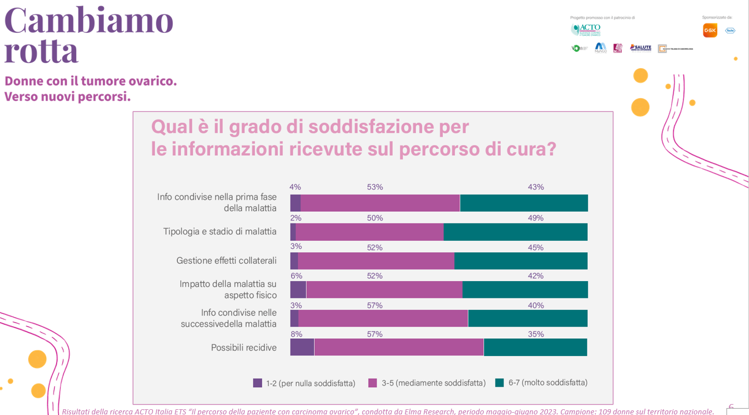
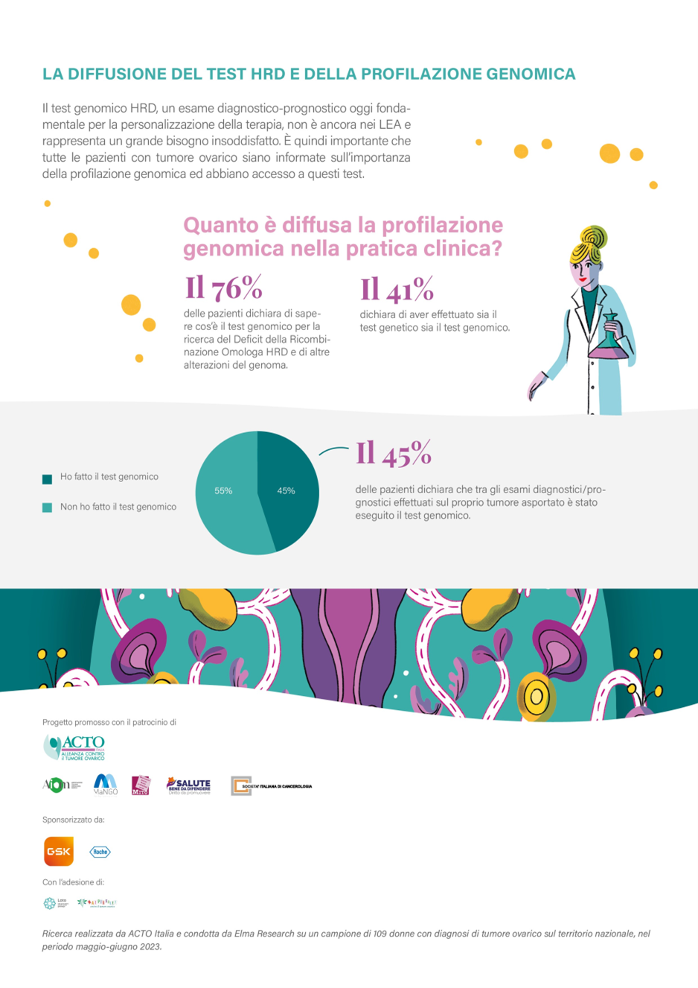
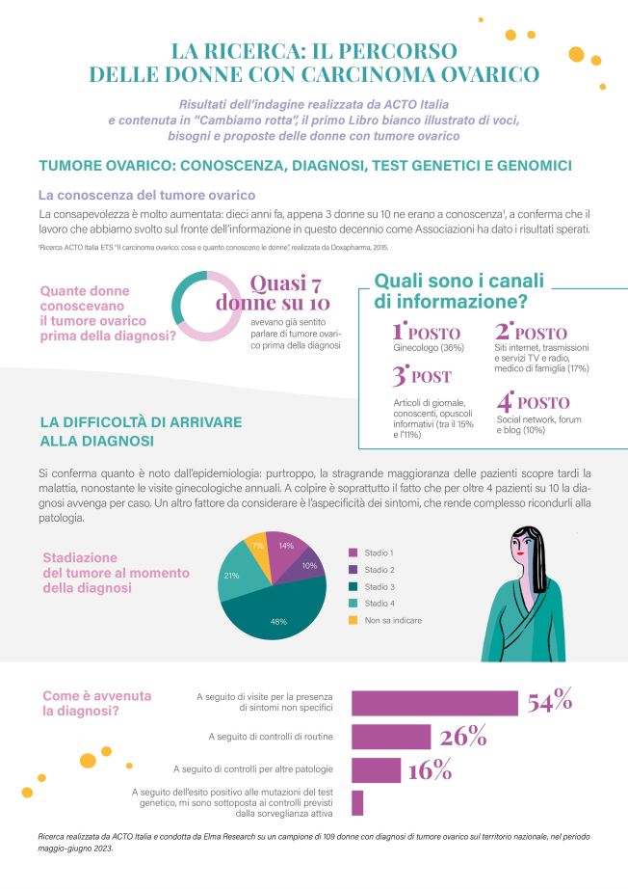
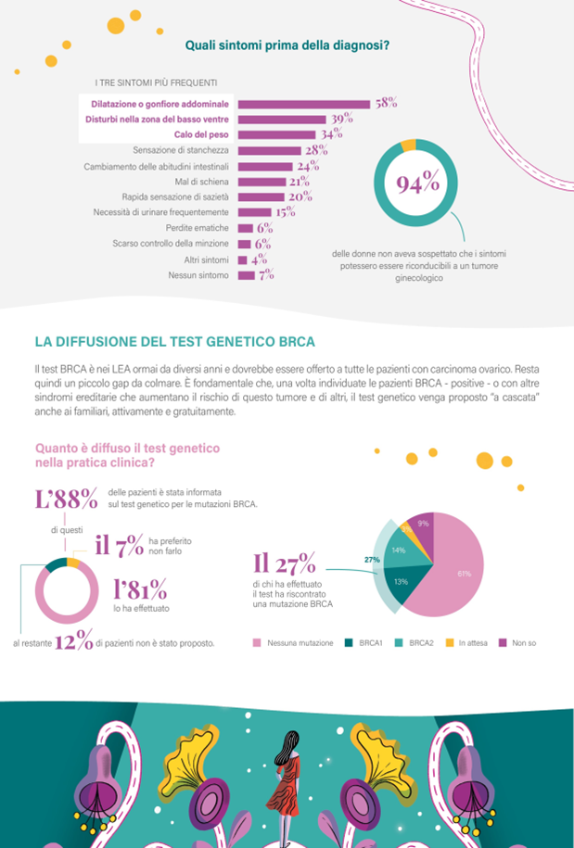
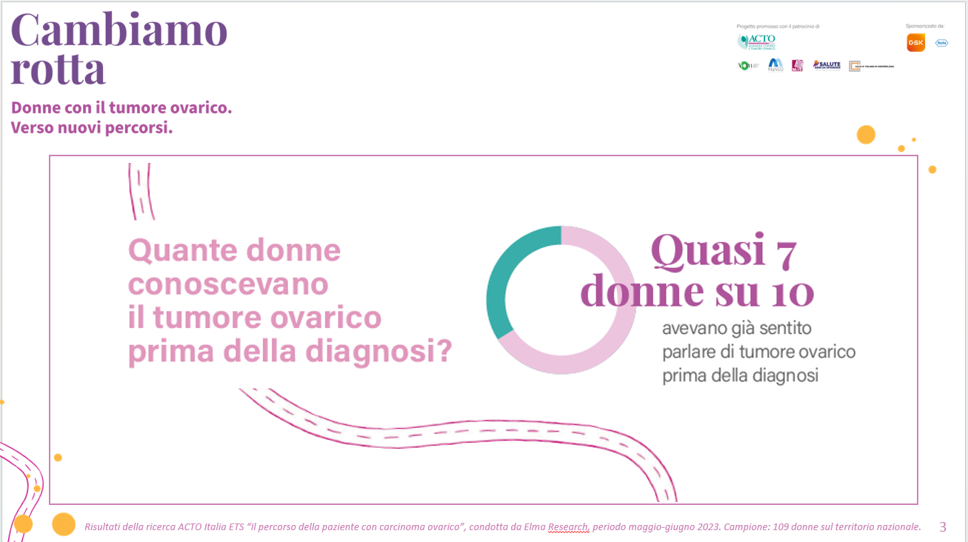
Let’s change direction
Identifying the new unmet needs
Quantitative survey involving
13 hospital
109 patients
37 questions
June-july 2023
Paper & CAWI methodology
to identify needs and criticalities
related to 37 specific aspects
of the care journey

Slide 4









Let’s change direction
Identifying the new unmet needs
Patients and caregivers experience: 9 stories
about 9 topics
  symptoms, diagnosis
  genetic & genomic test
  treatments pathway & surveillance
  progression, chronicity
  fertility& sexuality
  precision medicine
  caregiving
  QoL
  social & legal rights

Slide 5
Let’s change direction
Major current unmet needs in Italy
Disease Awareness:
still, 3 out of 10 women have never heard of ovarian cancer.
Specialized Care:
Only 27% of women choose a specialized center for ovarian cancer treatment.
Diagnostic Tests:
81% of women undergo genetic testing, but only 41% undergo genomic testing.
Oncofertility paths:
only 32% of women under 50 are aware of them.
Relationship with Sexuality:
worsened in 52% of patients, but only 16% seek and find a support from a specialist.
Economic and employment situation and information :
worsened in 65% of actively working women, only one in four women feels well-informed.

Slide 6


Let’s change direction
Drawing the attention towards the new unmet needs
  Publication of the White Paper «Let’s change direction»
  Promoted by Acto Italia in partnership with the 7 Acto regional PAGs
  With the patronage of 4 major Italian oncology scientific society: AIOM (Italian Society of Clinical Oncology), Italian Society of Cancerology, MITO and Mango Research groups
  94 pages
  Quantitative survey results
  9 ACTO patient stories commented by 18 clinicians
  9 editorial contributions signed by prominent opinion leaders in politics, medicine, and national government
  Preface signed by the italian Ministry of Health
  Supported by GSK and Roche

Slide 7
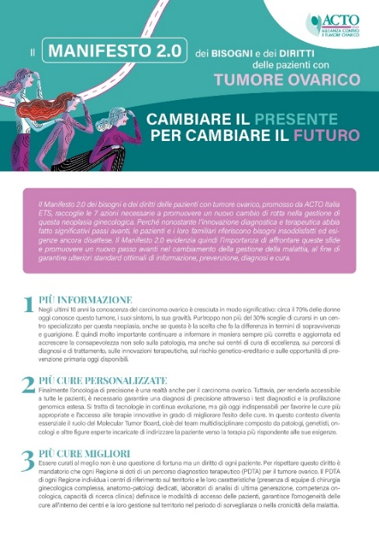
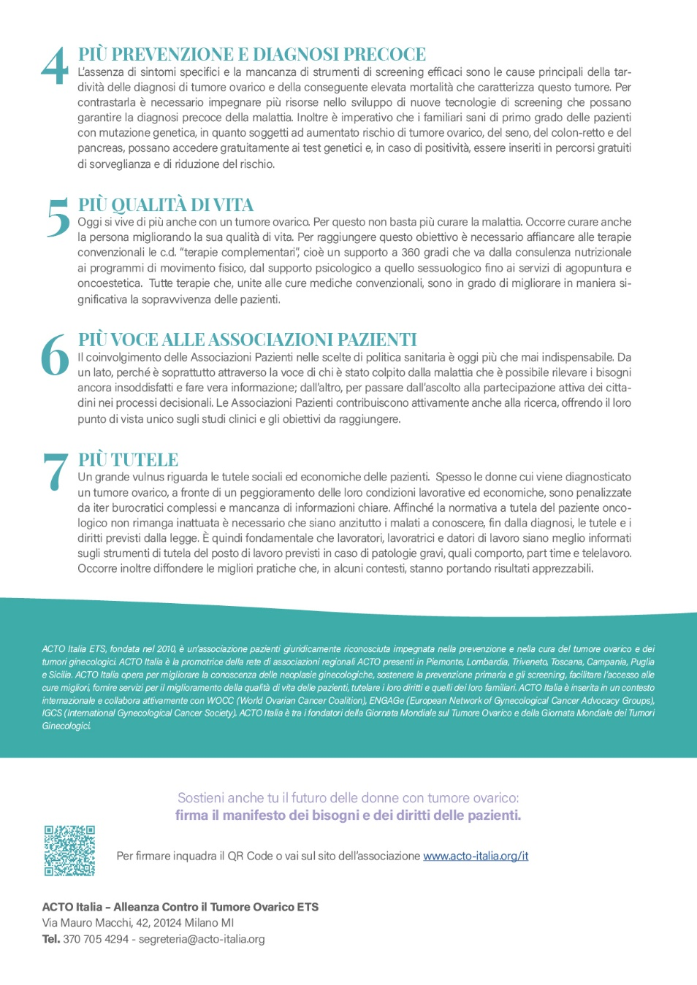
Let’s change direction
Drawing the attention towards the new unmet needs
  Publication of the 2.0 Manifesto “Needs and rights of ovarian cancer patients”
  More information
  More personalized care
  Better treatments
  Increased prevention and early diagnosis
  Improved quality of life
  Greater voice for patient associations
  Enhanced economic and social protections

Slide 8
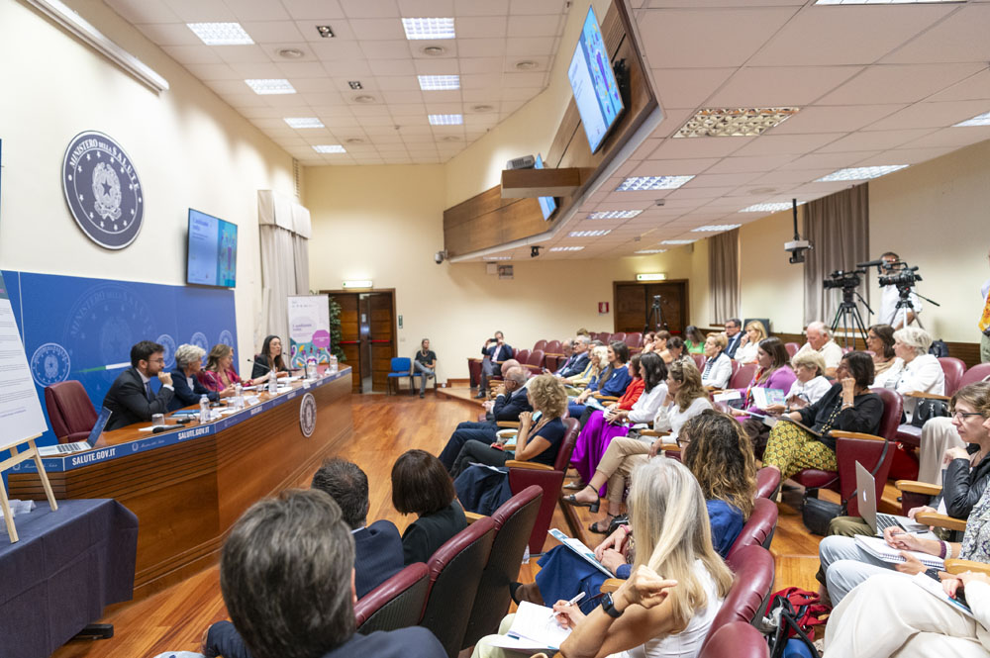
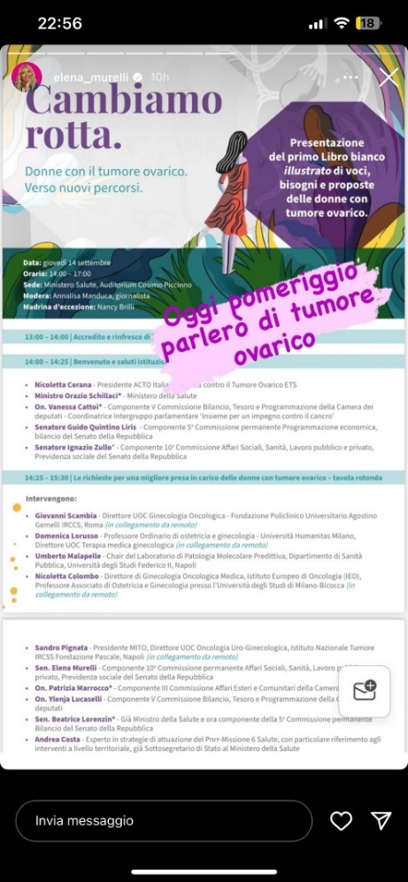
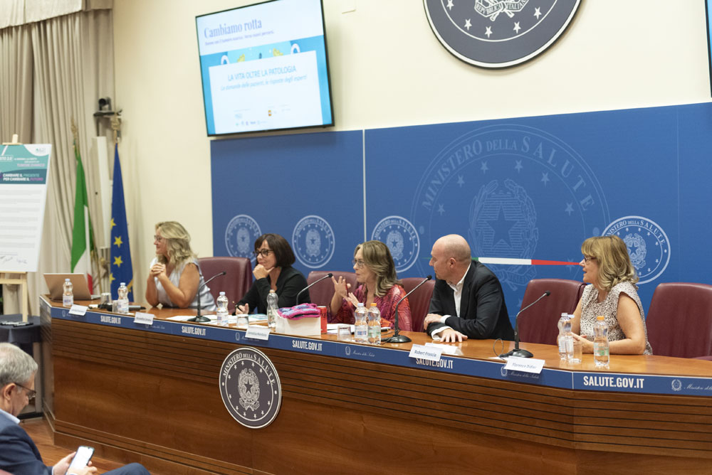
Let’s change direction
Opening a public discussion on new unmet needs
White Paper and Manifesto national launch
White Paper launch trough a live national events organized in Rome at the Ministry of Health
Event streaming on Youtube and Facebook,
2 sessions: one adressed to politicians and health authorities , one adressed to patients, caregivers and public opinion
Launch of the Manifesto by Nancy Brilli, wellknown italian actress ovarian cancer patient
Creation and publication on Youtube of 9 video-interviews with the 9 ACTO patients involved in the White Paper
Multichannel communication campaign on online and offline media, health information websites, Acto Italia website, and sponsors’ websites.

Slide 9
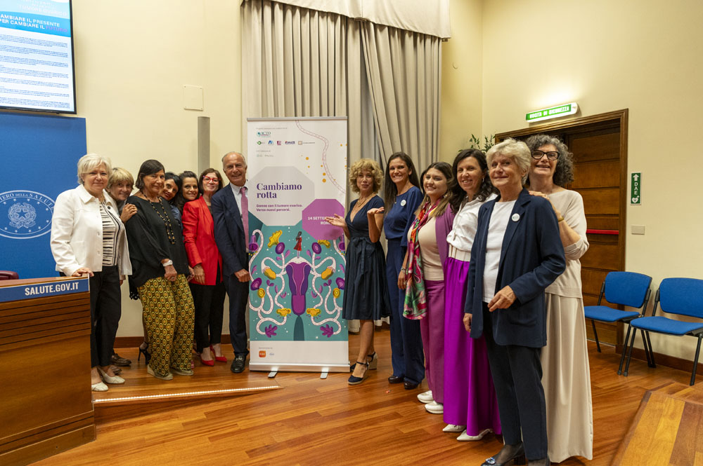
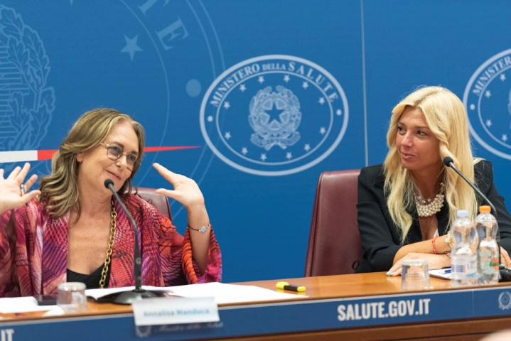
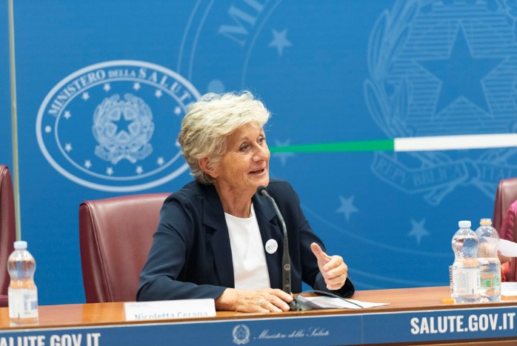
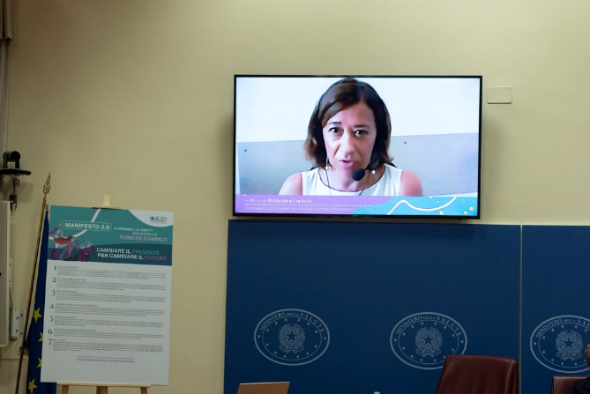
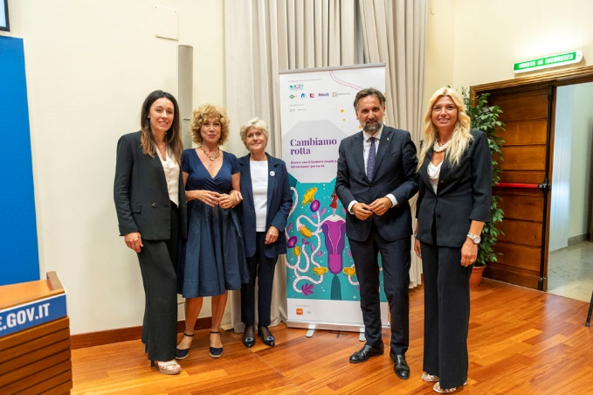
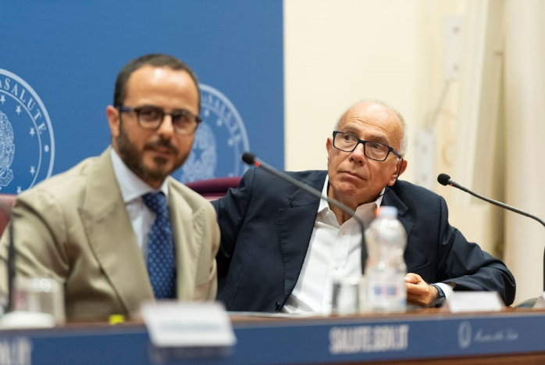
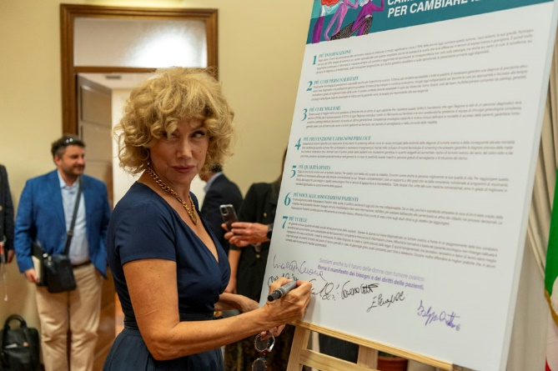
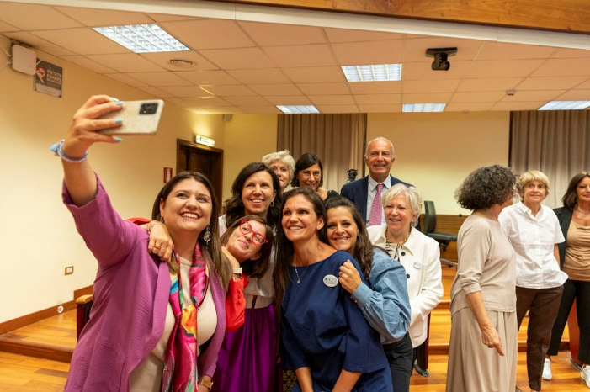
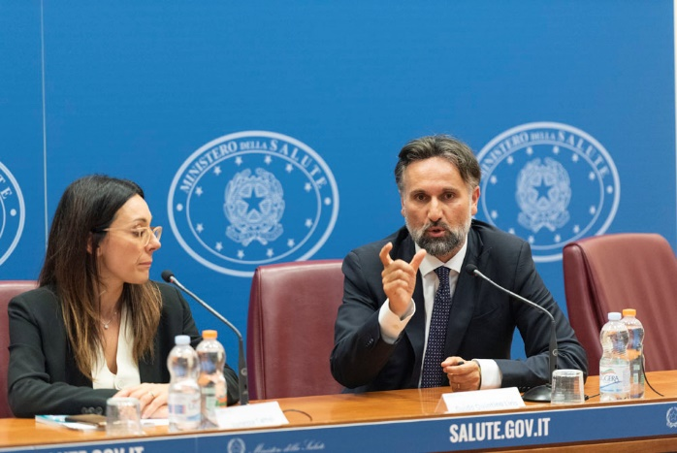
Let’s change direction
National launch: participants and results
Speakers: 13 (8 in presence,5 via videolink)
Journalists in presence: 16
Participants in presence: 98 people
Participants in streaming : more than 600
Press: publication of 83 articles for a total readership of 16,5 million.
Social media campaign
  FB reach 28,203
  Instagram reach 10,233
  FB videostreaming reactions 1,970.
  Acto youtube channel and social page: 476 visualizations
Online Manifesto: 190 people signature in 2 months

Slide 10
Let’s change direction
Let’s change direction: the project value
    The project has a dual value:
    it urges medical professionals and healthcare institutions to provide concrete responses to these needs at national and regional level
    It guides ACTO ITALIA towards the new direction that services and support activities for patients should take.
    The project will continue in 2024 involving ACTO associations in 7 regions.
    The implementation of the project is feasible in other countries, especially where there is a higher survival rate, leading to the emergence of new needs.

Slide 11
GRAZIE!
THANK YOU!
www.acto-Italia.org

Slide 12
Let’s change direction

