Slide 1
Preventive operation for BRCA / Lynch mutation
8th March 2024
Prof Ranjit Manchanda MD, MRCOG, PhD
Professor of Gynaecological Oncology
Wolfson Institute of Population Health, Queen Mary University of London
Barts Health NHS Trust , Royal London Hospital, UK
Honorary Professor, London School of Hygiene & Tropical Medicine
NHS Innovation Accelerator (NIA) Alumnus

Slide 2
Disclosures……………
Research Funding
China Medical Board
Other Disclosures- Honorarium – MSD, Astrazeneca, GSK, EGL, Israel National Institute for Health Policy Research

Slide 3
BACKGROUND
Preventive Surgery in BRCA +
Preventive Surgery in Lynch
SUMMARY

Slide 4
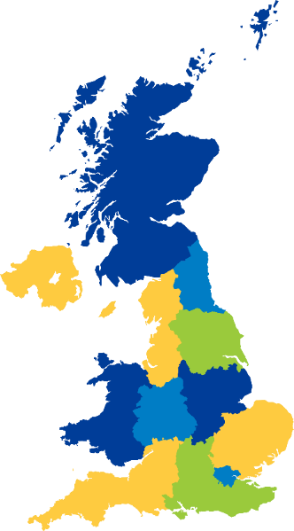
2020
50% women’s cancers
Cases WORLDWIDE | Breast Cancer | Ovarian Cancer | Bowel Cancer | Womb (Endometrial) Cancer
Number of Cases Annually | 2,261,419 | 313,959 | 1,931,590 | 417,367
WORLD
UK
4.9 M cases annually
116,000 cases annually

Slide 5
2020
Predicted Rise in Cancer Cases by 2040
WORLD
UK
Cases: 27-53%
Deaths: 49-69%
Cases: 20-36%
Deaths: 36-47%
Notes:
26-36% CASES INCREASE IN UK, 47-58% OC CASES INCREASE WORLDWIDE

Slide 6
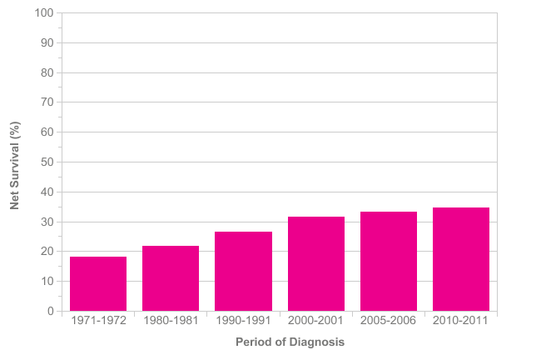
Ovarian Cancer is a horrible disease ……………..
65% patients will die from OC
Much higher if we look at high grade EOC
65%
Ovarian Cancer (C56 C57.0-C57.7): 1971-2011
Age-Standardised Ten-Year Net Survival, England and Wales

Slide 7
PREVENTION STRATEGY
BETTER IDENTIFICATON OF HIGH-RISK PEOPLE
BETTER TARGETED PREVENTION
SCREENING
RISK MANAGEMENT
FEWER CANCERS
REDUCED DEATHS
MOST EFFECTIVE STRATEGY: SURGICAL PREVENTION

Slide 8
BRCA1
BRCA2
All Ovarian Cancers
20%
MLH1
MSH2
MSH6
PMS2
Lynch Syndrome
1 in 5
PALB2
RAD51C
RAD51D
BRIP1
Other Genes

Slide 9
3%
All Womb Cancers
Lynch Syndrome
1 in 33

Slide 10
Breast | Ovary | Bowel | Endometrial
BRCA1 | BRCA1 | MLH1 | MLH1
BRCA2 | BRCA2 | MSH2 | MSH2
PALB2 | PALB2 | MSH6 | MSH6
RAD51C | RAD51C | PMS2 | PMS2
RAD51D | RAD51D | EPCAM
CHEK 2 | BRIP1
ATM | MLH1
BARD1 | MSH2
 | MSH6
20% Ovarian Cancers
4% Breast Cancers
3% Womb Cancers
4% Bowel Cancers
~1% women in the general population may have one of these cancer genes
THESE CANCERS ARE POTENTIALLY PREVENTABLE

Slide 11
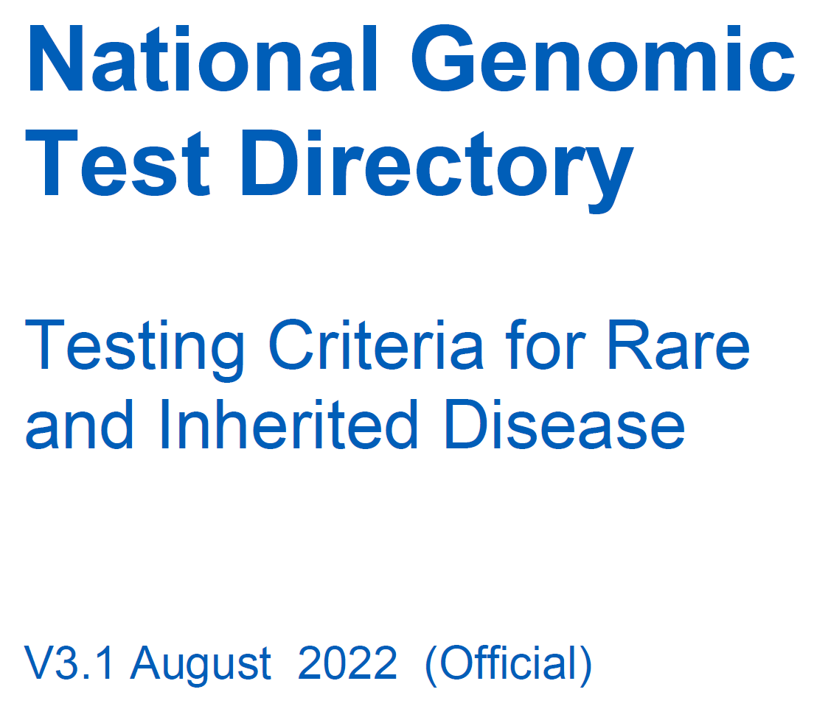
GERMLINE
TUMOUR (SOMATIC)
OVARIAN CANCER GENES
WOMB CANCER GENES
BRCA1
BRCA2
BRCA1
BRIP1
MLH1
MSH2
HRD assay/test
BRCA2
PALB2
MSH6
PMS2
RAD51C
RAD51D
MMR: Lynch Syndrome Genes
MLH1, MSH2, MSH6
GUIDELINES RECOMMEND
TESTING FOR THESE GENES

Slide 12
Lynch Syndrome
 | Cancer risks (%)
GENE | Ovarian cancer | Colorectal cancer | Endometrial cancer
MLH1 | 11 | 48 | 37
MSH2 | 17 | 47 | 49
MSH6 | 11 | 20 | 41
PMS2 | 3% | 10 | 13
General population risk (no altered gene) | 2% (1 in 50) | 5.6% (1 in 18) | 2.7% (1 in 36)
Prospective Lynch Syndrome Database, Moller, et al. 2020
Notes:
PLSD Moller

Slide 13
GENE | Ovarian Cancer Risk​
BRCA1​ | 44%​
BRCA2​ | 17%​
RAD51C | 11%
RAD51D | 13%
BRIP1 | ~8%
PALB2 | 5%
MLH1 | 11%
MSH2 | 17%
MSH6 | 11%
General Population Risk | 1.3-2%
Breast Cancer Risk
77%
69%
53%
12-15%

Slide 14
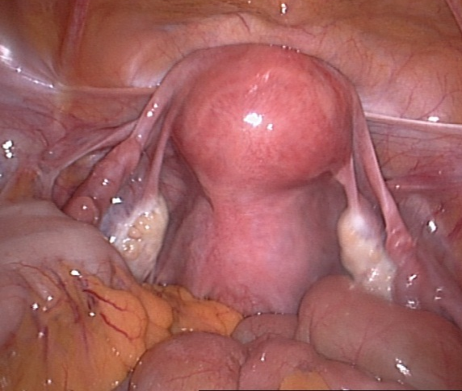
REMOVING BOTH TUBES & OVARIES
RRSO: RISK REDUCING SALPINGO-OOPHORECTOMY
REMOVING UTERUS + BOTH TUBES & OVARIES
HYSTERECTOMY AND BILATERAL SALPINGO-OOPHORECTOMY
NEW 2 STAGE OPTION:
BOTH TUBES FIRST BOTH OVARIES LATER
RRESDO: RISK REDUCING EARLY SALPINGECTOMY
+ DELAYED OOPHORECTOMY
BROADENING ACCESS TO SURGICAL PREVENTION

Slide 15
Removing Tubes and Ovaries:
Most effective method to reduce Ovarian Cancer risk
Keyhole surgery, Washings for cytology
~ 80-97% reduction in Ovarian Cancer Incidence
Reduction in Deaths from Ovarian Cancer (Mortality)
Reduction in deaths overall (all-cause)
Reduces Anxiety and Ovarian Cancer worry
No change in General Quality of Life
Wei, Manchanda 2023 AJOG
Domchek et al, JAMA 2010, Kotsopoulos Jama Oncol 2024
Finch et al, JCO 2014
Crosbie, Evans IJC 2020, Domchek JAMA 2010, Finch 2014 JCO, Rebbeck 2009 JNCI

Slide 16
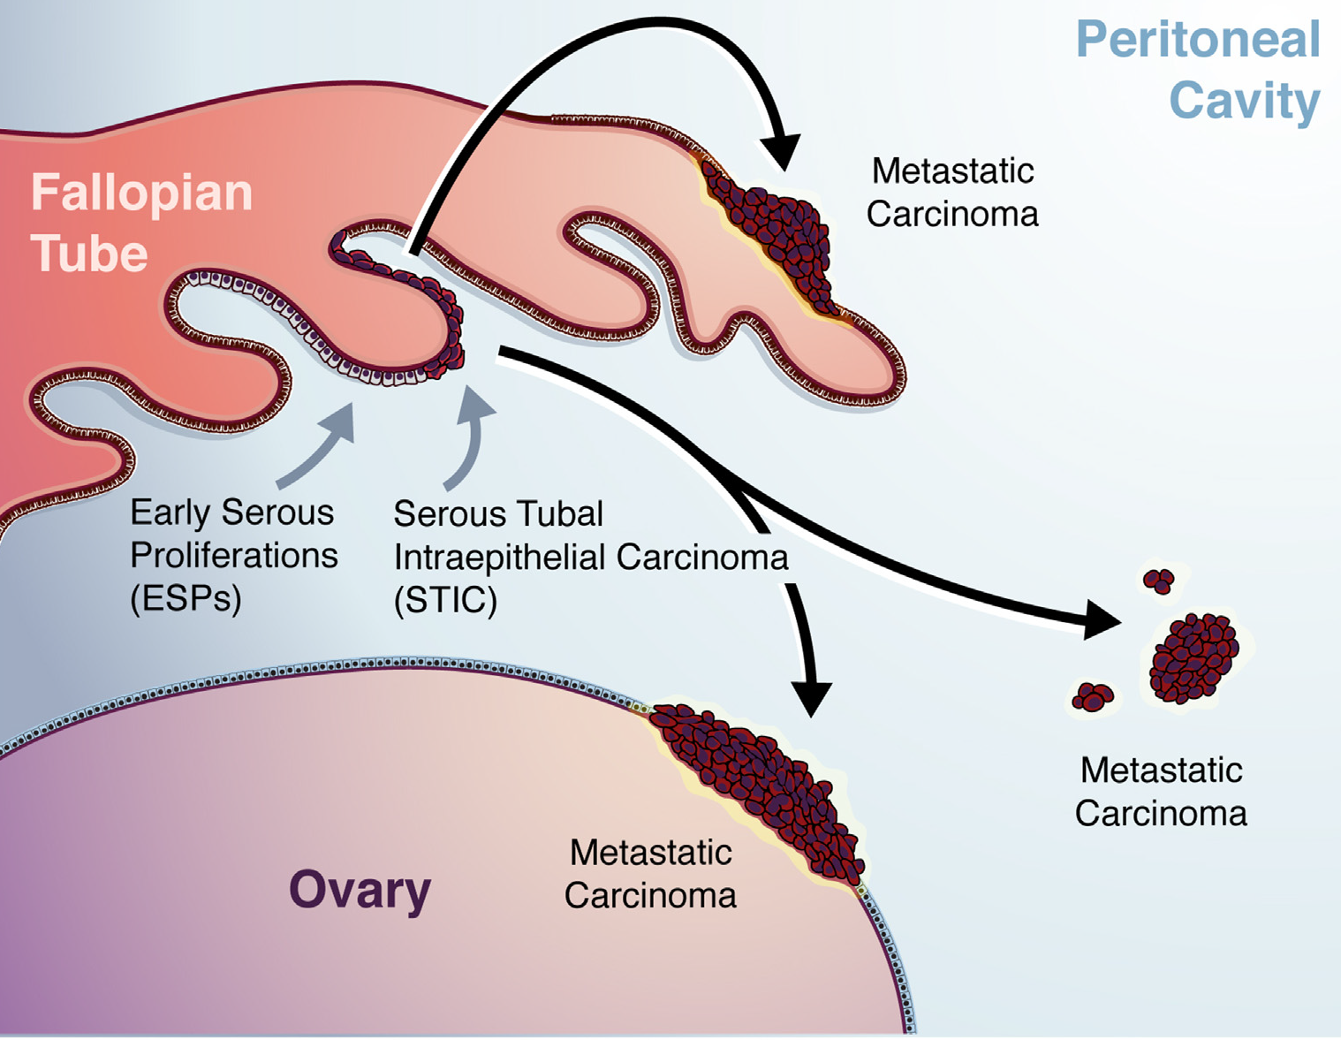
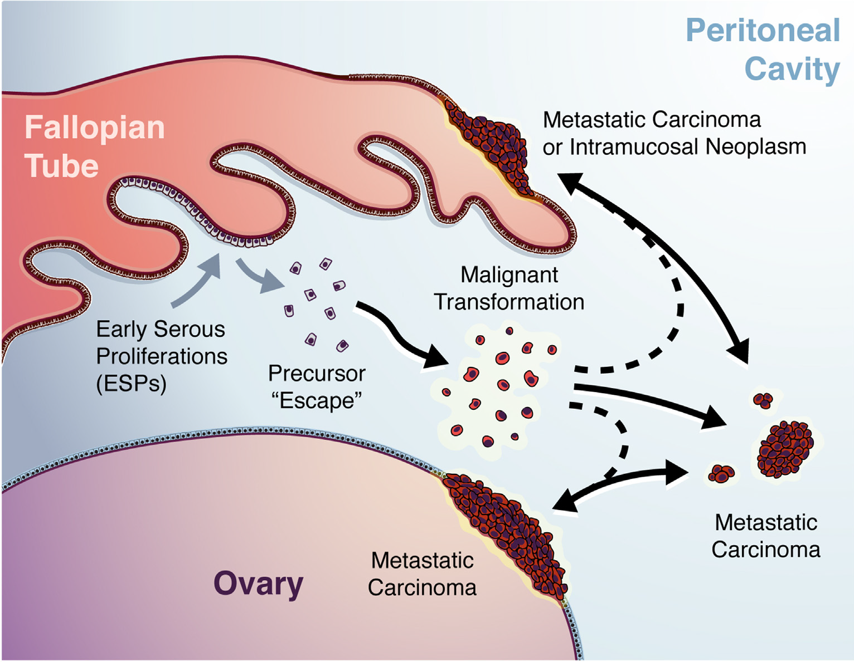
Gynecol Oncol 2019
TUBAL ORIGIN OF OVARIAN CANCER
Notes:
These early lesions were described as serous tubal intraepithelial carcinoma (STIC).
STICs share several histological features in common with HGSOC
Accumulating evidence supporting STIC as a precursor lesion of HGSC, with the potential to progress to invasive carcinoma and metastasize⁶².

Slide 17
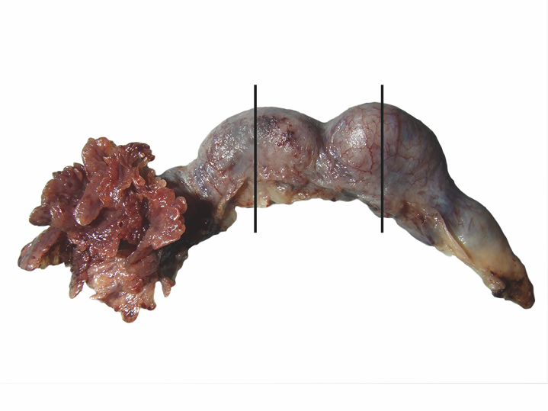
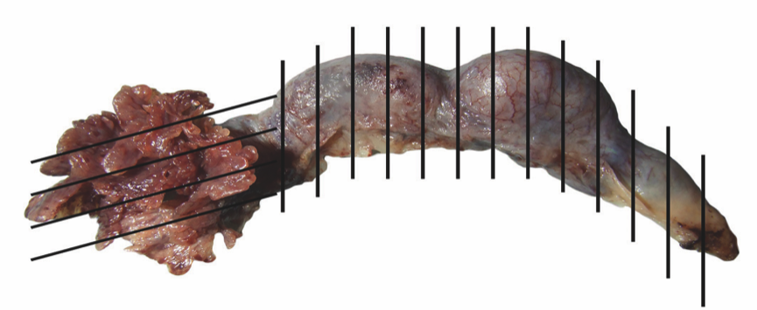
SPECIAL PATHOLOGY PROTOCOL
IMP
Historical
SEEFIM PROTOCOL-
Sectioning and Extensively Examining the FIMbriated end of the Fallopian Tube
ESSENTIAL

Slide 18
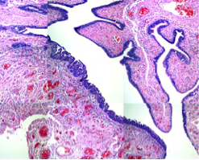
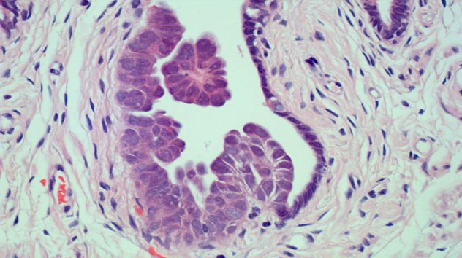
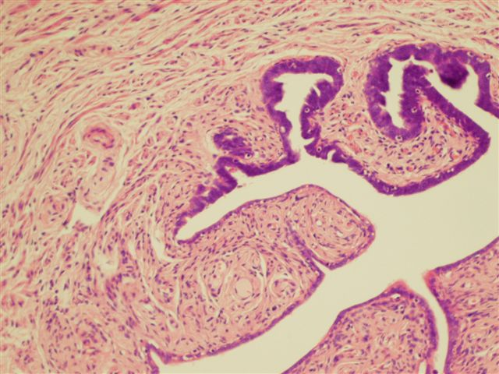
Serous Tubal Intraepithelial Carcinoma = STIC
CANCER
PRE CANCER
1:20 Individuals
Normal scan and Ca125
SEEFIM ESSENTIAL

Slide 19
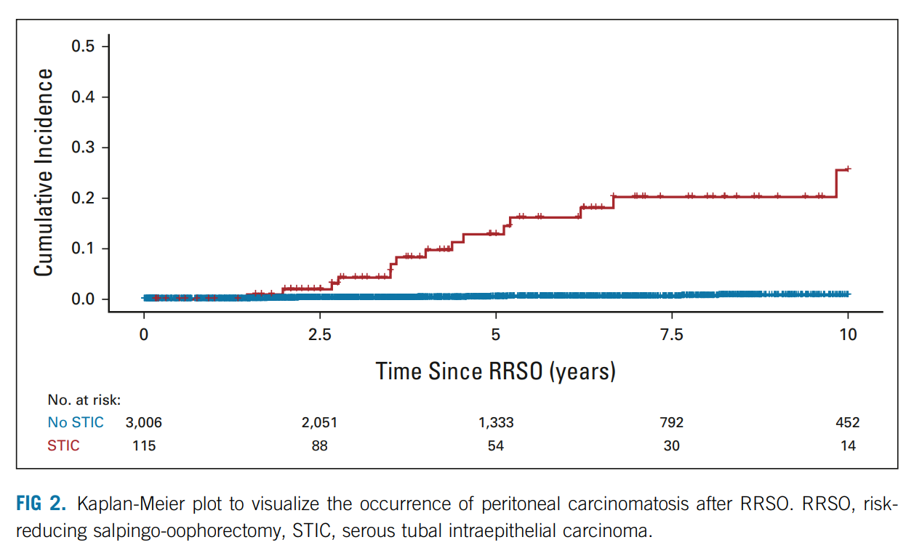
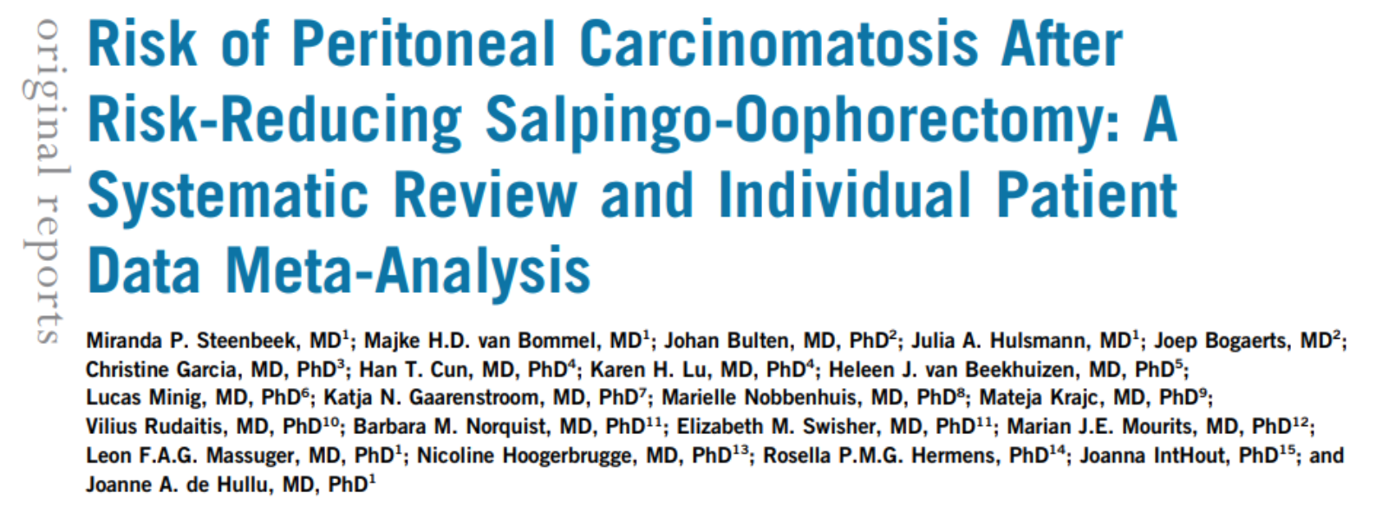
Other Points
70% these lesions are Tubal
Small residual chance of Peritoneal cancer over 20 yrs
2-4% Finch 2014 J Clin Oncol
0% Marcinkute 2021 JMG (Manchester)
Presence of STIC | 5 Year | 10 Year
STIC | 10.5% | 27.5%
No STIC | 0.3% | 0.9%
JCO Feb 2022

Slide 20
Important issues
Fertility
Age
Gene, Cancer Risk
Premature Surgical Menopause: implications
HRT

Slide 21
Initially multiple studies: Up to a 50% reduction BC incidence in premenopausal women Recently become controversial: Many Studies showing no benefit
IMPACT ON BC RISK
META ANALYSIS
Reduction of Breast Cancer risk in BRCA2-carriers alone
(RR=0.63, 95%CI:0.41-0.97)
Reduction Deaths from breast cancer in BC-affected BRCA1 carriers
(RR=0.46, 95%CI:0.30-0.70)
21 RRSOs to prevent one breast cancer in BRCA2-carriers
6 RRSOs - Prevent one BC-death in BRCA1-&-BRCA2-carriers

Slide 22
HYSTERECTOMY: YES or NO?
OUR VIEW + TRADITIONAL VIEW: NOT ROUTINELY UNLESS OTHER INDICATION
PROPONENTS :
Avoids smears
Estrogen alone HRT
In patients on tamoxifen
Not a Strong enough Clinical Rationale
BRCA1 & Serous EC Risk? - Recent studies
Small number cases 2-5, Wide CI
Only 7% EC
Overall EC risk not increased
Increased Serous EC risk
Saule JNCI 2018
Shu, Kauff 2016 Jama Oncol
Laitman Cancer 2018
Kitson 2020 EJC
No increase in serous EC risk
More Corroboratory evidence is needed

Slide 23
CSG-specific strategies
Screening
Surgery
Medical prevention
BRCA1: RRSO @35 ; RRM @30
BRCA2: RRSO @35-40 ; RRM @30
PALB2: RRSO @45 ; RRM @40
RAD51C/RAD51D: RRSO @45
BRIP1: RRSO @45

Slide 24
Base case
Population impact of risk-reducing surgery for preventing cancer (per 1,000 pathogenic variant carriers)
Strategy | BC cases | BC deaths | OC cases | OC deaths | BC cases prevented | BC deaths prevented | OC cases prevented | OC deaths prevented
BRCA1
High-risk BC surveillance and tamoxifen from age 30* | 601 | 63 | 412 | 253
RRM at age 30 | 83 | 11 | 423 | 260 | -518 | -52 | 11 | 6
RRSO at age 35 with high-risk BC surveillance and tamoxifen from age 30 | 710 | 56 | 24 | 7 | 108 | -7 | -388 | -246
RRM at age 30 with RRSO at age 35 | 65 | 7 | 25 | 8 | -536 | -56 | -387 | -246
BRCA2
High-risk BC surveillance and tamoxifen from age 30* | 630 | 74 | 171 | 106
RRSO at age 35 with high-risk BC surveillance and tamoxifen from age 30 | 549 | 33 | 7 | 2 | -80 | -41 | -164 | -103
RRM at age 30 | 91 | 15 | 174 | 107 | -539 | -59 | 3 | 2
RRM at age 30 with RRSO at age 35 | 65 | 5 | 7 | 2 | -565 | -69 | -163 | -103
PLAB2
High-risk BC surveillance and tamoxifen from age 30* | 481 | 109 | 46 | 30
RRM at age 40 | 77 | 18 | 47 | 30 | -404 | -91 | 0 | 0
RRSO at age 45 with high-risk BC surveillance and tamoxifen from age 30 | 402 | 40 | 4 | 2 | -79 | -69 | -42 | -28
RRM at age 40 with RRSO at age 45 | 59 | 7 | 4 | 1 | -422 | -102 | -42 | -28
RAD51C
Moderate-risk BC surveillance and tamoxifen from age 40* | 188 | 53 | 108 | 66
RRSO at age 45 with moderate-risk BC surveillance and tamoxifen from age 40 | 238 | 48 | 6 | 2 | 50 | -6 | -102 | -64
RAD51D
Moderate-risk BC surveillance and tamoxifen from age 40* | 174 | 48 | 124 | 78
RRSO at age 45 with moderate-risk BC surveillance and tamoxifen from age 40 | 220 | 43 | 6 | 2 | 46 | -5 | -118 | -76
BRIP1
No surgery* | / | / | 63 | 40 | / | /
RRSO at age 45 | / | / | 7 | 3 | / | / | -55 | -37

Slide 25
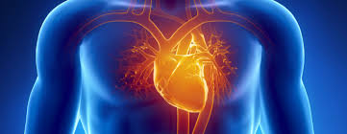
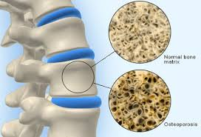
Inc CV risk
CV mortality: NNH 1:33 without HRT
Sexual DysFn
Neurocognitive problems:
Parkinsons, Dementia
Surgical Menopause
VMS
Osteoporosis
HRT Until Age 51, Unless Any Contraindications
2020

Slide 26
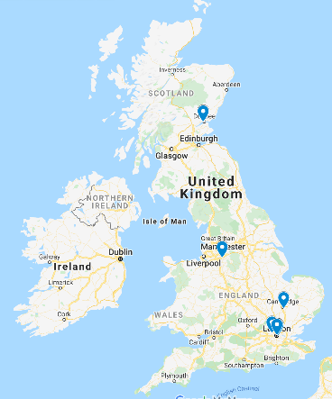
Manchester
Barts
UCLH
Guys
Cambridge
Dundee
2020
RRESDO
683 BRCA women
89% premenopausal vs 95% postmenopausal Satisfaction with RRSO
9.4% premenopausal vs 1% postmenopausal Regretted RRSO
RRESDO high acceptability - 69%
38% RRSO women would have opted for RRESDO in retrospect
Concerned about sexual-dysfunction- RRESDO TWICE AS acceptable
Women who prioritise greater reduction in OC risk: prefer RRSO

Slide 27
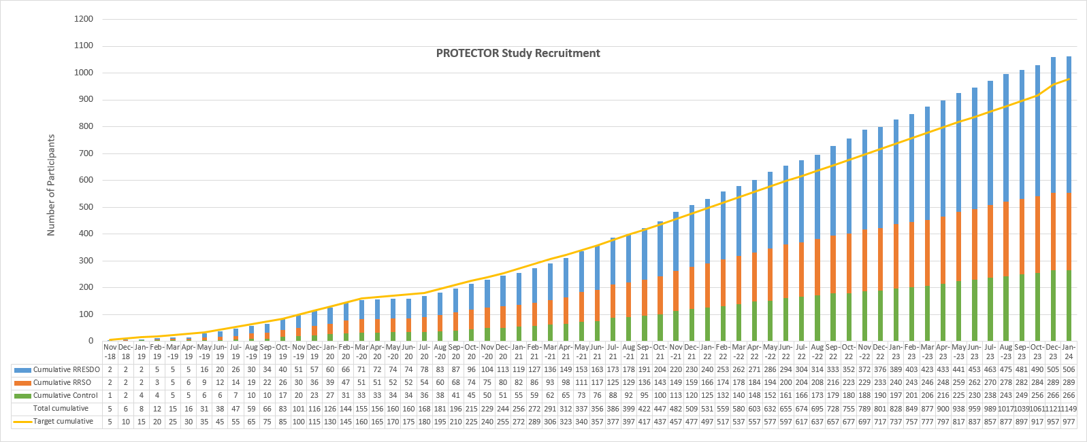
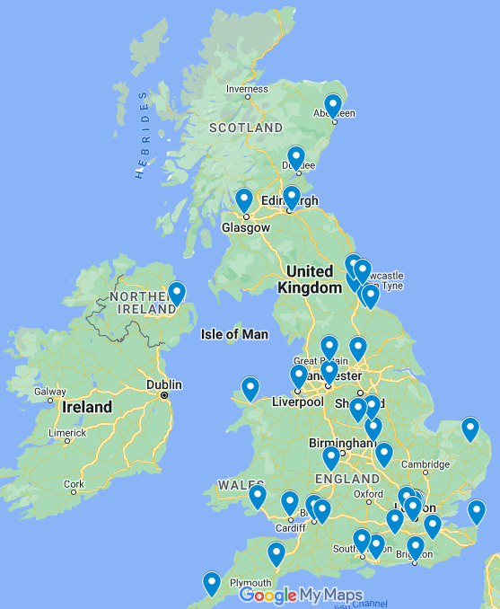
2 step – tubes and then ovaries
Tubes & ovaries
N = 1250
Control
Multicentre Prospective Study
Risk reducing
salpingo-oophorectomy
(RRSO)
Risk reducing early salpingectomy followed by delayed oophorectomy (RRESDO)
No surgery
(Control)
Participants Self-Select Study Arm

Slide 28
RRESDO offers women delaying/declining premenopausal oophorectomy, particularly those concerned about menopausal effects, a degree of ovarian cancer risk reduction whilst avoiding premature menopause
TUBA Study
EARLY SALPINGECTOMY HAS IMPROVED MENOPAUSAL SYMPTOMS & SEXUAL FUNCTION COMPARED TO RRSO
Steenbeek et al 2021

Slide 29
Experiences of women following risk-reducing early-salpingectomy and delayed-oophorectomy and salpingo-oophorectomy on the PROTECTOR trial: a qualitative study
Decision making
High satisfaction and low decision regret
RRES enabled participants to benefit from risk-reduction sooner than otherwise
Control of DO timing is essential. Patients value annual follow-up to answer concerns, discuss timing and HRT
The decision for DO is more difficult – patients need more support
Menopause management
Patients desire adequate pre-op counselling and post-op management - often the major determinant of satisfaction
Strongly prefer specialist advice
STIC
Uncertainty over risks, heightened cancer worry, desire for follow-up/ monitoring.
Particularly grateful for risk-reducing surgerY

Slide 30
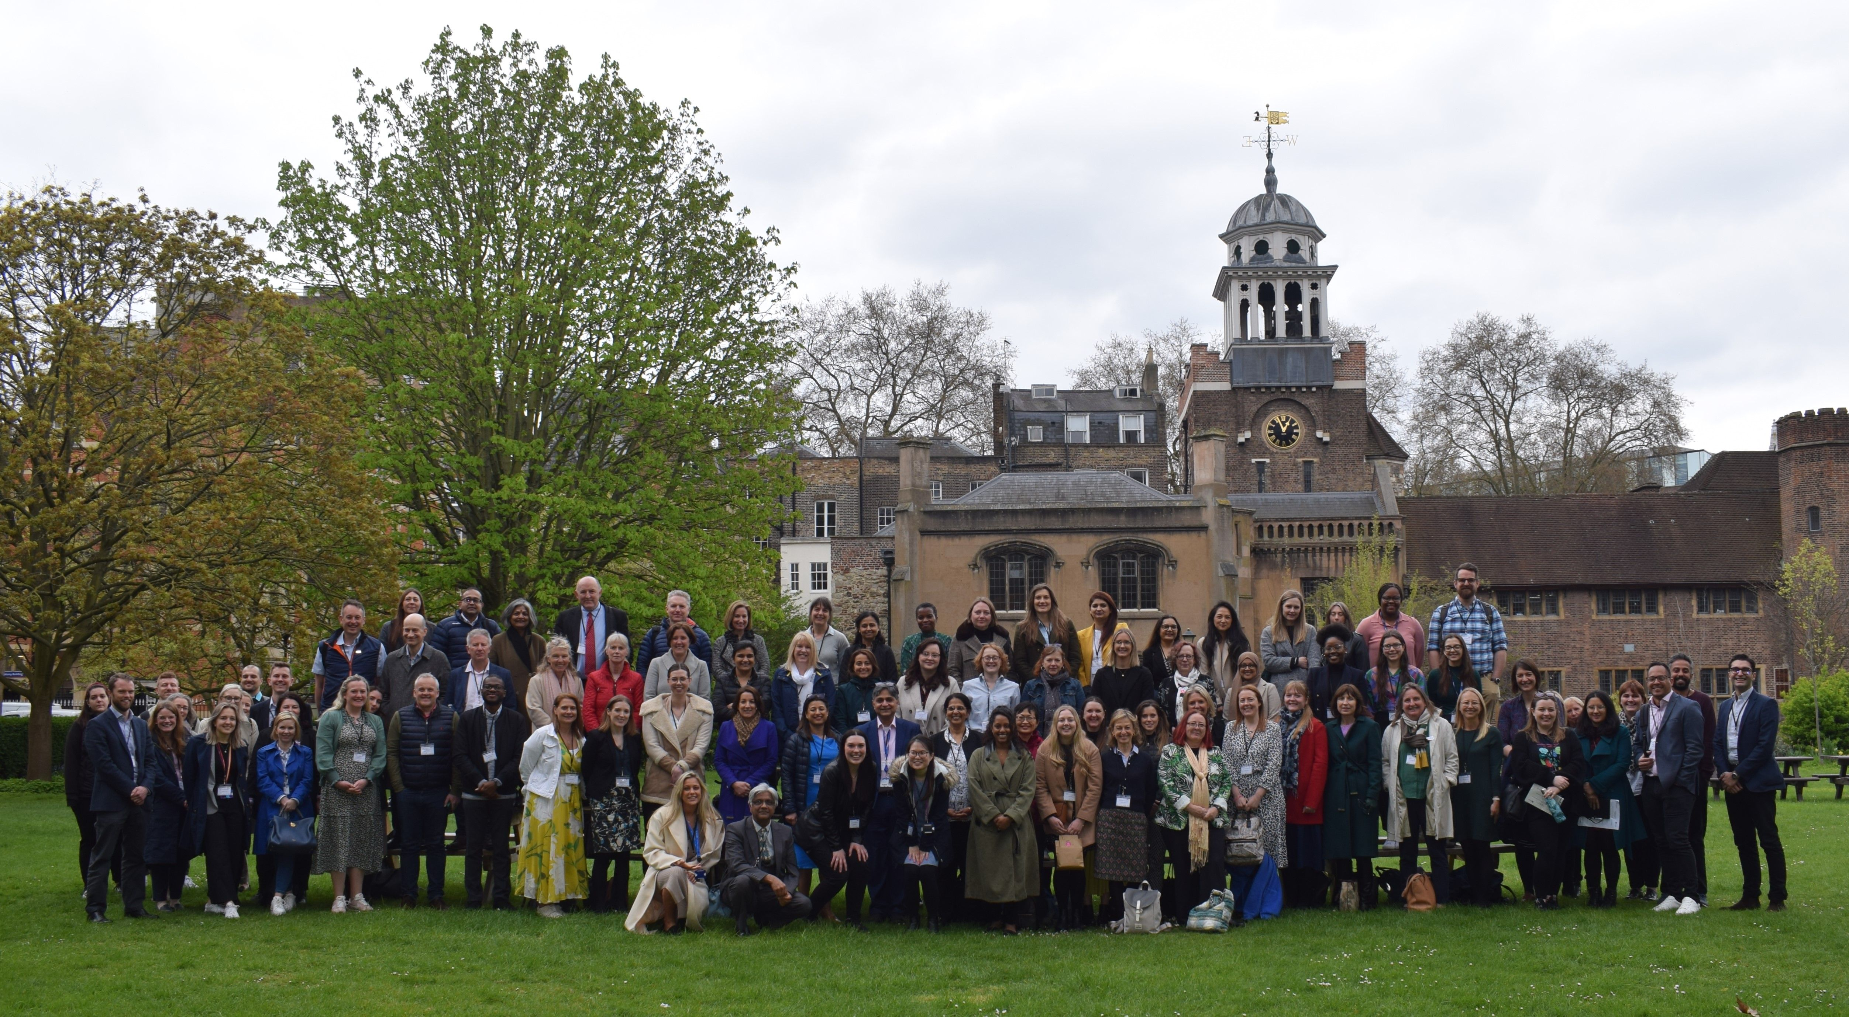

Slide 31
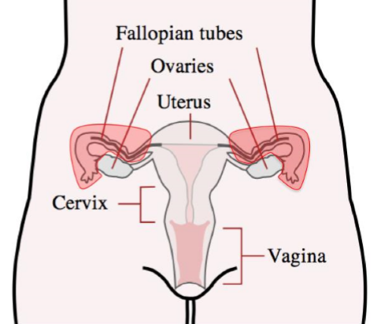
What We Don’t Know about early salpingectomy or removal of tubes
Level of Reduction in Cancer Risk
Impact on long term hormonal function and menopause
How best to manage STIC?
RRESDO should only be offered in a research study
(UK CGG, RCOG, NICE)

Slide 32
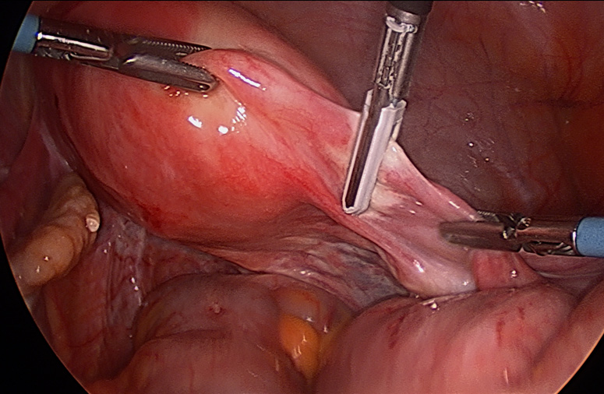
Lynch Syndrome:
Surgical Prevention
HYSTERECTOMY +
BILATERAL SALPINGO OOPHORECTOMY
REMOVAL OF UTERUS,
TUBES AND OVARIES
MLH1, MSH2, MSH6
REMOVAL OF UTERUS,
TUBES AND OVARIES
PMS2
REMOVAL OF UTERUS

Slide 33
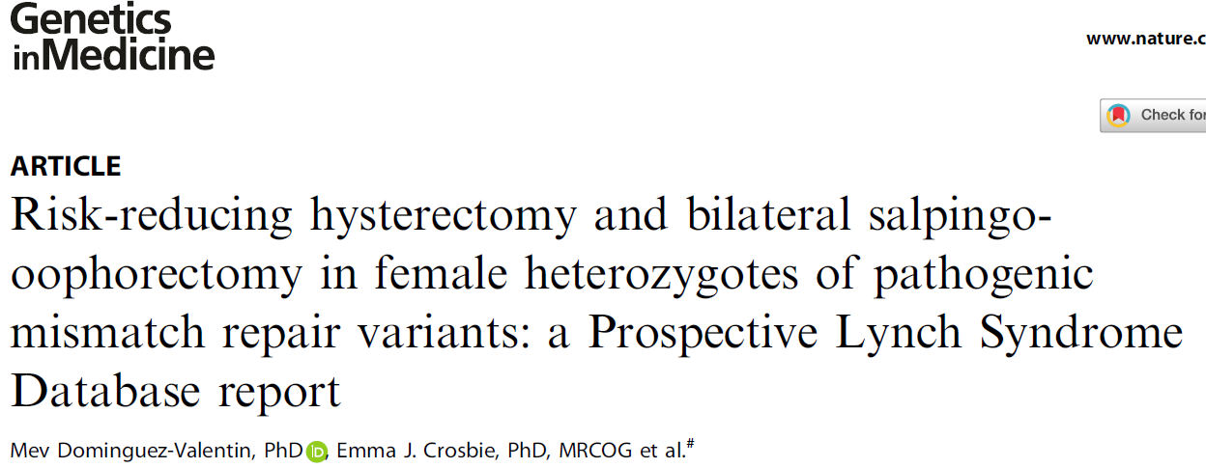
Age of Surgery-
35-40 years onwards
Usually Minimal Access
As complete protection as possible

Slide 34
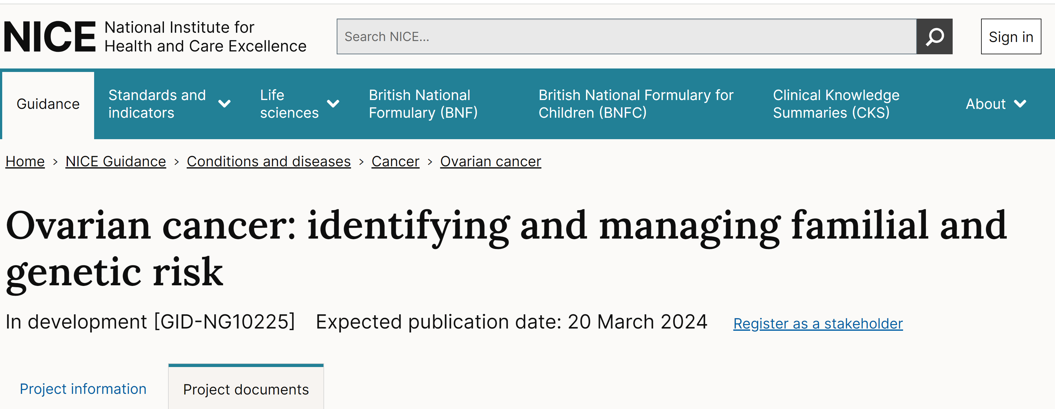
FINAL GUIDELINE – expected 20/03/24

Slide 35
Key Messages
Removal of tubes &ovaries is the most effective strategy to prevent ovarian cancer
It can be offered for a number of ovarian cancer genes - >5% lifetime risk
SEEFIM special pathology protocol is essential for RRSO
HRT till 51 for premenopausal RRSO if no other contraindication
Removal of Uterus, tubes and ovaries – effective in women with Lynch Syndrome
Surgical prevention needs to be personalised depending on gene, age, risk, fertility, personal wishes, etc.
Early Salpingectomy should be undertaken in a research study only

Slide 37
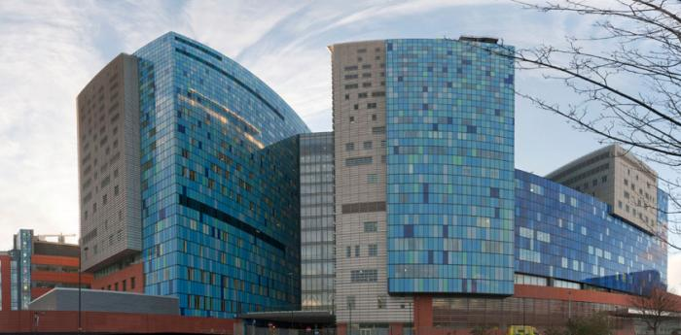
THANK YOU

